Slide 1
Optimizing data lakehouses with Starburst
Bank of America Private Training
11/02/2026 & 11/04/2026

Slide 2
Optimizing data lakehouses with Starburst
This course features instructor-led discussions, demonstrations, and hands-on exercises designed to build a working knowledge of the Starburst query engine.
Upon completion, you will gain a more thorough awareness of Starburst architecture, with a specific focus applied to best practices for data lake based schemas, including table formats and partitioning, file formats and sizes, and other optimization techniques.
Notes:
This mirrors the opening paragraph of the datasheet; https://docs.google.com/document/d/1hfKnGr-SfJzMv0bRoduRYgyJjn5DczjB2LBW9z5cmak/edit

Slide 3
Course introduction
Who, what, where, when & why

Slide 4
Course objectives
Use Starburst as a single point of access for multiple data sources and federate queries across them.
Use Hive and Iceberg table formats; construct, populate, query, and modify partitioned tables.
Employ file size/format/hierarchy strategies to improve query performance.
Understand the role of the Cost-based optimizer and read query plans to ensure optimizations are occurring as expected and to identify possible issues.
Work with curated data products.
Use table scan redirection and materialized views for performance gains.

Slide 5
What to expect
Blend of conceptual and practical
Focused learning objectives
Instructor demonstrations
Plenty of hands-on labs
Interactive discussions
  Ask questions
  Validate assumptions
  Discuss use cases
  FEEDBACK IS OXYGEN

Slide 6
Class Timings
Start: 9 AM ET
Break: 10:30 AM ET (15 minutes)
Lunch: 12:00 PM ET (1 hour)
Break: 3:00 PM ET (15 minutes)
Wrap Up: 5:00 PM ET
Notes:
Are these timings fine for everyone? Do we have any suggestions? Are you all in the same timezone?
Is there anyone who can keep track of the time and let me know if I am spilling nover? I tend to do that

Slide 7
Course agenda
5 - Advanced Iceberg
Schema & partition evolution
Snapshots & compaction
6 - Data lake performance
Limit data exchanges
File format options
Small files problem
Partitioning & bucketing
7 - Cache Service
Overview
Materialized views
8 - Data Products
Definition & importance
9 - Cost based optimization
Overview
Query plan analysis
1 - Starburst Data
Connectors & catalogs
Client tools integration
2 - Data lake tables
Understanding & creating
3 - Table formats
Moving beyond Hive
Comparing & contrasting alternatives
4 - Apache Iceberg
Creating tables
Insert, delete, & update
CDC with MERGE

Slide 8
Introductions
Please feel free to share as much (or as little) as you feel comfortable with
You! What’s your name?
  Where are you location? Working remote?
  High-level role (company and/or project)
  Any hobby/activity you want to share?
Identify the email address you want for your Starburst training ID
Prior experience with
  Trino (Presto) and/or Starburst (Enterprise and/or Galaxy)
  Other open-source big data solutions such as Apache Hive or Spark
Any expectations that appear to not be addressed in the agenda

Slide 9
Starburst Data
Connectors & catalogs
Notes:
TIMING NOTE: Approx. 15 min lecture

Slide 10
Lesson objectives
Describe how data sources are integrated into the Starburst cluster.
Explain the hierarchy and difference between catalogs, schemas, and tables.
Describe how Starburst deploys a single point of access across a rich ecosystem of technologies.
Explain the role of query federation in the Starburst cluster, and how it differs from traditional query federation.
Subtitle here
Starburst Data: Connectors & catalogs

Slide 11
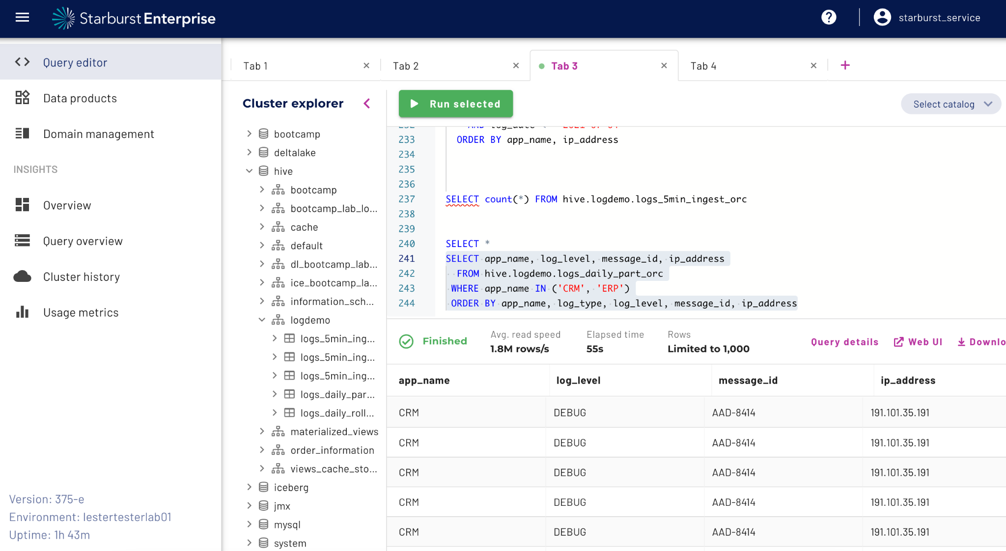
Starburst Enterprise – The cluster
The web UI directly shows the catalogs in the Cluster explorer.

Slide 12













Rich ecosystem of data source connectors
Live access to 50+ modern and legacy enterprise data sources
Federate access to multiple sources without moving or copying data
Combine external data with data that cannot move
Join data stored in different formats - relational, non-relational, structured, unstructured, streaming, object stores
Integrate with existing security solutions
Deliver data warehouse functionality to the data lake
Continue to use the tools you know and love while getting more value out of your data
50+
supported connectors
Notes:
Federate access to multiple sources without moving or copying data
This includes the ability to:
Combine external data with data that cannot move
Join data stored in different formats - relational, non-relational, structured, unstructured, streaming, object stores
Integrate with existing security solutions
Deliver data warehouse functionality to the data lake
Continue to use the tools you know and love while getting more value out of your data

Slide 13
Connecting to data sources
Catalog
Schema
Table
A catalog is an instance of a data source connector.
Multiple catalogs can use the same underlying connector with different configuration settings.
A way to organize tables.
Analogous to the organization concepts in popular RDBMS tools.
A set of unordered rows, which are organized into named columns with data types.
Includes views.
Three-part name for a table’s unique identifier: catalog.schema.table

Slide 14
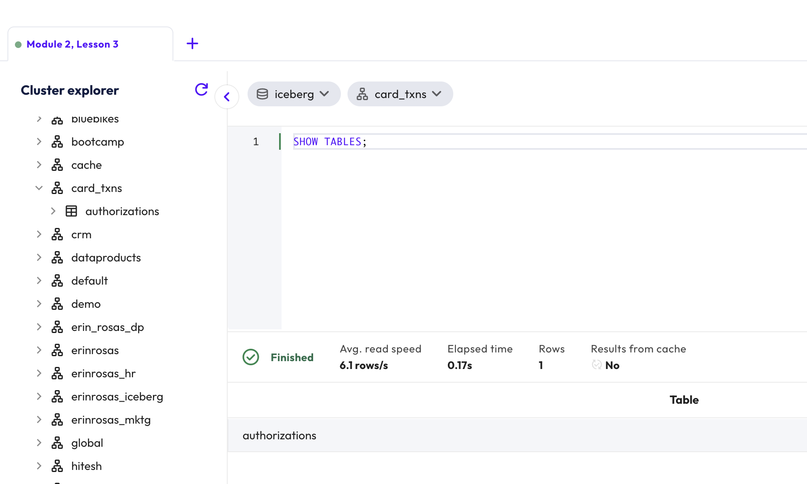
Multiple ways to reference tables & views
Notes:
From the Cluster explorer hierarchy, from classic show/describe SQL commands, and from the upper-right way to focus in on any part of the 3–part naming convention

Slide 15
What can we do with multiple catalogs?
Single point of access for a variety of data sources
Same UI/CLI/API for access all of your data.
Configure security and governance in one place.
Query federation
Access data from multiple systems within a single query.
Example: Join historic log data stored in S3 object storage with customer data stored in a MySQL database.
Notes:
The best real-world examples of query federation is with loosely coupled datasets, but our datasets are usually bundled together (like burstbank, tpc*) which means that in our technical examples we often have to artificially break them apart (usually with a CTAS to another catalog), but the presenter should use examples such as joining telecom centralized customer data with streaming datasets that show status updates to provisioning orders. Another example could be to join your centralized partner content with some kind of sentiment data so that you can be aware of any partners that are being perceived negatively.

Slide 16
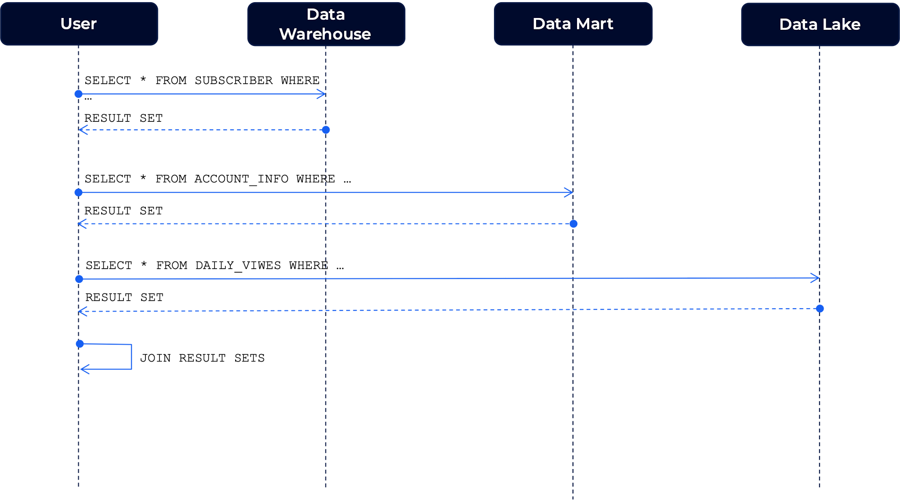
Query federation the traditional way
Notes:
User is responsible to connect to every single source
Understand the particularity of the data source
Pulling more data than necessary
Large resource consumption on the application side
BI Tools, Notebooks, Applications

Slide 17
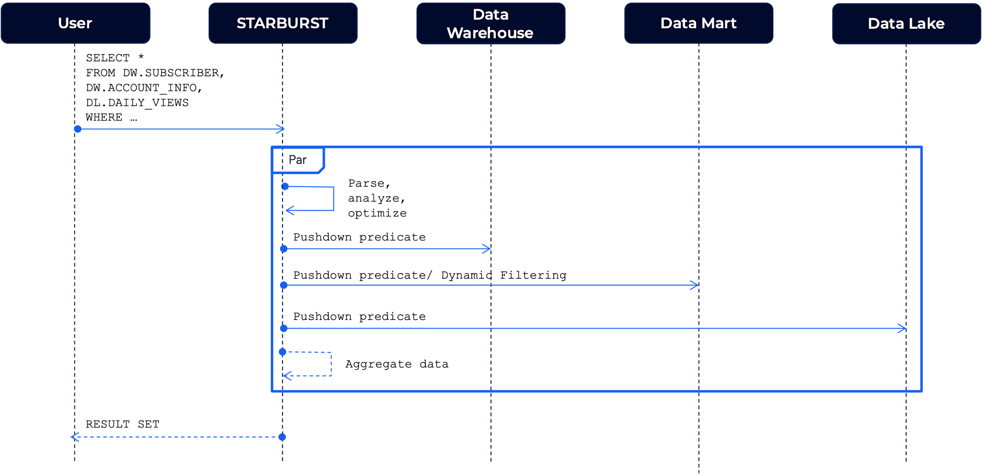
Query federation the Starburst way
Notes:
Move the data complexity to Starburst
Spend time analyzing data instead of searching and getting data
A single ANSI SQL syntax for all data sources
Use the application side resources for its purpose
Visualization, dashboarding, ML algorithms, and more

Slide 18
Instructor demonstration
View available catalogs and run a federated query (10 mins)

Slide 19
Hands-on exercises
Lab 1: Execute queries in Starburst Enterprise (40 mins)
Lab 2: Exploring federated queries (15 mins)

Slide 20
Lesson summary
Starburst Data: Connectors & catalogs
Starburst Enterprise deploys a single, configurable cluster.
Starburst includes 50+ integrations, allowing for connections to multiple data sources. These include relational and non-relational systems.
Tables hold row and columns of data; schemas organize tables; catalogs contain schemas.
Starburst allows you to connect to any data source from a single point of access.
Starburst aggregates the complexity of query federation, allowing a single SQL statement to join across multiple data sources.

Slide 21
Starburst Data
Client tools integration
Notes:
TIMING NOTE: Approx. 10 min lecture

Slide 22
Lesson objectives
Understand how client tools integrate with Starburst, and which tools can be used.
Explain the impact that client tool integrations like Tableau and DBeaver have for data producers and data consumers.
Describe how Starburst products can be accessed via the Python client.
Subtitle here
Starburst Data: Client tools integration

Slide 23



Connect with client tools
Data Engineers
Data Analysts
Data Scientists
CLI, API and REST access
SQL clients
  DBeaver
  dbVisualizer
  etc
Business Intelligence tools
  Tableau
  Power BI
  etc
Web-based notebooks
  Jupyter
  IPython
  Zeppelin
  etc

Slide 24
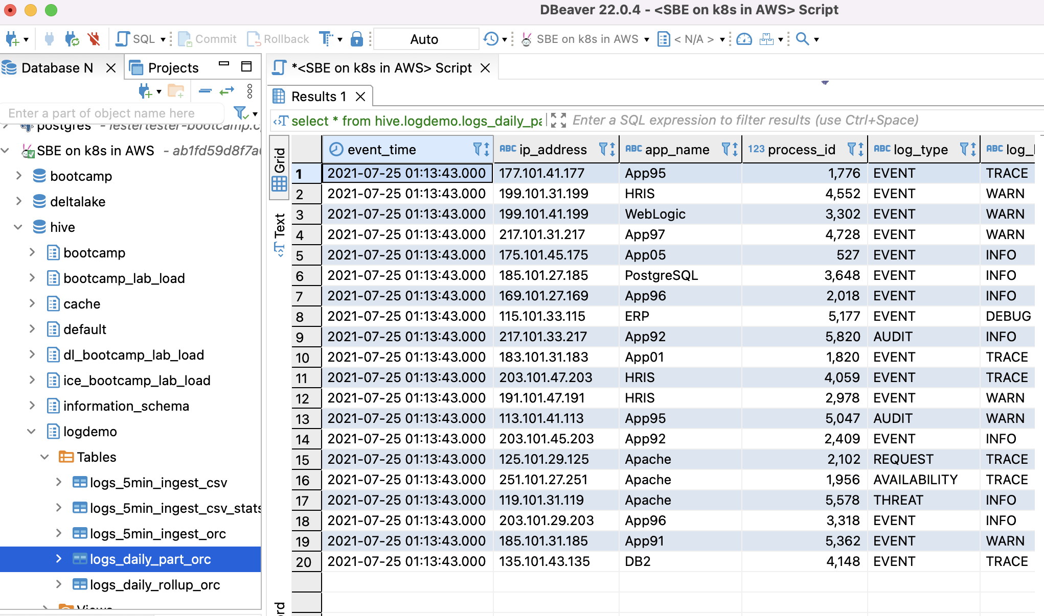
Connect via DBeaver

Slide 25
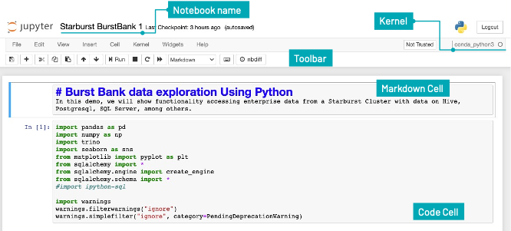
Connect via Jupyter (via Python client)
Artifact: trinodb / trino-python-client (GitHub)
Notes:
Show ​​https://github.com/trinodb/trino-python-client and then just demo the SageMaker Jupyter notebooks in the enablement account.

Slide 26
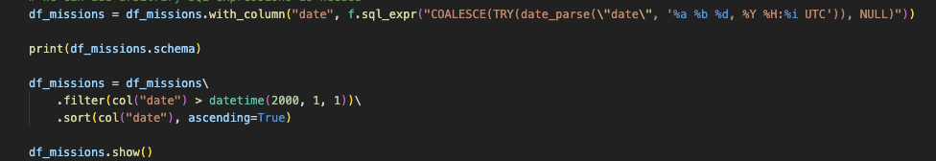

PyStarburst Overview [Data Engineers/Scientists]
Starburst
PySpark-like Syntax
Lazy execution
Python gets converted to SQL
Heavy lifting done by Trino
Links: API Docs & Example Code
PyStarburst
Trino
DF Definition
DF to SQL
Results
Currently supported on Starburst Galaxy and Starburst Enterprise.

Slide 27
Lesson summary
Starburst Data: Client tools integration
Starburst integrates with a number of client tools, including DBeaver, Tableau, and Jupyter.
Data producers use these tools to support ETL pipelines. Data consumers, including data scientists and analysts, use them to achieve business insights.
Starburst makes full use of JDBC and ODBC connectors, both of which are versatile and adaptable.
Starburst can be accessed via Python clients, often through web based notebooks.

Slide 28
Data lake tables
Understanding and creating
Notes:
TIMING NOTE: Approx. 30 mins

Slide 29
Lesson objectives
Define the data lake.
Become aware that multiple file formats can be used in data lakes.
Explain the nature of schema on read, and compare it to schema on write in both data lakes and data warehouses.
Describe the role that the Hive metastore plays in data lakes.
Discuss the difference between external and managed tables.
Subtitle here
Data lake tables: Understanding and creating

Slide 30
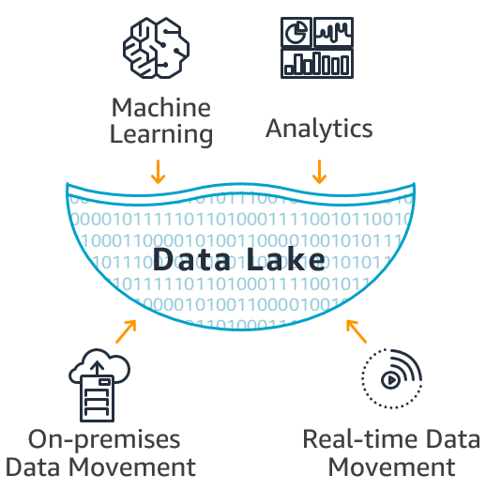
What is a data lake?
“A data lake is a system or repository of data stored in its natural/raw format“
Supports business units having TB/PB of data in different formats
Cheap decoupled storage that can be reused for multiple purposes by multiple engines & frameworks
Strategically aligned with Cloud Vendors (compute on-demand)
Everyone is trying to do ML / AI projects
New generation of Developers/Architects/Data People with skills acquired after 2006+ (Hadoop Era)

Slide 31







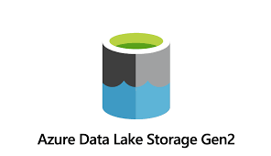






Components of a modern data lake
Storage
File format
Modern table formats
Query engine
+
+
+
HDFS
+ others…
Metastore
(Glue, HMS)

Slide 32
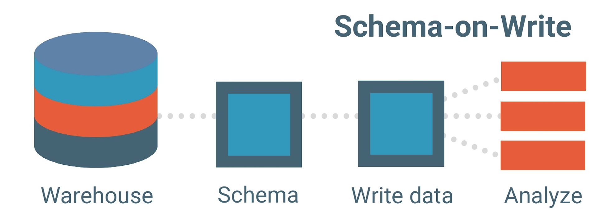
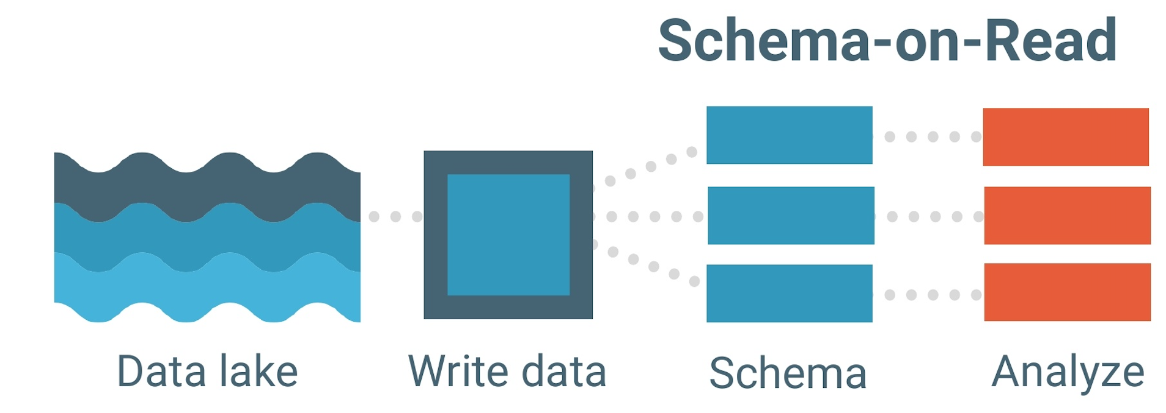
Schema considerations
Data lake vs data warehouse
Data warehouse: Schema on Write
Schema must be pre-defined
Full relational data model required
Data must be “transformed” to match schema & data model before it can be loaded into DW
Data lake: Schema on Read
Load data in its raw form (historically immutable)
Schema can be defined or inferred from raw data as it’s read
Schema can evolve easily as data changes
Lacks PK/FK integrity checks

Slide 33
Schema on read requirements
{
CREATE TABLE mycat.myschema.mytable (
event_time TIMESTAMP,
ip_address VARCHAR(15),
app_name VARCHAR(25),
process_id SMALLINT,
log_level VARCHAR(15),
message_details VARCHAR(555)
) WITH (
external_location = 'objStore/mytable/',
format = 'ORC'
);
3 pieces of information are required:
1.What does it look like? (the schema)
2. Where is it? (the directory location)
3.What will I find there? (the file type)

Slide 34
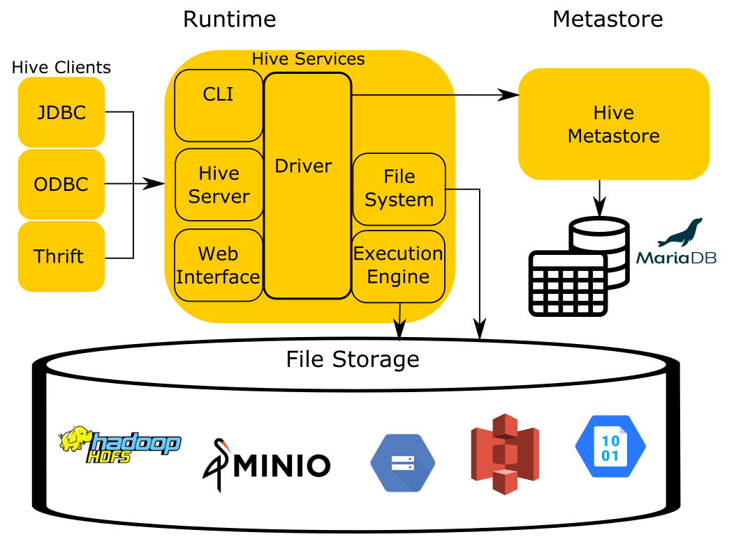
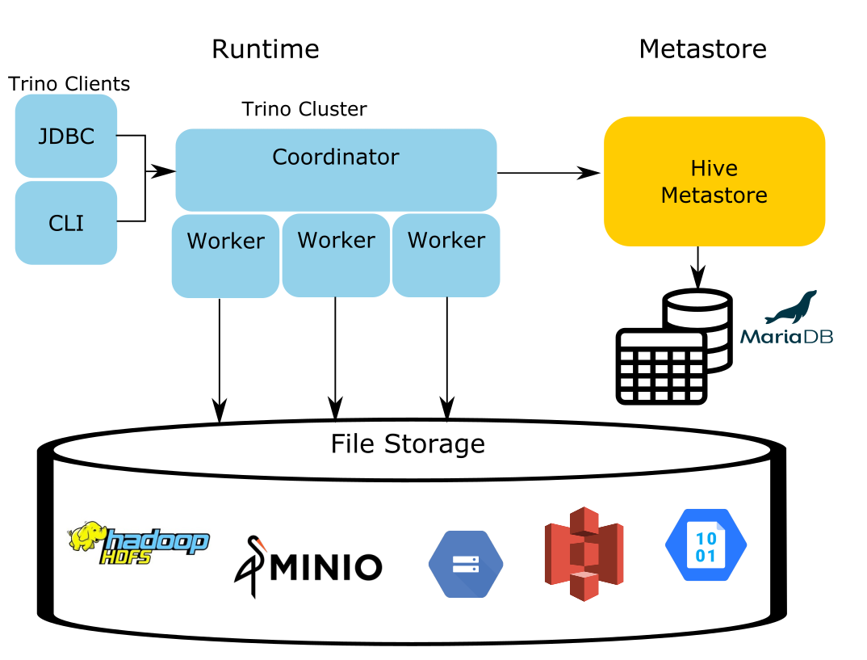
Reusing the Metastore (ONLY) from Hive
Hive vs Trino
Notes:
Common theme from other frameworks such as Spark and Impala.

Slide 35
External vs managed tables
External tables
Managed tables
An approach were the underlying data files are created prior to the table being created.
Identifiable by an external_location property in the table creation’s WITH clause.
Characteristics
Usually, Starburst will not write files to this data lake location
If the table is dropped
  The metadata is deleted
  The underlying data files remain
Often, leverage file formats such as CSV or JSON
Strategy where Starburst is creating the underlying data files as data as needed.
Normally, these tables default to being stored as a subdirectory under their schema’s location.
Characteristics
Starburst creates any necessary files to implement insert/update/delete operations
If the table is dropped
  The metadata is deleted
  The underlying data files are deleted
Often, leverage file formats such as ORC or Parquet

Slide 36
Instructor demonstration
Create tables (15 mins)

Slide 37
Hands-on exercises
Lab 1: Create a schema and tables (20 mins)
Lab 2: Investigate Hive’s special columns (15 mins)

Slide 38
Lesson summary
Data lake tables: Understanding and creating
Data lakes store structured, semi-structured, and unstructured data and make use of traditional table formats like Hive, often using cloud object storage or other storage means.
Data lakes make use of multiple file formats like ORC, Parquet, and Avro.
Schema on read applies schemas only when data is read, whereas schema on write applies schemas when data is added to a data lake.
Data lakes use metastores to manage metadata, and the Hive Metastore is one of the most common implementations.
External tables often are populated, and accessed, by other systems, whereas underlying files for managed tables are created directly by the query engine.

Slide 39
Table formats
Moving beyond Hive
Notes:
TIMING NOTE: Approx. 30 min lecture for all 3 of the Table formats module’s sections.

Slide 40
Lesson objectives
Explain the role that Hive played in data lakes.
Explain what a table format is and how it impacts data lakes and lakehouses.
Describe the difference between a table format and file format.
Explain the limitations of Hive compared to newer technologies.
Describe the difference between a data lake and data lakehouse.
Subtitle here
Table formats: Moving beyond Hive

Slide 41

Hive: The original disruptor
Hugely influential, and still used extensively.
The grandparent of all schema-on-read solutions.
Standard for SQL access to traditional data lakes.
Notes:
This IS your grandfather’s Big Data SQL solution! ;)
All other solutions have built upon the efforts of Apache Hive and that’s important to note.

Slide 42
Table formats
What are they?
Isn’t that Hive??
Open-source mechanisms that manage and track all the files and metadata that make up a table.
Essentially, an abstraction layer between the physical files and how they are represented as tables accessible via SQL.
Were developed to address limitations with Hive.
Yes, Hive’s approach of maintaining a table’s schema along with the location of where the files are, plus the file format being used, does just that.
It was only when alternatives were developed that the “Table Format” terminology surfaced.
Hive is the first-generation table format.

Slide 43
Table format vs file format
Table formats
File formats
A table format specifies the way in which a schema is enacted when recorded as actual files.
Examples:
Apache Hive
Apache Iceberg
Delta Lake
Apache Hudi
File formats control the way that each individual file stores data inside it.
Examples:
Apache ORC
Apache Parquet
Apache AVRO
JSON

Slide 44
Hive limitations
Metadata
The Hive Metastore (HMS) impacts scalability & performance
Data manipulation
Inconsistent and limited INSERT, UPDATE, DELETE, MERGE abilities
Structural rigidity
Difficult to evolve the schema and impossible to change partitioning
Table history
No inherent table history concepts for rollback or “as of” querying
Notes:
MetaData – HMS stores not only the the table definition, but the finer grained folder layout that is used with partitioning. Fetching this from a database at scale has issues across the cluster and for very large tables, it can be expensive to get all the details. Furthermore, this simply gets folder names and more operations are required on object stores (more so than HDFS) in retrieving large amounts of file names in large amounts of directories.
Data Manipulation - Hive has some abilities in the UPDATE/DELETE/REALM (namely Hive ORC ACID), but they are not universally utilized features in Hive installations and not all other frameworks that need to read the Data Lake can fully leverage this approach to data manipulation.
Structural Rigidity - Hive does offer ALTER TABLE functionality, but in practice it is usually only useful for adding new columns. Additionally, changes to partitioning or bucketing strategies are not allow. When needed, a new table needs to be created and the content from the old table is moved into the new.
Table History - While some point-solutions have been individually created that leverage HDFS Snapshots, these approaches still require many additional bits of control and configuration to be created. Additionally, they only work when the data lake is HDFS, not the cloud object stores.

Slide 45
From data lakes to data lakehouses
Data lake benefits
+ Warehouse features
= Data lakehouse
Hive accessing the data lake offers:
Separation of storage and compute
Massive scalability
Support for multiple file formats
Low cost
Integration with data science & machine learning tooling
Traditional data warehouses support:
Full use of INSERT, UPDATE, DELETE, and MERGE statements
Transactional support
Table structure modifications
High performance when data and hardware sizes are optimally configured
Modern table formats feature:
Data lake benefits plus additional scalability & performance
Transaction support of INSERT, UPDATE, DELETE, and MERGE statements
Seamless schema & partition evolution
Rich versioning of table structure and contents
Notes:
Can make this point short/n/sweet. State that for the purposes of the rest of this module and into the Iceberg ones, the data lakehouse is adding the modern table formats to the data lake environment that we have covered until this point.

Slide 46
Lesson summary
Table formats: Moving beyond Hive
Hive is the original schema on read solution and the de facto standard for SQL access to data lakes for more than a decade.
A table format specifies the way in which a schema is enacted when recorded as actual files. Hive table format is associated with data lakes, whereas more modern table formats, like Iceberg, are associated with data lakehouses.
A file format controls the way that each individual file stores the data inside it.
Hive’s limitations center around how it stores metadata, its support for transactional processing, its structural rigidity, and the lack of table versioning.
Data lakehouses make use of modern table formats like Iceberg, Delta Lake, and Hudi. These offer additional benefits including transactional support, schema partitioning and evolution, and roll-back.

Slide 47
Table formats
Comparing & contrasting alternatives
Notes:
TIMING NOTE: Approx. 30 min lecture for all 3 of the Table formats module’s sections.

Slide 48
Lesson objectives
Explain the differences between Hive, Iceberg, Delta Lake, and Hudi.
Describe the key features associated with each table format.
Subtitle here
Table formats: Comparing & contrasting alternatives

Slide 49





Overview
Feature
Started at | Facebook | Netflix | Databricks | Uber
First OSS commit | 2010 | 2017 | 2019 | 2016
Project governance | Apache Software Foundation (diverse PMC) | Apache Software Foundation (diverse PMC) | Linux Foundation (all-Databricks TSC) | Apache Software Foundation (diverse PMC)
Starburst integration |  |  |  | read-only
Skills Library
Live, Private Training
$525 per user/year
$6,750 per day
Online, Self Paced
Virtual
Notes:
Explain that Delta Lake was first a Databricks specific table format then they open-sourced it. They still have Databricks Delta Lake (similar to Databricks Spark) with is a forked version focused on performance improvements for their product offering.

Slide 50
ACID transactions
Feature
INSERT | Statement available on all tables, but transactional via Hive ACID tables only** |  |  | via Spark, not supported in Trino/Starburst
UPDATE | Hive ACID tables only** (no changes to partition or bucket columns) |  |  | via Spark, not supported in Trino/Starburst
DELETE | Hive ACID tables** Additionally, insert-only partitioned tables when filter matches full partition |  |  | via Spark, not supported in Trino/Starburst
MERGE | Hive ACID tables only** |  |  | via Spark, not supported in Trino/Starburst
Skills Library
Live, Private Training
$525 per user/year
$6,750 per day
Online, Self Paced
Virtual
** Hive ACID tables created with Hive Streaming Ingest are not supported
Notes:
See https://trino.io/docs/current/connector/hive.html#data-management and https://docs.starburst.io/latest/connector/hive.html#data-management for more info on Hive’s support for ACID tables. Also, note https://trino.io/docs/current/connector/hive.html#hive-3-related-limitations calling out that table stats collection on Hive ACID tables must be done directly via Hive.
See https://hudi.apache.org/docs/writing_data for more info on Hudi support for non SELECT statements.

Slide 51
Key features
Feature
File format support | Parquet, ORC, AVRO, RCText, RCBinary, SequenceFile, JSON, TextFile, CSV, RegEx | Parquet, ORC, AVRO | Parquet | Parquet, ORC
Time-travel
Schema evolution | Limited support and only updates metadata |  |  | via Spark, not supported in Trino/Starburst
Partition evolution
Skills Library
Live, Private Training
$525 per user/year
$6,750 per day
Online, Self Paced
Virtual
Notes:
See https://docs.starburst.io/latest/connector/hive.html#data-management for more info and warnings at https://cwiki.apache.org/confluence/display/hive/languagemanual+ddl#LanguageManualDDL-RulesforColumnNames about user being responsible for making sure all will be OK with the underlying datasets and the changes made

Slide 52
Consumption model nuance with CREATE TABLE
Starburst Enterprise
Specific connectors are available for Hive, Iceberg, Hudi, and Starburst Delta Lake. Alternatively, the Great Lakes connector provides a unified catalog for Hive, Iceberg, Delta Lake, and Hudi tables, allowing you to query and write across multiple table formats through a single catalog.
Creating a table in a catalog configured with a dedicated connector uses that connector’s supported table format and metadata conventions. Great Lakes catalogs can work with multiple table formats, while these catalogs may use the same metastore or separate metastores, depending on the deployment architecture.

Slide 53
Instructor demonstration
Exploring table formats (25 mins)

Slide 54
Lesson summary
Table formats: Comparing & contrasting alternatives
The modern table formats had different origination stories, but all are addressing the limitations to Hive.
They each have comprehensive transactional processing support.
The modern table formats support schema evolution and time-travel querying & rollback features, but only Iceberg support partition evolution.

Slide 55
Apache Iceberg
Creating tables

Slide 56
Lesson objectives
Explain the syntax used to create Iceberg tables.
Demonstrate the syntax used to control table properties, including file format and partition strategy.
Explain the nature of Iceberg architecture, including the use of manifest files, and manifest lists.
Explain the role that metadata columns and tables play in Iceberg.
Demonstrate how to create and utilize Iceberg tables.
Subtitle here
Apache Iceberg: Creating tables

Slide 57
CREATE (an Iceberg) TABLE
Starburst Enterprise (Iceberg connector)
Starburst Enterprise (Great Lakes connector)
Use a schema located in a catalog leveraging the Iceberg connector. No need to specify table type. Example is using all default values.
CREATE TABLE customer (
name varchar, address varchar)
Use a schema located in a catalog leveraging the Great Lakes connector. You must specify Iceberg as the table type:
CREATE TABLE customer (
name varchar, address varchar)
WITH (
type = 'ICEBERG');
CREATE TABLE AS (CTAS) ALSO WORKS AS EXPECTED
Notes:
Basically, the CREATE TABLE statement is the same as creating any other data lake / lakehouse table.

Slide 58
Iceberg table property: format
Optionally specifies the format of the table data files.
Valid values:
Example:
CREATE TABLE customer (
name varchar, address varchar)
WITH (type='iceberg',
format=’orc’);
ORC | Apache ORC file format
PARQUET | Default value; Apache Parquet file format
AVRO | Apache Avro file format

Slide 59
Iceberg table property: partitioning
Optionally specifies table partitioning strategy.
Valid values:
No default value.
ARRAY['c1', 'c2'] | A comma-separated list of the partitioned-by columns are placed within the square-brackets. In this example, a table would be partitioned by columns c1 and c2.
Partition column(s) do NOT have to be listed last
Notes:
Like with Hive, partitioning is not required. Additionally, remind the students that usually the partitioning is on a single column.

Slide 60
Iceberg table property: location
Optionally specifies the file system location URI for the table.
Valid values:
Defaults to the URI of the schema the table is being created into, postfixed with a derivative of the table name.
A valid, reachable URI | Example: s3://my-bucket/at/this/path
This does NOT make it an EXTERNAL table, just allows the folder location to be controlled
Notes:
Do NOT manipulate data or metadata directly in this location designation. Iceberg would not be aware of what you were doing and not reflect it in the metadata files.

Slide 61
Iceberg table property: format_version
Optionally specifies the format version of the Iceberg specification.
Valid values:
Defaults to 2.
1 | Original version which was designed for analytical data tables
2 | Adds row-level updates and deletes for analytical tables with immutable files
Notes:
Iceberg Table Spec – https://iceberg.apache.org/spec/

Slide 62
Bloom filter properties
Additional optional properties for use with ORC bloom filter functionality. ORC file format is required.
Skills Library
Live, Private Training
PROPERTY | DESCRIPTION | DEFAULT
orc_bloom_filter_columns | Comma separated list of columns to use for ORC bloom filter. Improves query performance when using equality and IN predicates.. | []
orc_bloom_filter_fpp | The ORC bloom filters false positive probability. | 0.05
$525 per user/year
$6,750 per day
Online, Self Paced
Virtual
Notes:
Bloom filters were described in the Data lake performance : Partitioning & bucketing : Additional topics module

Slide 63

Architecture
overview
Iceberg catalog
db1.table1
Current metadata pointer
Metadata layer
Metadata file
Metadata file
Snapshot 0
Snapshot 0
Snapshot 1
Manifest list
Manifest list
Manifest file
Manifest file
Manifest file
Data layer
Data files
Data files
Data files
Notes:
Below taken from https://iceberg.apache.org/spec/, but the “builder slides” that follow tell a story.
This table format tracks individual data files in a table instead of directories. This allows writers to create data files in-place and only adds files to the table in an explicit commit.
Table state is maintained in metadata files. All changes to table state create a new metadata file and replace the old metadata with an atomic swap. The table metadata file tracks the table schema, partitioning config, custom properties, and snapshots of the table contents. A snapshot represents the state of a table at some time and is used to access the complete set of data files in the table.
Data files in snapshots are tracked by one or more manifest files that contain a row for each data file in the table, the file’s partition data, and its metrics. The data in a snapshot is the union of all files in its manifests. Manifest files are reused across snapshots to avoid rewriting metadata that is slow-changing. Manifests can track data files with any subset of a table and are not associated with partitions.
The manifests that make up a snapshot are stored in a manifest list file. Each manifest list stores metadata about manifests, including partition stats and data file counts. These stats are used to avoid reading manifests that are not required for an operation.

Slide 64
Architecture
overview
Iceberg catalog
db1.table1
Current metadata pointer
}
Metadata layer
Metadata file
Metadata file
Snapshot 0
Snapshot 0
Snapshot 1
Metadata and data persisted
together on the data lake
Manifest list
Manifest list
Manifest file
Manifest file
Manifest file
Data layer
Data files
Data files
Data files
Notes:
As different from Hive (whose metadata all lives in the metastore), data and metadata live together on the data lake file system

Slide 65
Architecture
overview
Iceberg catalog
db1.table1
Current metadata pointer
Metadata layer
Metadata file
Metadata file
Snapshot 0
Snapshot 0
Snapshot 1
Manifest list
Manifest list
Manifest file
Manifest file
Manifest file
Saved in the ./data dir
Data layer
Data files
Data files
Data files
Notes:
Underneath the table’s URI, there is a data folder where the actual data files live – if there were partitions, those folders would exist at this level and the actual data files would be within those subfolders (we will find out later this includes data files and delete files)

Slide 66
Architecture
overview
Iceberg catalog
db1.table1
Current metadata pointer
Metadata layer
Metadata file
Metadata file
Snapshot 0
Snapshot 0
Snapshot 1
All metadata lives in the ./metadata dir
Manifest list
Manifest list
Manifest file
Manifest file
Manifest file
Data layer
Data files
Data files
Data files
Notes:
All the metadata lives in the metadata folder within the table’s base directory (3 kinds of files)

Slide 67
Architecture
overview
Iceberg catalog
db1.table1
Current metadata pointer
Metadata layer
Metadata file
Metadata file
Snapshots are created anytime data or structure is changed
Snapshot 0
Snapshot 0
Snapshot 1
Manifest list
Manifest list
Manifest file
Manifest file
Manifest file
Data layer
Data files
Data files
Data files
Notes:
These are the points-in-time that can be leveraged for time-travel queries and/or for rollbacks

Slide 68
Architecture
overview
Iceberg catalog
db1.table1
Current metadata pointer
Metadata layer
Metadata file
Metadata file
Metadata files (JSON) contain the details of 1+ snapshots
Snapshot 0
Snapshot 0
Snapshot 1
Manifest list
Manifest list
Manifest file
Manifest file
Manifest file
Data layer
Data files
Data files
Data files
Notes:
A JSON metadata file can list more than one snapshot, but there will always be a defined CURRENT snapshot

Slide 69
Architecture
overview
Iceberg catalog
A reference to the current snapshot is stored in HMS
db1.table1
Current metadata pointer
Metadata layer
Metadata file
Metadata file
Snapshot 0
Snapshot 0
Snapshot 1
Manifest list
Manifest list
Manifest file
Manifest file
Manifest file
Data layer
Data files
Data files
Data files
Notes:
This means that only a single HMS-compatible metastore can be used for each table unlike Hive table format that could have multiple metastores pointing to the same information

Slide 70
Architecture
overview
Iceberg catalog
db1.table1
Current metadata pointer
Metadata layer
Metadata file
Metadata file
Snapshot details include the structure of the table and reference to a specific manifest list
Snapshot 0
Snapshot 0
Snapshot 1
Manifest list
Manifest list
Manifest file
Manifest file
Manifest file
Data layer
Data files
Data files
Data files
Notes:
Full structural details of the table’s schema to include partitioning/bucketing information and also the name of a single specific manifest list

Slide 71
Architecture
overview
Iceberg catalog
db1.table1
Current metadata pointer
Metadata layer
Metadata file
Metadata file
Snapshot 0
Snapshot 0
Snapshot 1
Each manifest list (AVRO) is tied to a snapshot and references 1+ manifest files
Manifest list
Manifest list
Manifest file
Manifest file
Manifest file
Data layer
Data files
Data files
Data files
Notes:
So, S0’s manifest list references the first 2 manifest files (which means the first 4 data files) *AND* S1’s manifest list references the first 2 manifest files from S0 plus the new manifest file (thus all 6 data files)

Slide 72
Architecture
overview
Iceberg catalog
db1.table1
Current metadata pointer
Metadata layer
Metadata file
Metadata file
Snapshot 0
Snapshot 0
Snapshot 1
Manifest list
Manifest list
Manifest file
Manifest file
Manifest file
Each manifest file (AVRO) references 1+ data files
Data layer
Data files
Data files
Data files
Notes:
When files are added (aka inserted) into a table they make their way to the data dir and one, or more, of these files is referenced in a manifest file

Slide 73
Access to metadata
Metadata columns
Metadata tables
Much like available from the original Hive table format, hidden columns are available on all tables.
$path – full file system path name of the file for a given row
$file_modified_time – timestamp of the last modification of the file for a given row
Metatable tables, including the following, contain information about the internal structure of each Iceberg table
$history
$snapshots
$manifests
$partitions
$files
Notes:
The metadata columns and tables will be explored more in the live demos and hands-on exercises

Slide 74

Instructor demonstration
How Iceberg tables are stored (15 mins)

Slide 75
Hands-on exercises
Lab 1: Create and populate Iceberg tables (30 mins)
Lab 2: Explore partitions with Iceberg (30 mins)

Slide 76
Lesson summary
Apache Iceberg: Creating tables
Iceberg tables are created using the CREATE command and feature multiple properties such as file format and partition columns used.
Iceberg uses a hierarchy of metadata files, manifest lists, and manifest files to track changes in the underlying data. When a change to structure or content, a new version is created.
Collectively, the metadata files allow for many of Iceberg’s features, including time travel and schema evolution.
Metadata regarding both columns and tables can be accessed directly using the metadata tables.

Slide 77
Apache Iceberg
Insert, delete, & update
Notes:
TIMING NOTE: Approx. 25 min lecture

Slide 78
Lesson objectives
Define the role that Data Manipulation Language (DML) plays in Iceberg.
Explain how SQL can be used with Iceberg to perform insert, delete & update operations.
Explain how these operations are handled inside the architecture.
Explain what ACID compliance is and why it is valuable in transactional settings.
Describe how Iceberg achieves ACID compliance.
Subtitle here
Apache Iceberg: Insert, delete, & update

Slide 79
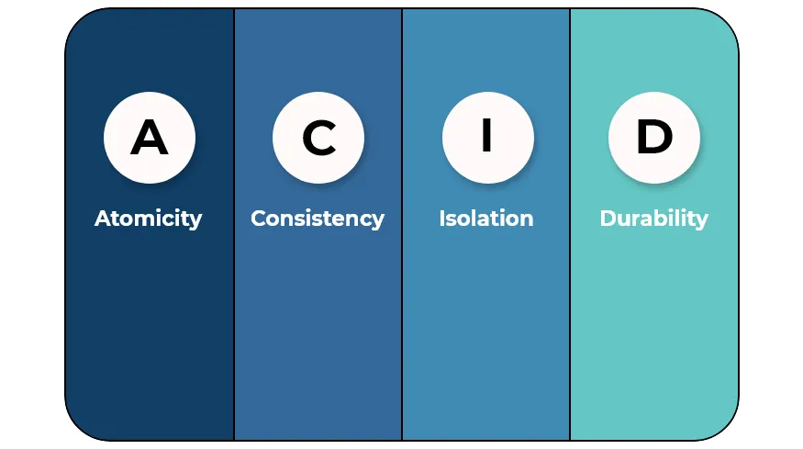
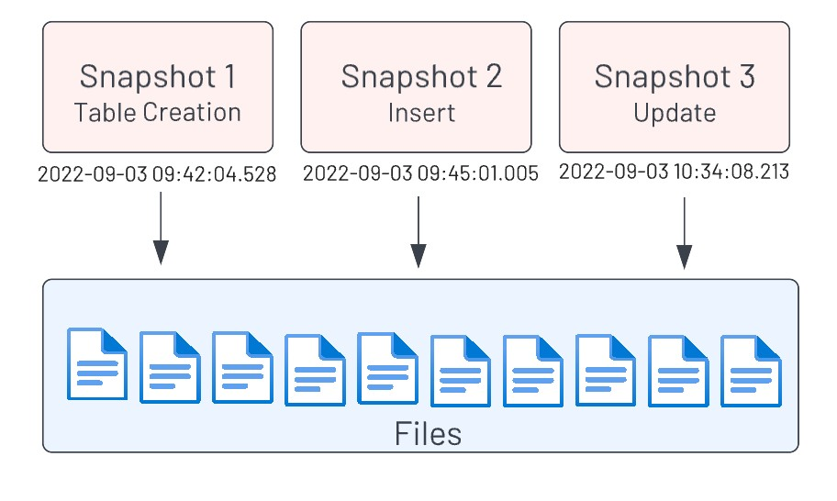
Modifying table contents
Data Manipulation Language (DML)
ACID transactions
This section will show each of the following DML commands along with what happens “behind the scenes” with the Iceberg table format
INSERT
DELETE
UPDATE
This section will also explain how Iceberg complies with the following elements of “ACID test” for transactional integrity
Notes:
DML is a subset of SQL. ACID compliance is the standard by which RDBMS transactions are judged against.
ACID graphic from https://henriquesd.medium.com/acid-properties-43e146b21e0d

Slide 80
DML: INSERT
Implementation
Write-time
  1+ data files are added
Read-time
  Same as prior snapshot
  Plus additional rows in new data files
Fundamentally the same as Hive table format (sans the metadata, manifest, and manifest list files).
ANSI SQL standard statement
INSERT INTO
customer (name, address)
VALUES
('Fred', 'Bedrock');

Slide 81
DML: DELETE
Implementation
Write-time
  1+ delete files are added
    Files that encode rows to be deleted by either
      Positional deletes
      Equality deletes
Read-time
  Same as prior snapshot
  Then deletes rows identified in delete files before returning results
This is known as a merge-on-read delete which does not rewrite file data.
ANSI SQL standard statement
DELETE FROM customer
WHERE
name = 'Fred';
Notes:
Row-level deletes are stored in delete files. There are two ways to encode a row-level delete:
Position deletes mark a row deleted by data file path and the row position in the data file
Equality deletes mark a row deleted by one or more column values, like id = 5
These merge-on-read deletes contrast with copy-on-write deletes. A merge-on-read delete is more efficient because it does not rewrite file data. When Starburst reads Iceberg data, it merges the Iceberg delete files with data files to produce the latest view of a table.
Delta Lake implements the copy-on-write deletes strategy.

Slide 82
DML: UPDATE
Implementation
Write-time
  1+ delete files are added for the rows being updated
  1+ data files added to include the full replacements for rows being updated
Read-time
  Same as prior snapshot
  Then deletes rows identified in delete files
  Adds newly updated rows in new data files
Iceberg does not support in-place updates
ANSI SQL standard statement
UPDATE customer
SET
address = 'Hollyrock'
WHERE
name = 'Fred';

Slide 83
Generic DML
operation
Iceberg catalog
Metastore points to snapshot 0 as the current snapshot
Its manifest list references 2 manifest files and their underlying data and delete files
db1.table1
Current metadata pointer
Metadata layer
Metadata file
Snapshot 0
Manifest list
Manifest file
Manifest file
Data layer
Data files
Data files

Slide 84
Generic DML
operation
Iceberg catalog
db1.table1
Current metadata pointer
Metadata layer
Metadata file
Snapshot 0
Manifest list
Manifest file
Manifest file
1+ data and/or delete files are created
Data layer
Data files
Data files
Data files

Slide 85
Generic DML
operation
Iceberg catalog
db1.table1
Current metadata pointer
Metadata layer
Metadata file
Snapshot 0
Associated manifest file(s) reference the data and/or delete files
Manifest list
Manifest file
Manifest file
Manifest file
Data layer
Data files
Data files
Data files

Slide 86
Generic DML
operation
Iceberg catalog
db1.table1
Current metadata pointer
Metadata layer
Metadata file
Snapshot 0
New manifest list is created pointing to prior snapshot’s manifest files plus the new manifest file(s)
Manifest list
Manifest list
Manifest file
Manifest file
Manifest file
Data layer
Data files
Data files
Data files

Slide 87
Generic DML
operation
Iceberg catalog
db1.table1
Current metadata pointer
New metadata file created to include prior snapshot(s) as well as the new [current] one referencing the manifest list
Metadata layer
Metadata file
Metadata file
Snapshot 0
Snapshot 0
Snapshot 1
Manifest list
Manifest list
Manifest file
Manifest file
Manifest file
Data layer
Data files
Data files
Data files

Slide 88
Generic DML
operation
Iceberg catalog
Pointer updated to snapshot 1
db1.table1
Current metadata pointer
Metadata layer
Metadata file
Metadata file
Snapshot 0
Snapshot 0
Snapshot 1
Manifest list
Manifest list
Manifest file
Manifest file
Manifest file
Data layer
Data files
Data files
Data files

Slide 89
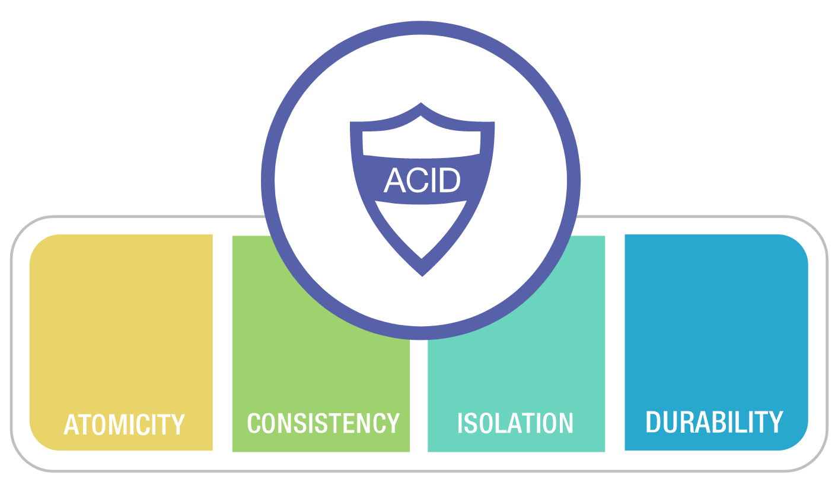
ACID defined
Wikipedia defines ACID as:
In computer science, ACID (atomicity, consistency, isolation, durability) is a set of properties of database transactions intended to guarantee data validity despite errors, power failures, and other mishaps.
…
These four properties are the major guarantees of the transactional paradigm, which has influenced many aspects of development in database systems.
Notes:
Graphic from https://www.marklogic.com/product/server/features/acid-transactions/

Slide 90
ACID properties: A transaction must be…
A
C
I
D
Atomic
completed in its entirety or not at all
Consistent
repeatable by producing the same outcome when using the same initial state
Isolated
independent of other concurrent transactions & not queryable while in progress
Durable
permanently saved even in the event of a system error
Only single-statement, single-table, transactions supported
Notes:
See https://en.wikipedia.org/wiki/ACID for more details on base definitions of these properties
Starburst and Iceberg support single-statement, single-table, transactions.
No use of BEGIN and COMMIT/ROLLBACK statements supported.
All DML statements are auto-committing.

Slide 91
Iceberg’s ACID compliance
PROPERTY | DESCRIPTION
Atomicity | Multiple data/delete files and manifest files, plus a new manifest list file and metadata file all have to be created to encompass a transactional change, but there is an atomic swap of the metastore pointer to the new snapshot identifier.
Consistency | Iceberg uses optimistic concurrency locking to make sure any concurrent writes do not lead to inconsistent data. Readers only see already committed data for a read-consistent view.
Isolation | Snapshot and serialization options are available to ensure that reads and concurrent writes are isolated.
Durability | The metastore handles durability for the current snapshot pointer update and the data lake provides durability for files.
Skills Library
Live, Private Training
$525 per user/year
$6,750 per day
Online, Self Paced
Virtual
Notes:
Good article at https://medium.com/snowflake/how-apache-iceberg-enables-acid-compliance-for-data-lakes-9069ae783b60
Another at https://lestermartin.blog/2024/06/05/well-designed-partitions-aid-iceberg-compaction-call-them-ice-cubes/

Slide 92
Instructor demonstration
DML, metadata, and snapshots with Iceberg (20 mins)

Slide 93
Hands-on exercise
Data modifications and snapshots with Iceberg (30 mins)

Slide 94
Lesson summary
Apache Iceberg: Insert, delete, & update
Data Manipulation Language (DML) controls the way in which tables are created, updated, and inserted into.
Metadata tracks the changes to tables over time, and Iceberg creates a hierarchy of files to track these changes.
ACID stands for Atomicity, Consistency, Isolation, and Durability. It is a set of design standards that guarantee the reliable processing of transactions.
Iceberg’s metadata files allow for ACID compliance in a data lakehouse, a major advantage over traditional data lakes.

Slide 95
Advanced Iceberg
CDC with MERGE
Notes:
TIMING NOTE: Approx. 20 min lecture
Used following resources to help created this lesson.
https://www.striim.com/blog/change-data-capture-cdc-what-it-is-and-how-it-works/
https://hevodata.com/learn/change-data-capture/

Slide 96
Lesson objectives
Define Change Data Capture (CDC) and its importance in data systems.
Define Slowly Changing Dimensions (SCD) and compare it with CDC.
Explain the syntax of the MERGE statement and how it relates to CDC and SCD.
Demonstrate use of the MERGE statement in Iceberg.
Subtitle here
Advanced Iceberg: CDC with MERGE

Slide 97
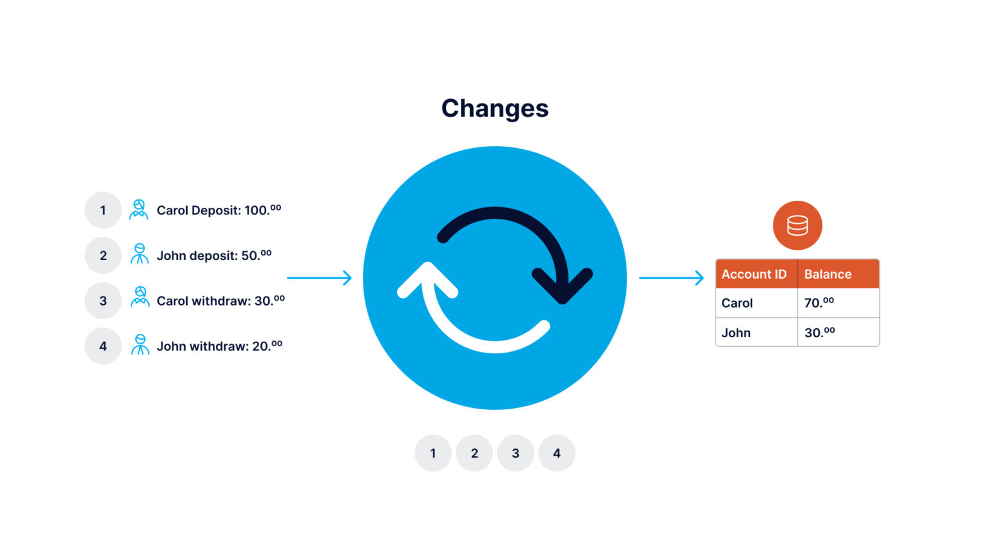
CDC defined
Wikipedia defines CDC as:
In databases, change data capture (CDC) is a set of software design patterns used to determine and track the data that has changed so that action can be taken using the changed data.
…
CDC occurs often in data-warehouse environments since capturing and preserving the state of data across time is one of the core functions of a data warehouse, but CDC can be utilized in any database or data repository system.
Notes:
Graphic from https://www.striim.com/blog/change-data-capture-cdc-what-it-is-and-how-it-works/

Slide 98
CDC source methods
METHOD | DESCRIPTION
Audit columns | By using existing “LAST_UPDATED” or “DATE_MODIFIED” columns you can create a CDC solution by persisting the last date used and leveraging it in a simple query.
Table deltas | A list of changes could be created by using a ‘tablediff’ utility to compare the source and target tables.
Table triggers | Created table-based triggers can run on inserts, updates and deletes to produce an ordered list of activities.
Transaction logs | The transaction logs (aka redo logs) that databases create for durability, produce an inherent ordered list of activities without additional effort.
Skills Library
Live, Private Training
$525 per user/year
$6,750 per day
Online, Self Paced
Virtual
Notes:
Audit columns
Pros: no special tool needed
Cons: overhead on the db, deletes not handled w/o additional work, and only get point-in-time updates
Table deltas
Pros: no special tool needed
Cons: have to maintain 3 copies of the datasource (original data plus previous & current snapshot), performance/scalability concerns
Triggers
Pros: Can get a log of every single change, most RDBMS solutions directly support triggers
Cons: Significantly reduces the performance of the database
Transaction logs
Pros: inherent solution of RDBMS that doesn’t require schema changes and has minimal impact on the database
Cons: these logs are vendor specific and often complex to process, unless you are looking at all tables it is likely there is a lot of “noise”

Slide 99
CDC vs change tracking
Change tracking is a subset of CDC. It allows the net changes made to data to be returned from a query easily. It can let you know a given row has changed since your last query, but does not have an idea about:
The different value changes that have been made to the row, or
The number of times it was changed
This approach usually syncs up the destination table on a regular schedule of the current state of any records in the source table that have changed since the last check.
Primarily produced from the “audit columns” and “table deltas” methods.
Notes:
Content from similarly named section of https://hevodata.com/learn/change-data-capture/
For our demos and exercises, we will just focus on “change tracking” and leverage a set of deltas to address

Slide 100
What is SCD and how is it different than CDC?
CDC identifies and tackles the data that has been changed.
A Slowly Changing Dimension (SCD) is a dimension table that manages & stores both historical & current data in a data warehouse or lakehouse.
Multiple approaches exist, but the most popular are:
Type 1 – Only maintains current data; no historical data is kept
Type 2 – Keeps current as well as historical data in the table made to the row
Notes:
Dimension tables are the warehouse star schema’s look-up tables that are leveraged in the central fact table, BUT… we can use these same techniques for any table whose rows can be updated.
Example could be a customer address dimension who allows changes to phone numbers, moving to new addresses, etc. The assumption is these are NOT frequent changes.
Type 2 has multiple strategies for mapping the historical values such as version numbers, flags and effective date ranges. See https://hub.packtpub.com/what-are-slowly-changing-dimensions-scd-and-why-you-need-them-in-your-data-warehouse/ for more info.

Slide 101
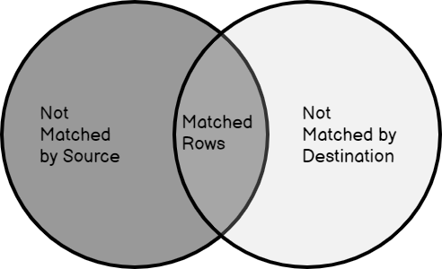
MERGE to the rescue
The MERGE SQL statement allows…
the deltas created from a CDC process to be…
integrated/merged into a target table leveraging…
various SCD strategies

Slide 102
MERGE syntax
where when_clause is one of
MERGE INTO target_table [ [ AS ] target_alias ] USING { source_table | query } [ [ AS ] source_alias ] ON search_condition when_clause [...]
WHEN MATCHED [ AND condition ] THEN DELETE
WHEN MATCHED [ AND condition ] THEN UPDATE SET ( column = expression [, ...] )
WHEN NOT MATCHED [ AND condition ] THEN INSERT [ column_list ] VALUES (expression, ...)
Notes:
Details at https://docs.starburst.io/latest//sql/merge.html with additional information at https://docs.starburst.io/latest/develop/supporting-merge.html
Let’s break it all down…

Slide 103
MERGE syntax
The replicated (dest) table
where when_clause is one of
MERGE INTO target_table [ [ AS ] target_alias ] USING { source_table | query } [ [ AS ] source_alias ] ON search_condition when_clause [...]
WHEN MATCHED [ AND condition ] THEN DELETE
WHEN MATCHED [ AND condition ] THEN UPDATE SET ( column = expression [, ...] )
WHEN NOT MATCHED [ AND condition ] THEN INSERT [ column_list ] VALUES (expression, ...)
Notes:
The target_table is the replicated, or destination, table that is a recent, but not current, version of the the table being replicated from

Slide 104
MERGE syntax
where when_clause is one of
MERGE INTO target_table [ [ AS ] target_alias ] USING { source_table | query } [ [ AS ] source_alias ] ON search_condition when_clause [...]
The delta (changes) table
WHEN MATCHED [ AND condition ] THEN DELETE
WHEN MATCHED [ AND condition ] THEN UPDATE SET ( column = expression [, ...] )
WHEN NOT MATCHED [ AND condition ] THEN INSERT [ column_list ] VALUES (expression, ...)
Notes:
The source_table is the list of deltas created from a CDC source process – sometimes called a delta file/table

Slide 105
MERGE syntax
where when_clause is one of
MERGE INTO target_table [ [ AS ] target_alias ] USING { source_table | query } [ [ AS ] source_alias ] ON search_condition when_clause [...]
An expression that returns a boolean value
WHEN MATCHED [ AND condition ] THEN DELETE
WHEN MATCHED [ AND condition ] THEN UPDATE SET ( column = expression [, ...] )
WHEN NOT MATCHED [ AND condition ] THEN INSERT [ column_list ] VALUES (expression, ...)
Notes:
The condition between the two tables which identifies a match. This is likely something like an identifier value (ex: target.entity_id = source.entity_id)

Slide 106
MERGE syntax
where when_clause is one of
MERGE INTO target_table [ [ AS ] target_alias ] USING { source_table | query } [ [ AS ] source_alias ] ON search_condition when_clause [...]
Multiple when clauses are allowed, but stops checking once one is met
WHEN MATCHED [ AND condition ] THEN DELETE
WHEN MATCHED [ AND condition ] THEN UPDATE SET ( column = expression [, ...] )
WHEN NOT MATCHED [ AND condition ] THEN INSERT [ column_list ] VALUES (expression, ...)
Notes:
The when_clause test are executed in order and when one is met, the corresponding DML operation is performed and then no more checking is done for the row being worked on

Slide 107
MERGE syntax
where when_clause is one of
MERGE INTO target_table [ [ AS ] target_alias ] USING { source_table | query } [ [ AS ] source_alias ] ON search_condition when_clause [...]
Multiple when clauses allowed for each of these three options
WHEN MATCHED [ AND condition ] THEN DELETE
WHEN MATCHED [ AND condition ] THEN UPDATE SET ( column = expression [, ...] )
WHEN NOT MATCHED [ AND condition ] THEN INSERT [ column_list ] VALUES (expression, ...)
Notes:
Multiple when_clauses allowed for each of the 3 examples show above; especially when considering you can add additional conditions

Slide 108
MERGE syntax
where when_clause is one of
MERGE INTO target_table [ [ AS ] target_alias ] USING { source_table | query } [ [ AS ] source_alias ] ON search_condition when_clause [...]
WHEN MATCHED clauses support UPDATE or DELETE actions
WHEN MATCHED [ AND condition ] THEN DELETE
WHEN MATCHED [ AND condition ] THEN UPDATE SET ( column = expression [, ...] )
WHEN NOT MATCHED [ AND condition ] THEN INSERT [ column_list ] VALUES (expression, ...)
Notes:
This is because we are finding a match it means the record in the delta table already exists in the replicated table, thus it is some kind of update (to include the possibility of a delete)

Slide 109
MERGE syntax
where when_clause is one of
MERGE INTO target_table [ [ AS ] target_alias ] USING { source_table | query } [ [ AS ] source_alias ] ON search_condition when_clause [...]
WHEN MATCHED [ AND condition ] THEN DELETE
WHEN MATCHED [ AND condition ] THEN UPDATE SET ( column = expression [, ...] )
WHEN NOT MATCHED [ AND condition ] THEN INSERT [ column_list ] VALUES (expression, ...)
WHEN NOT MATCHED clauses ONLY support INSERT actions
Notes:
This is because if the record only exist in the delta table, then naturally it is a new record needing to be added to the replicated table

Slide 110
MERGE implementation
Conceptual wrapper of multiple INSERT, DELETE & UPDATE statements
Write-time
  1+ data files added for any newly inserted rows
  1+ delete files are added for any rows to be completed deleted
  1+ delete files are added for any rows being updated
  1+ data files added to include the full replacements for any rows being updated
Read-time
  Same as prior snapshot
  Then deletes rows identified in delete files
  Adds newly inserted & updated rows in new data files
Metadata is modified via the previously presented generic DML operation flow

Slide 111
Instructor demonstration
Using MERGE (15 mins)

Slide 112
Hands-on exercise
Utilize Iceberg’s MERGE statement (30 mins)

Slide 113
Lesson summary
Advanced Iceberg: CDC with MERGE
Change Data Capture (CDC) is a set of design principles to help recognize changing datasets and manage those changes effectively.
A Slowly Changing Dimension (SCD) is a type of table that manages and stores both historical and current data over time in a data warehouse or lakehouse.
The MERGE statement allows the changes created from a CDC process to be integrated into a target table using various SDC strategies.

Slide 114
Advanced Iceberg
Schema & partition evolution
Notes:
TIMING NOTE: Approx. 15 min lecture

Slide 115
Lesson objectives
Describe how schema evolution functions as an Iceberg feature.
Explain how Iceberg uses hidden partitioning.
Describe the transformation function that allows a partition to be based on a derivative of a timestamp column.
Understand the limitations of partition evolution.
Demonstrate how to change Iceberg partition configuration.
Subtitle here
Advanced Iceberg: Schema & partition evolution

Slide 116

Schema evolution
In addition to simple operations such as renaming a table, Iceberg supports:
ADD – add a new column
DROP – remove an existing column
RENAME – rename an existing column
UPDATE – widen the type of a column
REORDER – change the order of columns
Schema updates are metadata changes – no data files are rewritten.
Notes:
Sourced straight from https://iceberg.apache.org/docs/latest/evolution/#schema-evolution
Pokemon evolution example; Pichu - Pikachu - Raichu (rye-chu)

Slide 117

Schema evolution correctness
Iceberg guarantees that schema evolution changes are independent and free of side-effects, without rewriting files.
Iceberg uses unique IDs to track each column in a table. When you add a column, it is assigned a new ID so existing data is never used by mistake.
Notes:
Sourced straight from https://iceberg.apache.org/docs/latest/evolution/#schema-evolution and pasted below.
Correctness 🔗
Iceberg guarantees that schema evolution changes are independent and free of side-effects, without rewriting files:
Added columns never read existing values from another column.
Dropping a column or field does not change the values in any other column.
Updating a column or field does not change values in any other column.
Changing the order of columns or fields in a struct does not change the values associated with a column or field name.
Iceberg uses unique IDs to track each column in a table. When you add a column, it is assigned a new ID so existing data is never used by mistake.
Formats that track columns by name can inadvertently un-delete a column if a name is reused, which violates #1.
Formats that track columns by position cannot delete columns without changing the names that are used for each column, which violates #2.

Slide 118
Schema evolution examples
ALTER TABLE planes RENAME COLUMN name TO description;
ALTER TABLE planes ADD COLUMN year integer;
ALTER TABLE planes DROP COLUMN color;

Slide 119
Iceberg’s hidden partitioning
Other table formats like Hive support partitioning, but Iceberg supports hidden partitioning.
Iceberg handles the tedious and error-prone task of producing partition values for rows in a table.
Iceberg avoids reading unnecessary partitions automatically. Consumers don’t need to know how the table is partitioned or need to add extra filters to their queries.
Iceberg partition layouts can evolve as needed.
Notes:
Sourced straight from https://iceberg.apache.org/docs/latest/partitioning/

Slide 120
Partitioning based on transforms
Like Hive, Iceberg allow for partitions based on one, or more, columns (which do NOT have to be last in the table definition), but also feature timestamp-based transformations using an existing column without needed to create a new column using one of the following possibilities:
year(ts) – A partition is created for each year.
month(ts) – A partition created for each month of the year.
day(ts) – A partition is created for each day of each year.
hour(ts) – A partition is created for each hour of each day.
Notes:
See more at https://docs.starburst.io/latest/connector/iceberg.html#partitioned-tables

Slide 121
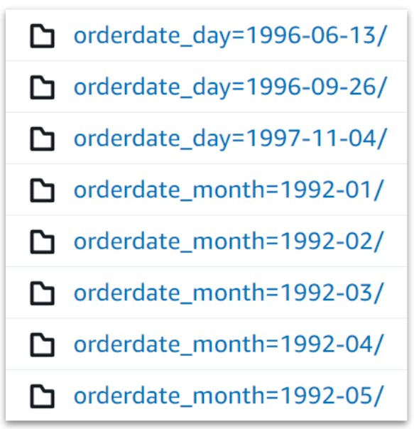
Partition evolution examples
CREATE TABLE orders_iceberg
WITH (partitioning =
ARRAY['month(orderdate)']) AS
SELECT * FROM tpch.sf1.orders;
ALTER TABLE orders_iceberg
SET PROPERTIES partitioning =
ARRAY['day(orderdate)'];

Slide 122
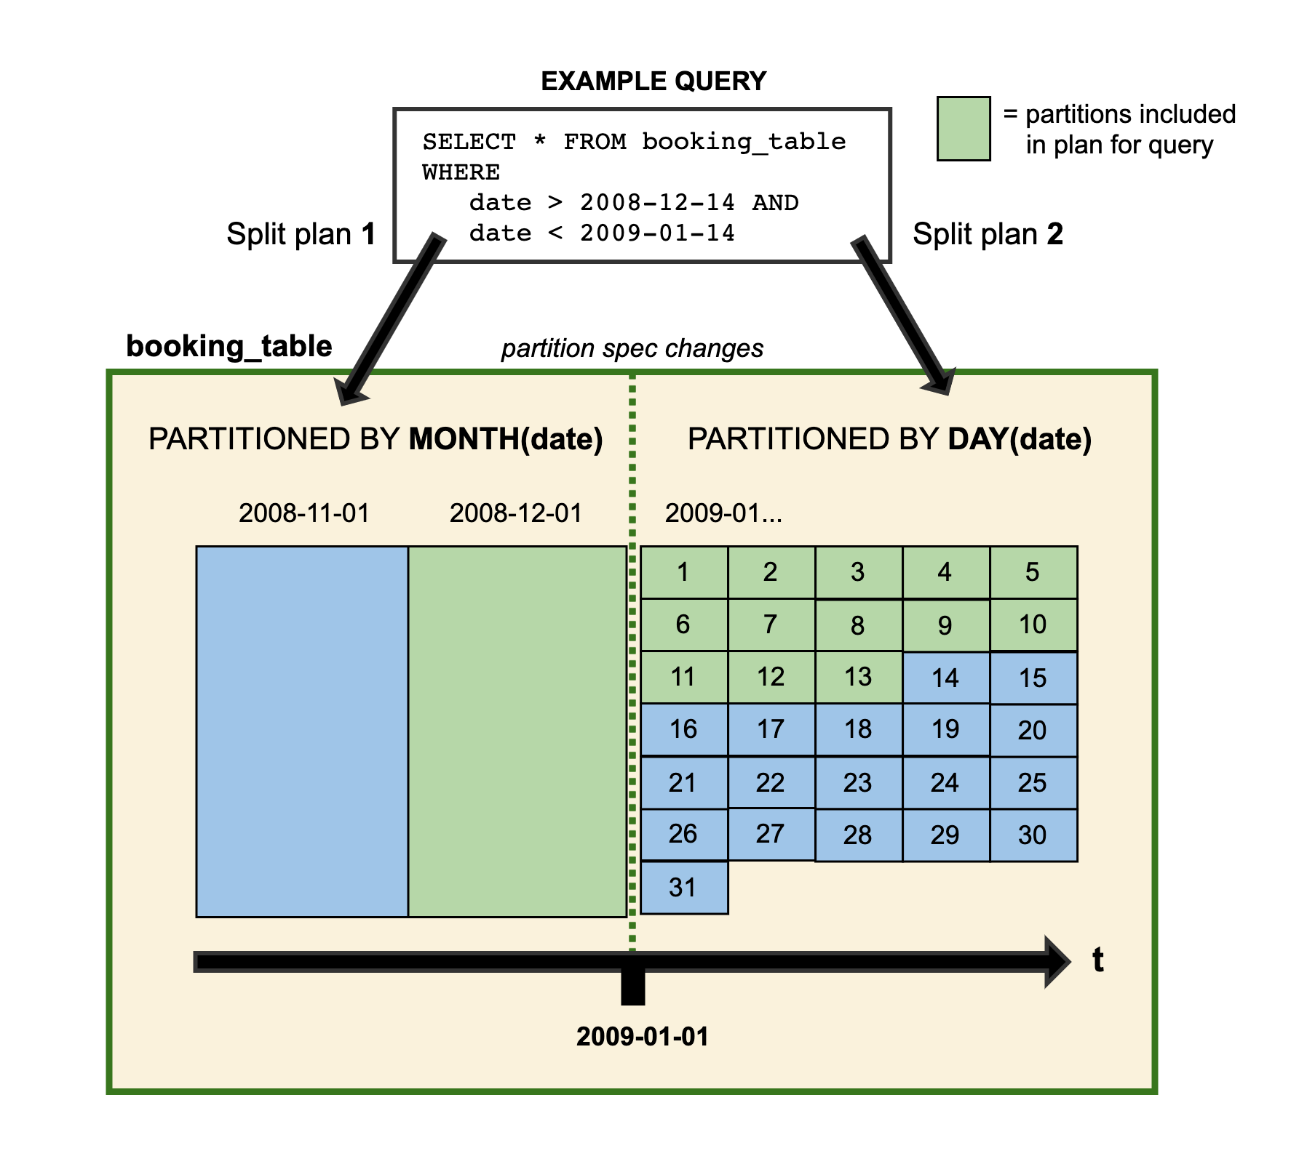
Partition change caveat
When you change the partitioning strategy, the existing data is NOT rewritten.
New data is written using the new layout.
Iceberg and Starburst will read only what they need to.
Notes:
Taken from https://iceberg.apache.org/docs/latest/evolution/#schema-evolution
Ask the class how they could get everything repartitioned. The answer is like before… create a new table such as the following DDL.
create table orders_iceberg_new with (partitioning=ARRAY['day(orderdate)'])
as select * from orders_iceberg

Slide 123
Instructor demonstration
Change Iceberg partitions (10 mins)

Slide 124
Lesson summary
Advanced Iceberg: Schema & partition evolution
Iceberg includes support for schema evolution, including add, drop, rename, update, and reorder operations.
This ensures that changes to schema do not impact the accuracy of your data or require rewrites.
Iceberg uses hidden partitions to automatically create row-level partitions without need for user intervention.
Iceberg allows for partitions based on transformations of timestamps.
Changing the partition strategy does not rewrite the data. This has both advantages and disadvantages.

Slide 125
Advanced Iceberg
Snapshots & compaction
Notes:
TIMING NOTE: Approx. 15 min lecture

Slide 126
Lesson objectives
Describe why maintenance activities are needed when using Iceberg.
Explain how to expire older/unwanted snapshots.
Describe how to remove orphaned files in Iceberg.
Explain how to compact files in Iceberg.
Demonstrate how snapshots work in Iceberg.
Subtitle here
Advanced Iceberg: Snapshots & compaction

Slide 127
Data and metadata sprawl
Short ingestion cycles (to include real-time) plus DML operations create potential longer-term issues with the Iceberg table format such as:
A large amount of metadata for all of the snapshots being created
Data files that are being referenced only by older snapshots that cannot be deleted
Very likely, a high percentage of new files being created fall into the “small files problem”
Notes:
See https://iceberg.apache.org/docs/latest/maintenance/ for more info
See also https://lestermartin.blog/2024/07/07/iceberg-snapshots-affect-storage-footprint-not-performance/

Slide 128
Required maintenance
To address the data/metadata sprawl, the following actions need to occur periodically:
Compact files – Rebuild small files into a fewer number of larger files
  Critical activity to reduce the small files problems
  Reconciles delete files to improve performance by eliminating the need to merge during read
Expire snapshots – Shorten the history of available snapshots
  Removes the snapshot information from the metadata files
  No longer available for time-travel queries
  Only deletes data files that are no longer referenced by remaining snapshots
Remove orphaned files – Deletes any files present that are not referenced by any existing snapshot which may be present due to
  Job failures from Starburst and possibly other distributed engines
  Any problems with snapshot expirations
Notes:
See https://iceberg.apache.org/docs/latest/maintenance/ for more info
COULD call out that https://iceberg.apache.org/docs/latest/configuration/ references the default value of 100 for the write.metadata.previous-versions-max property and this will likely add to the orphaned files as that property only keeps the list of snapshots manageable and doesn’t really delete the data

Slide 129
Compacting files
The optimize command uses an optional file_size_threshold parameter (default is 100MB) to determine the files to focus on compacting into larger ones.
For example, the following would focus on files under 100 megabytes in size to be merged into a few number of larger files.
ALTER TABLE orders_iceberg EXECUTE optimize;
This next example targets files in the table that are under 10 megabytes in size.
ALTER TABLE orders_iceberg
EXECUTE optimize(file_size_threshold => '10MB');
Notes:
See https://docs.starburst.io/latest/connector/iceberg.html#optimize for more info

Slide 130
Additional compaction options
Use a WHERE clause to target metadata about data files or the partition strategy.
For example, the following only compacts files that have arrived recently.
ALTER TABLE orders_iceberg EXECUTE optimize
WHERE $file_modified_time > <yesterday>;
This next example targets a particular partition.
ALTER TABLE orders_iceberg EXECUTE optimize
WHERE partition_key = <value>;
Notes:
See https://docs.starburst.io/latest/connector/iceberg.html#optimize for more info

Slide 131
Expiring snapshots
The expire_snapshots command uses a retention_threshold parameter to determine which snapshots and related metadata and data files to delete.
For example, the following would remove snapshots older than 7 days.
ALTER TABLE orders_iceberg
EXECUTE expire_snapshots(retention_threshold => '7d');
Notes:
See https://docs.starburst.io/latest/connector/iceberg.html#expire-snapshots for more info and note that it calls out the following:
The value for retention_threshold must be higher than or equal to iceberg.expire_snapshots.min-retention in the catalog otherwise the procedure will fail with similar message: Retention specified (1.00d) is shorter than the minimum retention configured in the system (7.00d). The default value for this property is 7d.
COULD call out that https://iceberg.apache.org/docs/latest/configuration/ references the default value of 100 for the write.metadata.previous-versions-max property and this will likely add to the orphaned files as that property only keeps the list of snapshots manageable and doesn’t really delete the data
See https://www.starburst.io/community/forum/t/how-to-modify-iceberg-expire-snapshots-min-retention-configuration/518/2 for how to change this permanently or for a specific session

Slide 132
Removing orphaned files
The remove_orphaned_files command also uses retention_threshold to delete any orphaned data files that are or older than a specific age.
For example, the following would remove orphaned files older than 7 days.
ALTER TABLE orders_iceberg
EXECUTE
remove_orphan_files(retention_threshold => '7d');
Notes:
See https://docs.starburst.io/latest/connector/iceberg.html?highlight=min+retention#remove-orphan-files for more info and note that it calls out the following:
The value for retention_threshold must be higher than or equal to iceberg.expire_snapshots.min-retention in the catalog otherwise the procedure will fail with similar message: Retention specified (1.00d) is shorter than the minimum retention configured in the system (7.00d). The default value for this property is 7d.
COULD call out that https://iceberg.apache.org/docs/latest/configuration/ references the default value of 100 for the write.metadata.previous-versions-max property and this will likely add to the orphaned files as that property only keeps the list of snapshots manageable and doesn’t really delete the data

Slide 133
Hands-on exercise
Exercise advanced features of Iceberg (30 mins)

Slide 134
Lesson summary
Advanced Iceberg: Snapshots & compaction
Frequent ingestions and DML operations create a large amount of metadata, which can present problems as they grow larger.
To help keep metadata in check, periodic maintenance is required, including: expiring snapshots, removing orphaned files, and compacting files.
Users should periodically run an ALTER TABLE command to clear all snapshots beyond a certain age.
Orphaned files can also be removed using ALTER TABLE.
Small files can be located and merged using Iceberg, a process known as compaction. This improves performance.

Slide 135
Data lake performance
Limiting data exchanges
Notes:
TIMING NOTE: < 5-10 mins on this micro-section

Slide 136
Lesson objectives
Describe the role that projection and filtering play on queries and the SQL commands needed to execute them.
Describe how data exchanges work and the impact they have on performance.
Subtitle here
Data lake performance: Limiting data exchanges

Slide 137
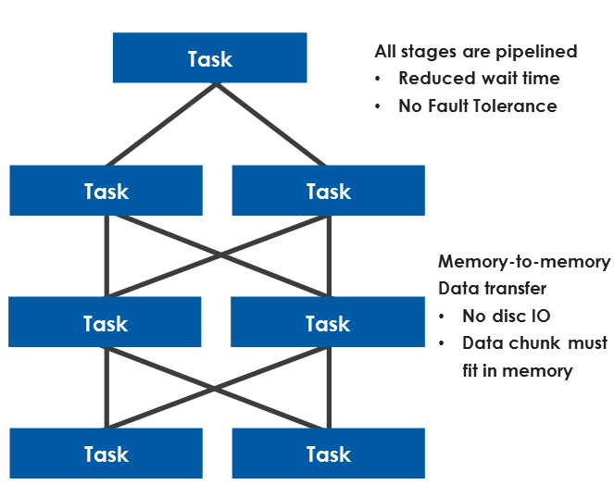
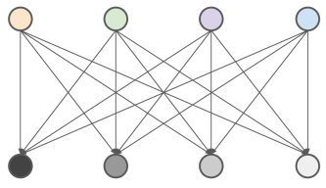
Project & filter early-and-often
Limit the amount of data transferred between query stages
Operations that work independently on each row are pipelined together into a single task.
Some operations require the entire dataset to be considered and require a new stage (ex: GROUP BY, JOIN, and ORDER BY).
  Data is shuffled from many:many
Referencing only columns you need (Projecting) and appropriate WHERE clauses (Filtering) limits:
  Initial data read (especially on columnar files)
  Amount of data transferred between stages
These exchanges can get
  very busy
  expensive
Notes:
BIG DATA Rule #1 remove columns and rows early & often
In the picture
Row on bottom might be reading two different datasets (could also be doing wide operations such as FILTER or a row-level function)
Next stage (row) might be there for a JOIN
2nd from top might represent a GROUP BY
Top row is coming down to one task to handle an ORDER BY

Slide 138
Projection & filtering in action
SELECT
order_id,
customer_name,
sale_amount,
sale_date
FROM
sales
WHERE
sale_amount > 1000
AND sale_date >= '2024-01-01';
Consider the query to the right.
The sales table has 20 columns and is 1TB in size.
We are only asking for 4 of those 20 columns.
We are using a WHERE clause to filter down to 10% of the rows in the table.
Result: Although the table is large, we are only processing around 2% of the data after projecting and filtering.

Slide 139
Lesson summary
Data lake performance: Limiting data exchanges
Projection limits the number of columns being queried. Filtering limits the number of rows being queried. Both help to ensure efficiencies across your cluster.
Some operations, like GROUP BY, JOIN, and ORDER BY, require data to be exchanged between one stage and another. This is resource intensive.

Slide 140
Data lake performance
https://docs.google.com/presentation/d/1kuh0ELp2Ja9Wq25iINz172h1kS3LMW2CdS5DIYZ4fxI/edit?usp=share_link
https://docs.google.com/presentation/d/1kuh0ELp2Ja9Wq25iINz172h1kS3LMW2CdS5DIYZ4fxI/edit?usp=share_link
https://docs.google.com/presentation/d/1kuh0ELp2Ja9Wq25iINz172h1kS3LMW2CdS5DIYZ4fxI/edit?usp=share_link
File format options
Notes:
TIMING NOTE: Approx. 20 min lecture

Slide 141
Lesson objectives
Explain the difference between row-oriented and columnar file formats.
Describe the comparative advantages and disadvantages of major file formats.
Explain the embedded statistics that are recorded inside ORC and Parquet file formats and how they are leveraged.
Subtitle here
Data lake performance: File format options

Slide 142
Multiple file formats to choose from
 | CSV | JSON | Parquet | ORC | Avro
Columnar | X | X | ✔ | ✔ | X
Compressible | ✔ | ✔ | ✔ | ✔ | ✔
Splittable | ✔ | ✔ | ✔ | ✔ | ✔
Human-readable | ✔ | ✔ | X | X | X
Complex data structure | X | ✔ | ✔ | ✔ | ✔
Schema evolution | X | X | ✔ | ✔ | ✔
Notes:
Launching point into more detailed conversations.
DON’T WALK THROUGH THE SCORECARDS ABOVE – ROUGH ILLUSTRATIVE PURPOSES…

Slide 143
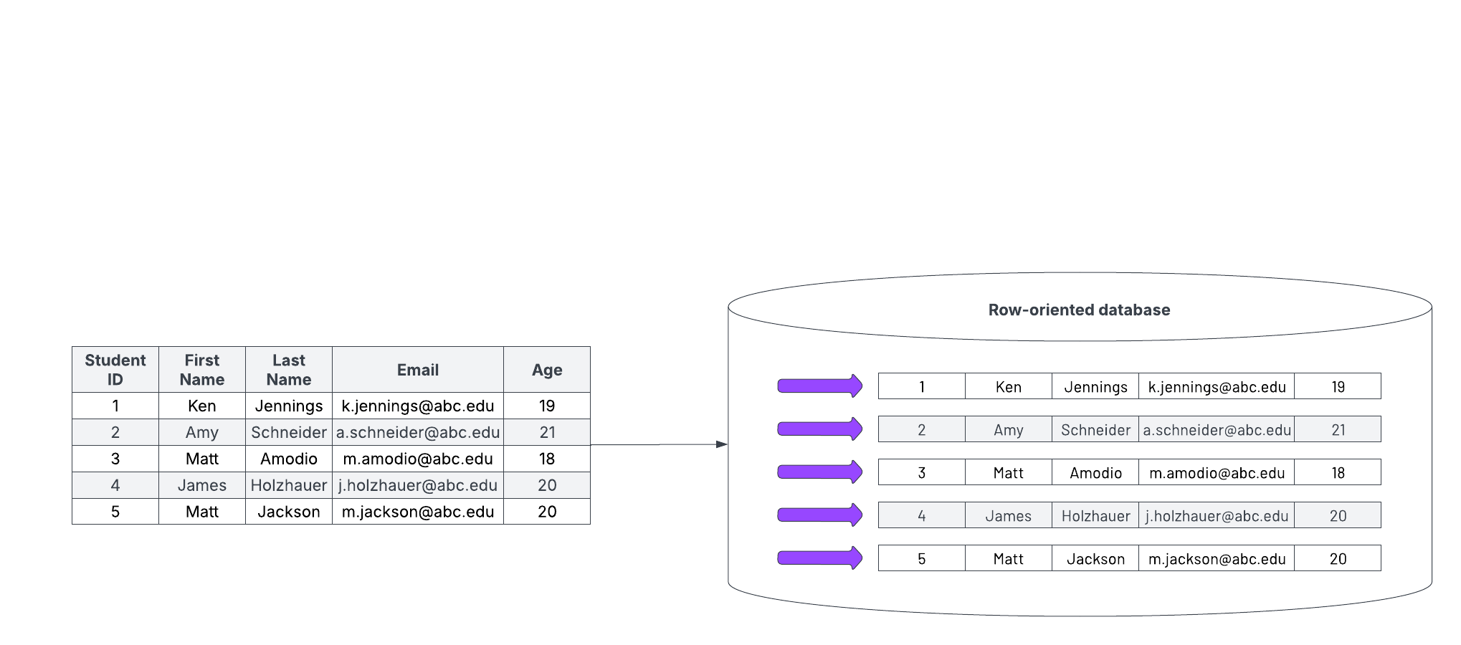
Row-oriented data storage
All data for a record is kept together and written in order of the fields. Subsequent records are appended to the end of the previous record.
File formats: delimited files (CSV), JSON, Avro

Slide 144
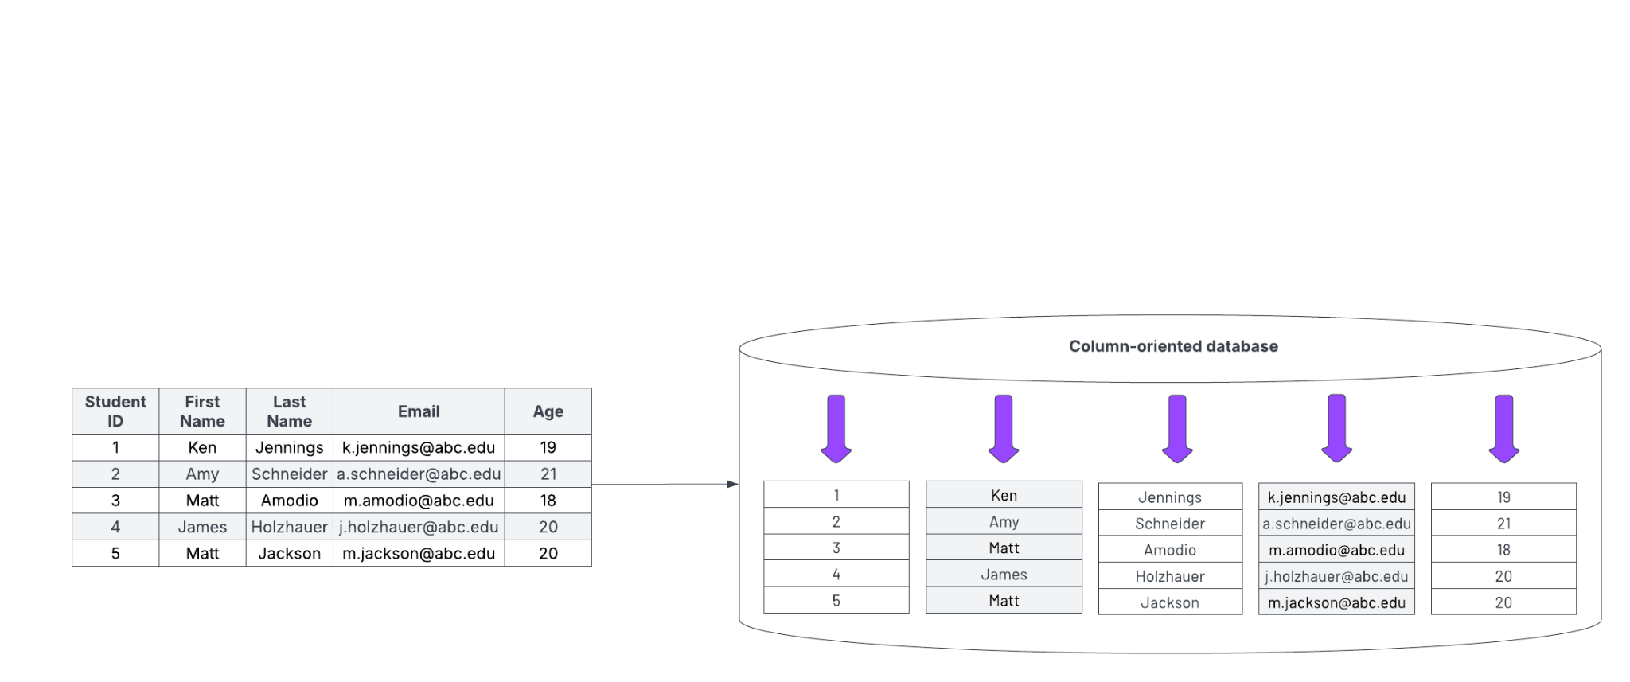
Columnar data storage
Data for a specific column (across all records) are stored independently from other columns. Low cardinality fields may employ a dictionary of unique values thereby shrinking the physical size of the data.
File formats: Apache Parquet, Apache ORC

Slide 145


Columnar storage is ideal for analytics
Columnar storage dramatically improves performance for analytical queries by:
✔ Reducing disk I/O through selective column scans
✔ Improving compression efficiency
✔ Enabling faster aggregations and filtering with predicate pushdown
✔ Supporting parallel processing for large-scale analytics
For Starburst, using columnar formats like Parquet and ORC is a best practice for optimized query performance.
Notes:
Analytical queries typically focus on specific columns, making column-oriented file formats more efficient. These formats allow analytical systems to read only the relevant columns needed for a query, reducing unnecessary data processing. Additionally, because data is stored by attribute, calculations such as minimum, maximum, average, and standard deviation can be performed more efficiently on a set of columns. For these reasons, column-oriented file formats are the preferred choice for analytic queries.

Slide 146
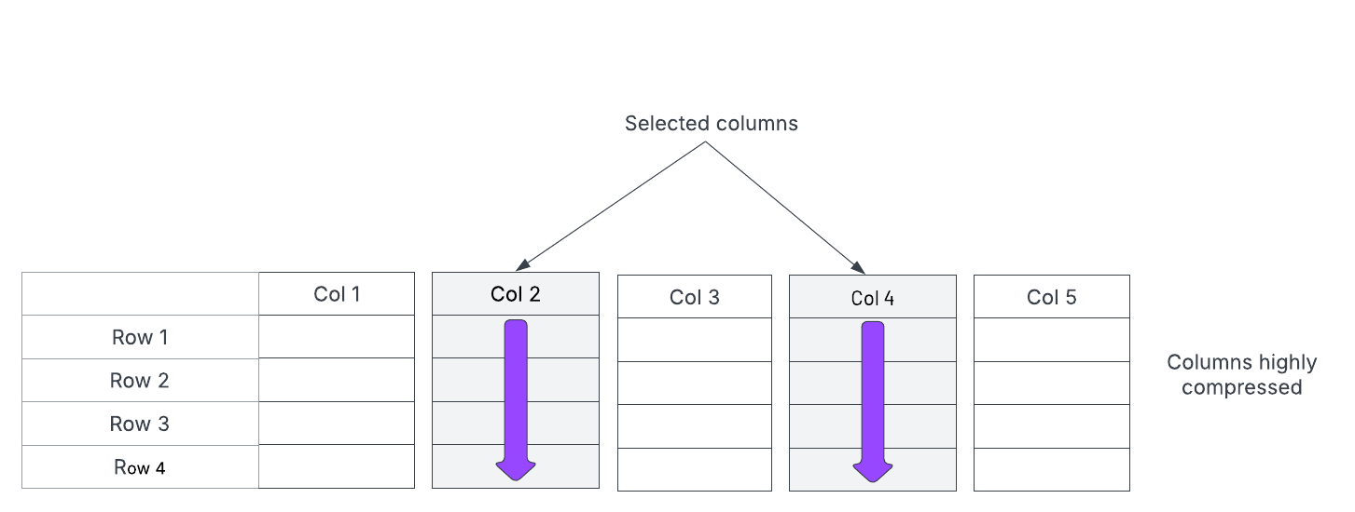
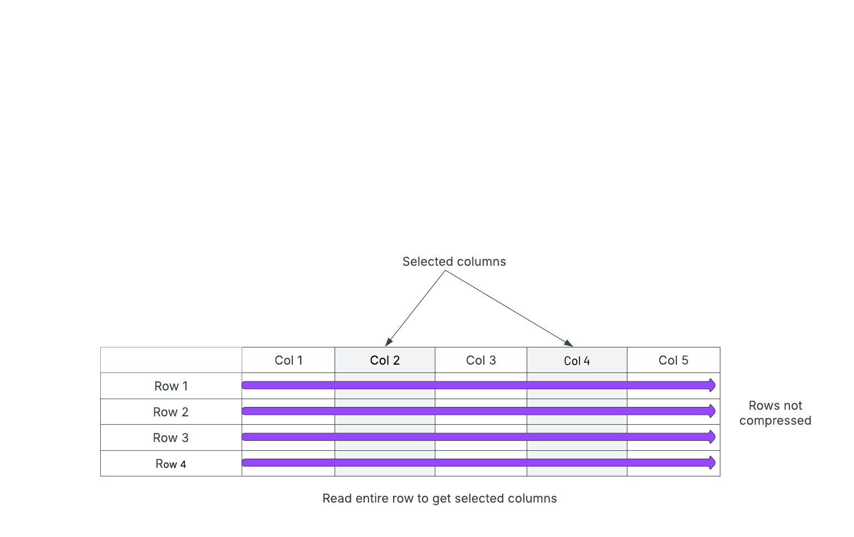
Row-oriented vs. columnar
Columnar file formats allow data to be pulled in from only the necessary columns.
Row-based file formats (like Text and Avro) pull in all data for a given row.
Notes:
Some cool animations worth glancing at with students at https://clickhouse.com/docs/en/intro

Slide 147
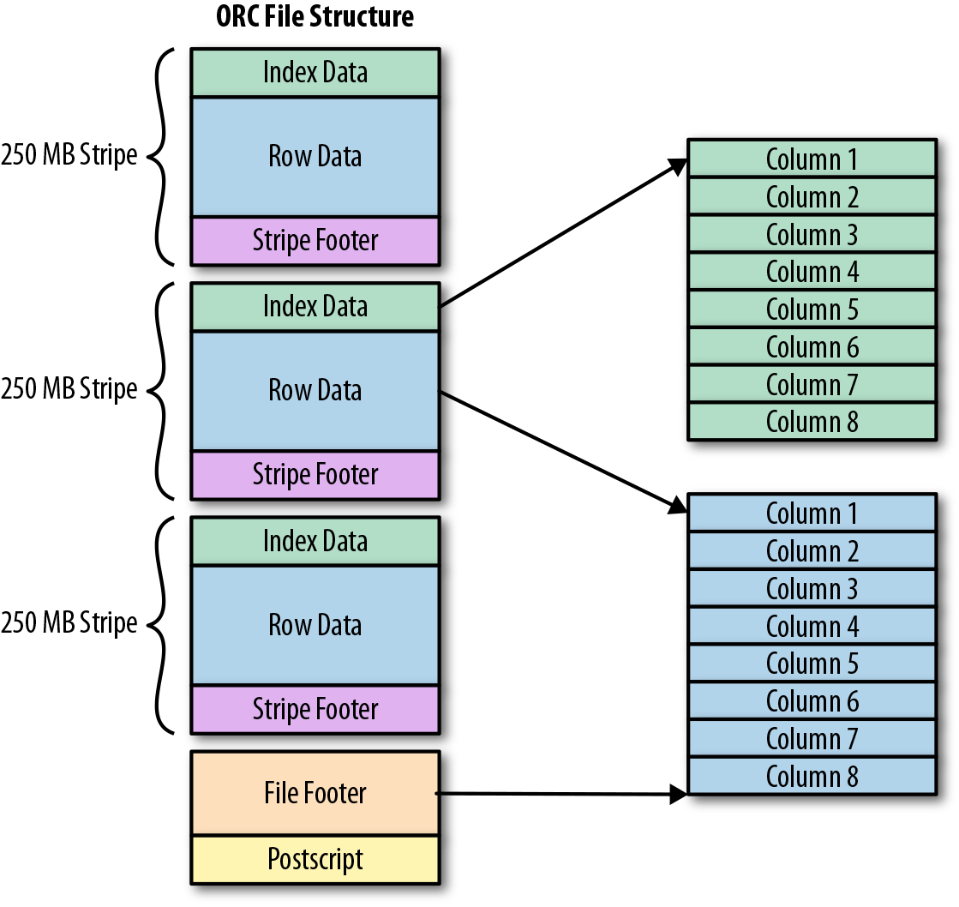
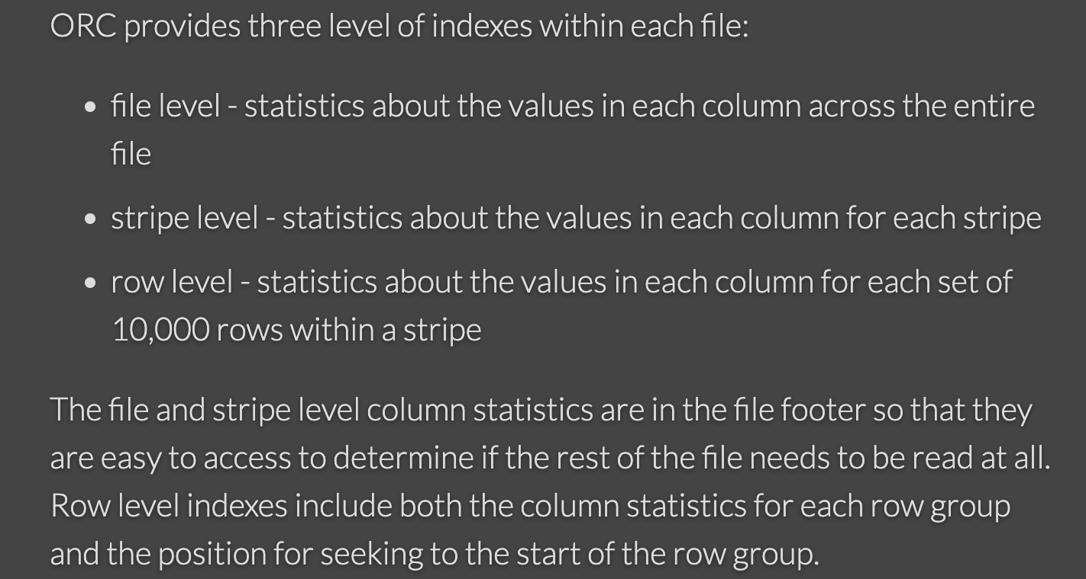
Multiple levels of statistics present
Internally sophisticated, but optimized for performance
Notes:
https://orc.apache.org/docs/indexes.html for more details.
The goal is to just make it clear this is not a simple file format like a CSV record. MAKE THE POINT THAT THERE ARE STATISTICS STORED IN THESE FILES THAT WILL HELP TRINO RUN FASTER AT QUERY TIME.

Slide 148

Instructor demonstration
Exploring file formats (20 mins)

Slide 149
Lesson summary
Data lake performance: File format options
Row-oriented file formats organize data by rows. Each new row represents a new record. Examples include CSV, JSON, and AVRO.
Columnar file formats organize data by column. Examples include ORC and Parquet.
Columnar file formats hold a significant performance advantage, particularly for datasets with low cardinality columns, for queries that retrieve specific columns, and for analytical queries such as aggregations.
ORC and Parquet file formats embed additional metadata regarding statistics at the row, stripe/segment, and file levels.

Slide 150
Data lake performance
https://docs.google.com/presentation/d/1kuh0ELp2Ja9Wq25iINz172h1kS3LMW2CdS5DIYZ4fxI/edit?usp=share_link
https://docs.google.com/presentation/d/1kuh0ELp2Ja9Wq25iINz172h1kS3LMW2CdS5DIYZ4fxI/edit?usp=share_link
https://docs.google.com/presentation/d/1kuh0ELp2Ja9Wq25iINz172h1kS3LMW2CdS5DIYZ4fxI/edit?usp=share_link
Small files problem
Notes:
TIMING NOTE: Approx. 10 min lecture

Slide 151
Lesson objectives
Explain the different factors that impact I/O performance costs in a cluster.
Describe the nature of the Small File Problem.
Demonstrate how file size impacts performance in real-world scenarios.
Subtitle here
Data lake performance: Small files problem

Slide 152
File size affects I/O costs
Uncompacted data - 256MB
Compacted data - 256MB
Consider this example
10MB
10MB
10MB
128MB
128MB
26 small files vs 2 large files, each containing the same payload.
In the 26 small files case, lots of files will be opened (relatively expensive I/O overhead).
In the 2 large files case, only a couple of files will be opened (relatively inexpensive I/O overhead).
Object stores such as S3 can introduce high latency due to opening and reading many files.
Multiple “compaction” options available.
10MB
10MB
10MB
10MB
10MB
10MB
10MB
10MB
10MB
10MB
10MB
10MB
10MB
10MB
10MB
10MB
10MB
10MB
10MB
10MB
10MB
10MB
6MB
Notes:
For the purpose of illustration we’re showing 26 files verses 2. But the real "noticeable" performance issue comes when we have 100s or 1000s of these small files needing to be read.
Taken a step further we also recommend partitioning. So, if we had 26 files in each of 365 partitions verse 2 files in each of 365 partitions then the difference between 2 and 26 matters. In general, we like to see the size be at least 200MB but for datasets which are many TBs then 1 to 2 GB are even better if possible.

Slide 153
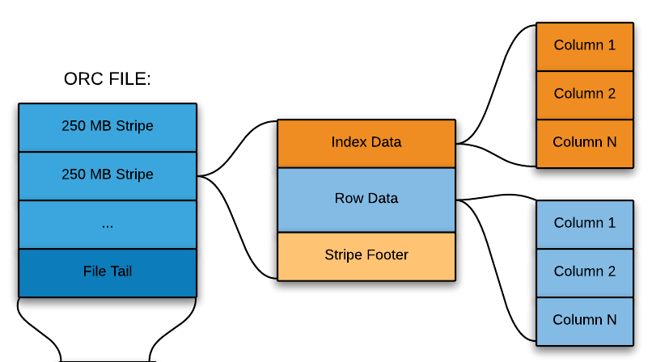
Dimensions of the problem
There are two dimensions to the small file problem
The size of an individual file
These internal segments are also known as row groups or stripes
Very small internal segment sizes (i.e. 2MB) can manifest as poor performance with low CPU utilization
Notes:
State that this will be mentioned in the lab that when files with good file formats are still too small, Trino just treats them as (basically) a simple file.

Slide 154
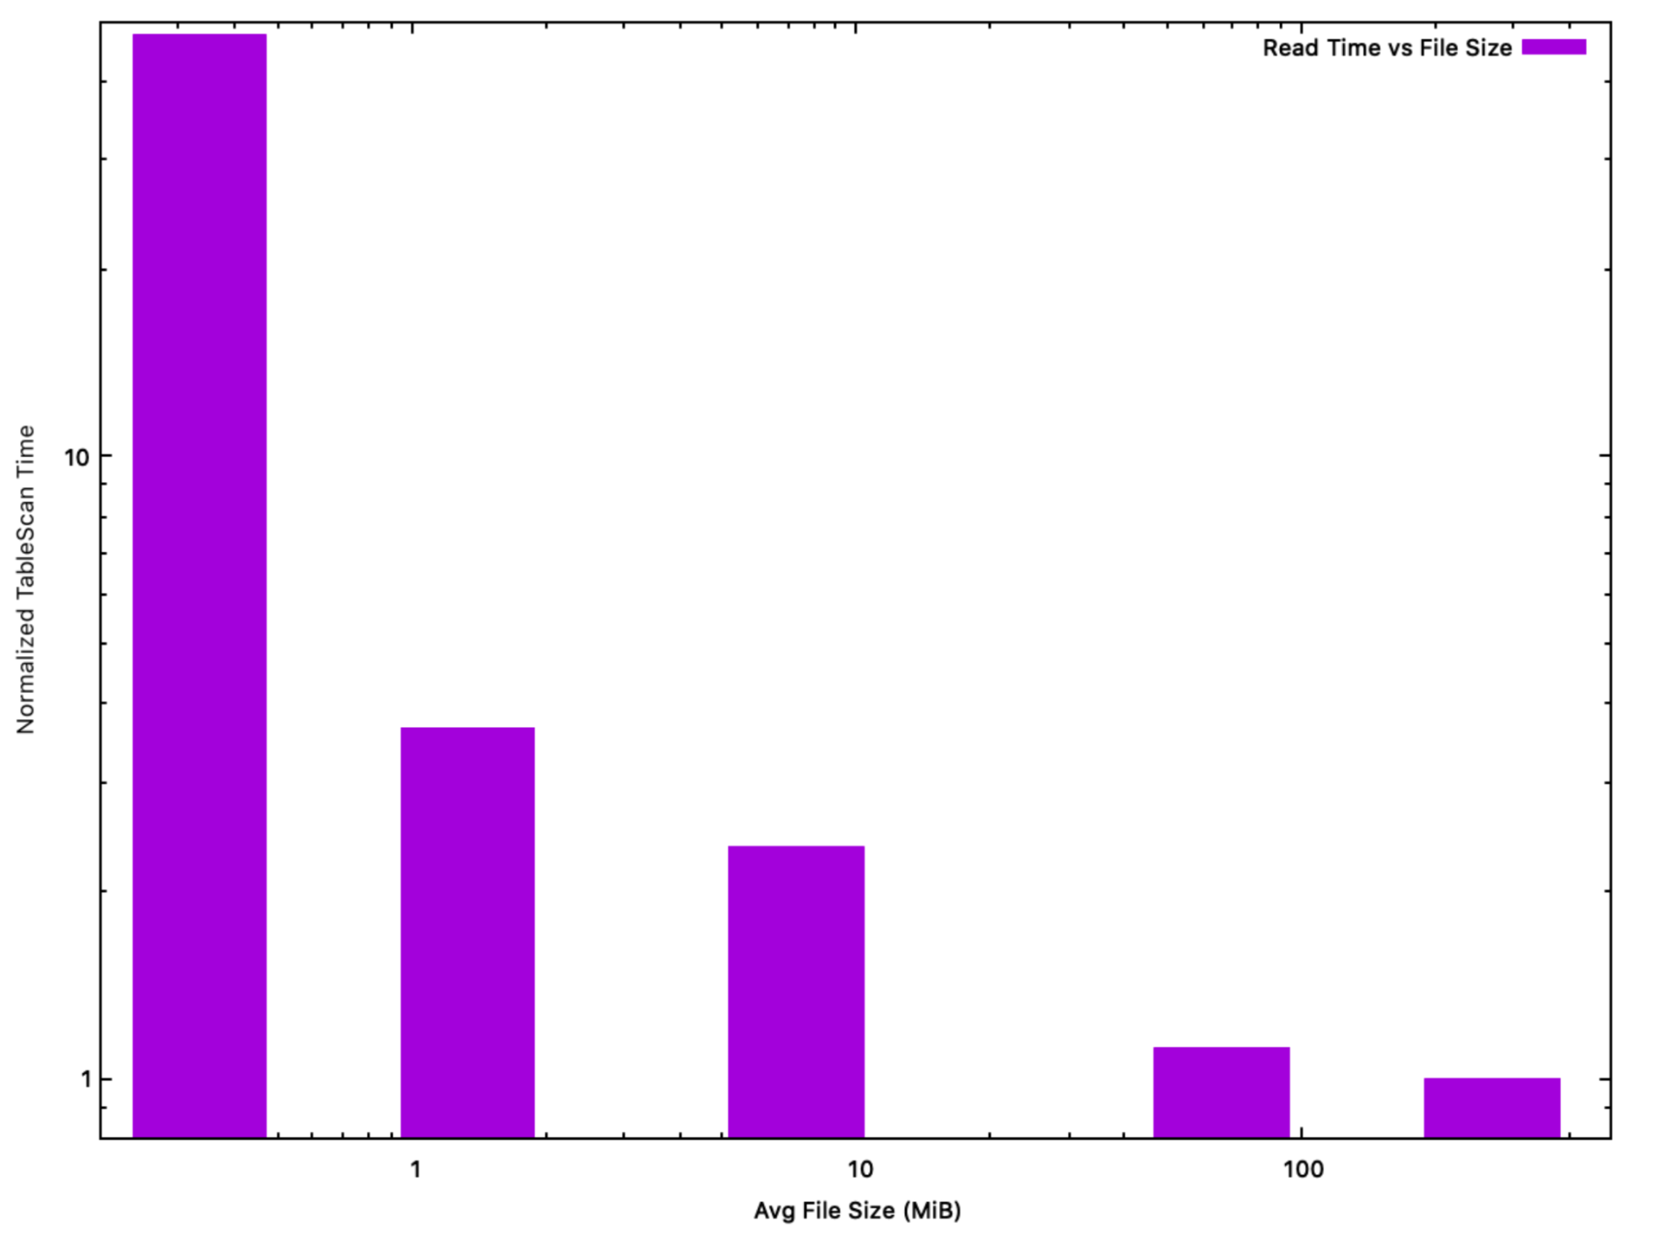
File size recommendations
Trino performs best when operating on individual file sizes > 10MB
10 MB is the lower threshold for avoiding the small files problem.
The ideal size range is 64 MB to 512 MB.
The general goal of larger files sizes (>10 MB) is to keep the ratio of data:metadata operations high (i.e. large:small).
Multiple “compaction” options.

Slide 155
Instructor demonstration
File size performance impacts (10 mins)

Slide 156
Hands-on exercises
Lab 1: Create tables with multiple file formats (20 mins)
Lab 2: Using columnar file formats and eliminating small files (40 mins)

Slide 157
Lesson summary
Data lake performance: Small files problem
Smaller files represent a more significant performance overhead when compared to larger ones.
Because there are certain unavoidable costs to opening each file, it is not efficient to store data in many small files.
Starburst clusters perform best on files larger than 10 MB, and ideally in the 64 MB to 512 MB range.

Slide 158
Data lake performance
https://docs.google.com/presentation/d/1kuh0ELp2Ja9Wq25iINz172h1kS3LMW2CdS5DIYZ4fxI/edit?usp=share_link
https://docs.google.com/presentation/d/1kuh0ELp2Ja9Wq25iINz172h1kS3LMW2CdS5DIYZ4fxI/edit?usp=share_link
https://docs.google.com/presentation/d/1kuh0ELp2Ja9Wq25iINz172h1kS3LMW2CdS5DIYZ4fxI/edit?usp=share_link
Partitioning & bucketing
Notes:
TIMING NOTE: Approx. 35 min lecture

Slide 159
Lesson objectives
Explain the role that partitioning plays in data lakes.
Explain the role that bucketing plays in data lakes.
Explain how sorting and bloom filters provide additional sorting strategies.
Subtitle here
Data lake performance: Partitioning & bucketing

Slide 160
Partitioning
Data lakes use partitioning as an alternative to indexing
A partition is just a way to divide data into subdirectories that are designed around logical groupings.
Example: Suppose you have 5 years of historical data.
  Rather than dump all 5 years into a single folder, you might create a folder for each year, and then put each year’s data into the appropriate folder.
  When a query includes the partition key in the predicate or join, the query engine can avoid reading partitions that don’t match.
Number of partitions not fixed: Partitions are added as new data is added (IE: New year = new partition).
.../cat/sch/hist_tbl
|-- year=2020
| |-- file1
| |-- file2
|-- year=2021
| |-- file3
| |-- file4
| |-- file5
|-- year=2022
| |-- file6
| |-- file7

Slide 161
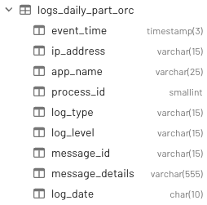
Define partition columns at table creation
CREATE TABLE mycat.myschema.logs_daily_part_orc (
event_time TIMESTAMP,
ip_address VARCHAR(15),
app_name VARCHAR(25),
process_id SMALLINT,
log_type VARCHAR(15),
log_level VARCHAR(15),
message_id VARCHAR(15),
message_details VARCHAR(555),
log_date CHAR(10)
) WITH (
format = 'ORC',
partitioned_by = ARRAY['log_date']
);
Notes:
Call out that there can be more than one column, but they have to be in that order and in the case of hive, they have to be at the end of the column list. Point out that these “virtual columns” do not really exist in the data and are materialized based on the folder names themselves where the data lives.

Slide 162
Instructor demonstration
Partitioning performance impacts (10 mins)

Slide 163
Bucketing
Another technique for dividing data into manageable chunks
While partitions logically subdivide data into folders, buckets control the number of files within a folder.
With bucketing, you choose a fixed number of buckets/files up front.
Decide bucket count based on desired/ideal file size
A consistent algorithm is used to determine the bucket assignment.
  Bucketing keeps data that has the same key value in the same bucket.
  This can improve performance, as matching data is always stored together in the same bucket.
BY ITSELF
.../cat/sch/hist_tbl
|-- bucketfile0
|-- bucketfile1
|-- bucketfile2
w/PARTITIONING
.../cat/sch/hist_tbl
|-- year=2020
| |-- bucketfile0
| |-- bucketfile1
| |-- bucketfile2
|-- year=2021
| |-- bucketfile0
| |-- bucketfile1
| |-- bucketfile2
|-- year=2022
| |-- bucketfile0
| |-- bucketfile1
| |-- bucketfile2

Slide 164
Define bucketing details at table creation
CREATE TABLE hive.web.page_views (
view_time timestamp,
user_id bigint,
page_url varchar,
ds date,
country varchar
)
WITH (
format = 'ORC',
partitioned_by = ARRAY['ds', 'country'],
bucketed_by = ARRAY['user_id'],
bucket_count = 50
);

Slide 165
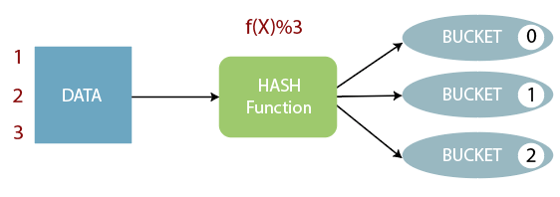
Hashing: The bucket assignment algorithm
A hash function is a way to map data of arbitrary size into a fixed number of buckets.
An example of a simple hash function is “modulo,” which provides the remainder after dividing two values.
For example: 4 mod 3 = 1 because 4 divided by 3 leaves a remainder of 1.
Hash functions are used to map values in joins to buckets in a hash table, or to map them to specific server nodes for processing.
Notes:
Youtube video on hashing: https://youtu.be/l8ncJ7OCMoQ

Slide 166
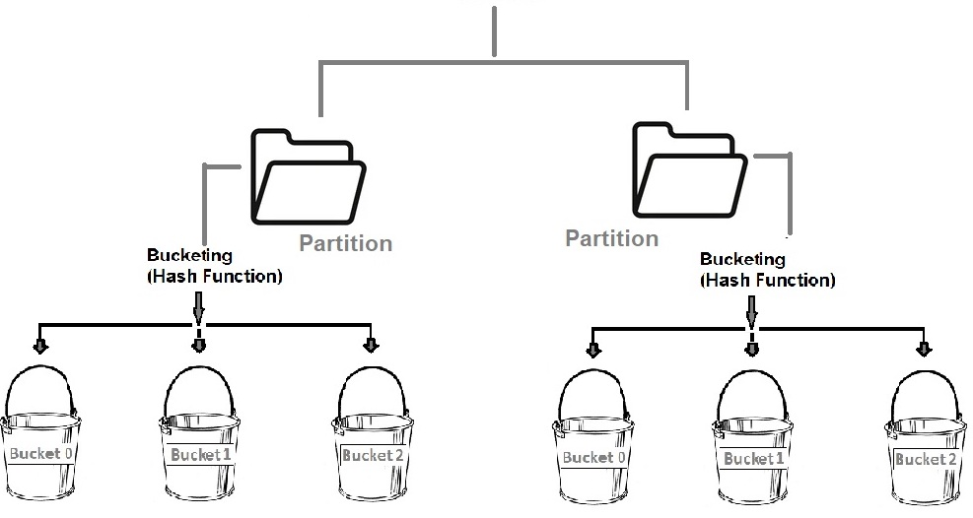
Bucketing vs. partitioning
Each solves a different problem.
Both are useful to limit the amount of data to read.
Partitions:
  Implemented using folder structures
  Work best on low cardinality columns that have fairly uniform distribution
Buckets:
  Implemented by splitting files
  A way to continue to subdivide data that may not make sense to partition, such as high cardinality and/or highly skewed columns
BE CAREFUL OF CREATING SMALL FILES USING EITHER/BOTH OF THESE FEATURES
Notes:
A good example of understanding this is thinking about the population of each state in the US. If we had a table with a state column then partitioning by state likely wouldn't be an even distribution of the data, so for that situation bucketing is better. Whereas, if you have a date column and in general you write out the same number of rows per day to a table then partitioning on the month or year of the date column may be OK. This is easily done with Iceberg. HOWEVER, one more example after that is also to mention partitioning on date itself may create far more folders than you desire.
See following blog post to help with the “humpback whale” styled partitions that make a lot of sense.
https://lestermartin.blog/2024/06/05/well-designed-partitions-aid-iceberg-compaction-call-them-ice-cubes/

Slide 167
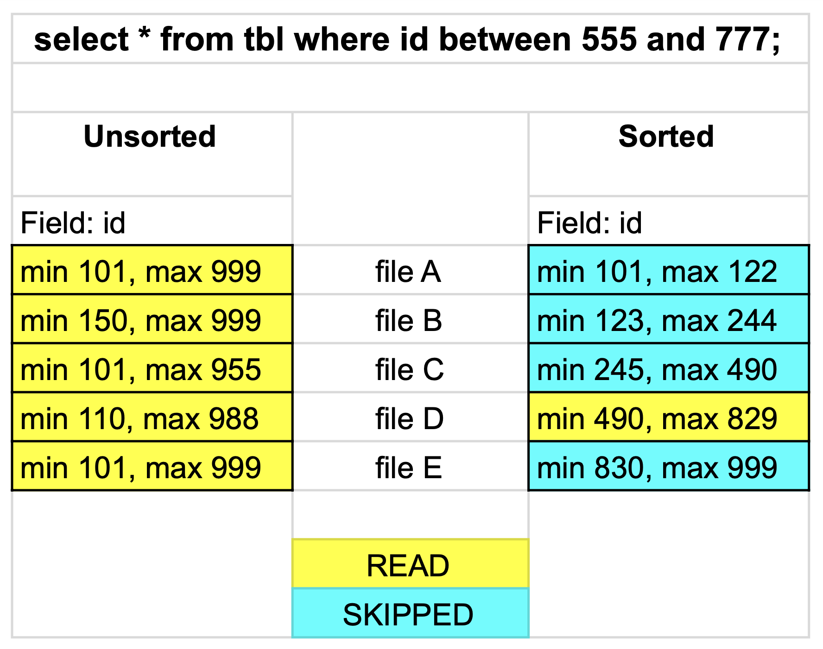
Additional strategy: Sorting
Total order sorting for a table or partition
Sorting all of the files for a specific table, or partition, on heavily queried column(s) allows for index-like behavior.
Sorting uses the statistics associated with each file, including min & max values, and checks to see if a particular WHERE selection is either:
  Potentially in the file
  Definitely not in the file
Like partitioning & bucketing, this is another way to intelligently limit the amount of data it has to read
Notes:
For Hive tables this is going to work best to sort the data for a given partition once you are done writing to it. For Iceberg tables (another module) they have a sort_by DDL comment that can do this automagically for you.
Walkthrough at https://www.youtube.com/watch?v=Sop4OJXdceA

Slide 168
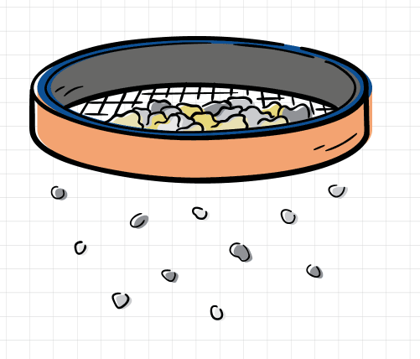
Additional strategy: Bloom filters
Another way to walk away from a file
A space-efficient, probabilistic data structure used to test if a specific column value could possibly be in a particular file.
False positives are possible, but false negatives are not.
Useful with high cardinality columns where the value to be searched is rarely present
Notes:
Named after Burton Bloom; https://en.wikipedia.org/wiki/Bloom_filter
A possible example for a table could be web logs which include the source IP address and a bloom filter was created on that column as there is a use case that happens occasionally where a security analysts wants to quickly see what activity may have come from a specific IP address that is likely not in most files.

Slide 169
Hands-on exercise
Exploring table partitioning & bucketing (40 mins)

Slide 170
Lesson summary
Data lake performance: Partitioning & bucketing
Partitioning separates data into folders based on a low cardinality column’s value and allows a WHERE clause to determine a subset of these folders to be read.
Using a hashing algorithm, bucketing ensures all data with the same value of a high cardinality column is persisted together in the same file thus allowing a WHERE clause to determine which file(s) to read.
Total order sorting across files allows the statistics associated with columnar formats to be utilized by the query engine to quickly stop reading a file if a particular value, or range of values, could not be present.
A bloom filter is a probabilistic technique that can allow the majority of files to not have to be read when querying for rare values in high cardinality columns.

Slide 171
Cache service
https://docs.google.com/presentation/d/1kuh0ELp2Ja9Wq25iINz172h1kS3LMW2CdS5DIYZ4fxI/edit?usp=share_link
https://docs.google.com/presentation/d/1kuh0ELp2Ja9Wq25iINz172h1kS3LMW2CdS5DIYZ4fxI/edit?usp=share_link
https://docs.google.com/presentation/d/1kuh0ELp2Ja9Wq25iINz172h1kS3LMW2CdS5DIYZ4fxI/edit?usp=share_link
Overview
Notes:
TIMING NOTE: Approx. 35 min lecture

Slide 172
Lesson objectives
Define Starburst Cached Views.
Describe table scan redirection and its typical use cases.
Explain the use of the cache service.
Subtitle here
Cache service: Overview

Slide 173
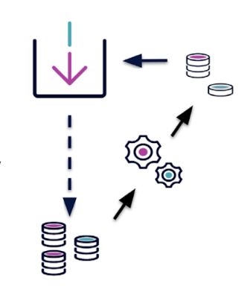
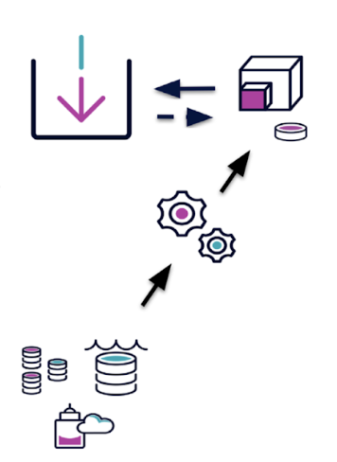
Starburst Cached Views
Starburst Cached Views is a collection of performance features exclusive to Starburst Enterprise
Table scan redirection
Materialized views
Notes:
Starburst Cached Views adds caching capabilities across different data sources that are transparent to the end user. For example, data from a relational database can be cached on S3. The end user still issues the same query to the relational source and Starburst redirects the read operation from the relational table to the cache in S3. Starburst Cached Views allows you to incrementally update new rows of data, without needing to execute a full refresh. Starburst Cached Views can improve read performance up to 20x and update 100’s of times faster.

Slide 174
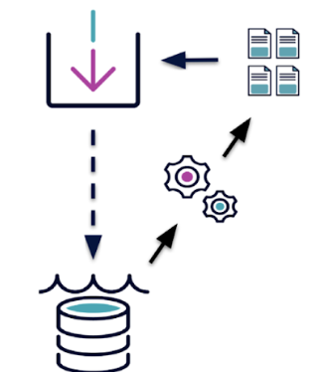
Starburst Cached Views
Cache service
Used to configure and automate the management of table scan redirection
Cache service CLI provides an easy management interface for the cache service as a command line tool
Also manages refresh of materialized views
Notes:
Starburst’s cache service provides the ability to configure and automate the management of table scan redirections. The service connects to an existing Starburst installation to run queries for copying data from the source catalog to the target catalog. The target catalog is regularly synchronized with the source and used as a cache. The cache service also manages the refresh of materialized views.

Slide 175
Starburst Cached Views
Table scan redirection
Allows read operations in a source catalog to be transparently redirected by reading the data from another catalog, the target catalog.
Can reduce load off underlying sources to improve query performance
The cache service automates the management of the cached data used during table scan redirection.
Good performance when federating between geographically distinct locations.
Typical use case: redirection from a relational database to Hive.
Notes:
Table scan redirection is a mechanism for transparently using a cached version of a table in a query. This can be useful to reduce load off underlying sources and improve query performance by storing the cached data in an optimized fashion. The cache service automates the management of the cached data used during table scan redirection. Table scan redirections allow you to materialize the data from remote locations in a center of data gravity. That access pattern allows us to get good performance when federating between geographically distinct locations.
It takes less work for Starburst customers to access data, as caching table projections transparently shifts data access to a more performant system. A typical use case is the redirection from a catalog configuring a relational database to a catalog using the Hive connector to access a data lake. The result is a positive impact to performance and reduction of cost and load on underlying systems.

Slide 176
Starburst Cached Views
Materialized views
Deliver saved views that you can access faster to improve query speed.
The cache service can manage automatic refreshes based on your desired schedule.
Can reduce data analytics expenses
Notes:
Materialized views offer a saved view that you can access faster to improve query speed. Materialized views allow data analysts using BI platforms like Tableau or Looker access to new data faster. Despite their innovation, the data refresh period can be burdensome in BI as it relies heavily on complex queries running across large datasets over and over again. With materialized views, the dashboards no longer need to rerun complicated queries, data analysts simply access the save materialized view directly and experience significantly faster time to insight. Materialized views also help you dramatically reduce data analytic expenses.

Slide 177
Instructor demonstration
Cache service administration (15 mins)

Slide 178
Hands-on exercise
Table scan redirection in action (10 mins)

Slide 179
Cache service
https://docs.google.com/presentation/d/1kuh0ELp2Ja9Wq25iINz172h1kS3LMW2CdS5DIYZ4fxI/edit?usp=share_link
https://docs.google.com/presentation/d/1kuh0ELp2Ja9Wq25iINz172h1kS3LMW2CdS5DIYZ4fxI/edit?usp=share_link
https://docs.google.com/presentation/d/1kuh0ELp2Ja9Wq25iINz172h1kS3LMW2CdS5DIYZ4fxI/edit?usp=share_link
Materialized views
Notes:
TIMING NOTE: Approx. 35 min lecture

Slide 180
Lesson objectives
Create, list, and describe a materialized view.
Refresh data in a materialized view.
List options for persisting the storage table.
Subtitle here
Cache service: Materialized views

Slide 181

Create a data lake materialized view
Creates and validates the definition of the materialized view based on the identified query
The materialized view is physically persisted from the results of this query based on the configured refresh interval.
This persisted data is utilized by future queries.
Optional clauses:
OR REPLACE allows the view to be replaced if it already exists
IF NOT EXISTS only executes if it does not exist yet
Usage example:
SELECT * FROM mv_nation;
SQL statement
CREATE MATERIALIZED VIEW
mv_nation AS
SELECT
name,
nationkey
FROM
nation10;
Notes:
Just reiterating some of the points from the first lesson. This example is a simple query against a single table, but can obviously be much more complex. Key point is MVs are MATERIALIZED (aka saved) and those data lake files are read once a query runs against it.
Stress that, after creation, a materialized view won’t necessarily be persisted right away. It depends on the connector and/or time interval for refresh. Users can always use the REFRESH MATERIALIZED VIEW command to force it to persist. In some cases, like with the Iceberg connector, they must use that command.
Key terms; view definition (the “table” / MV that users will query) and storage table (the underlying table that is accessed when a query on the MV is executed).

Slide 182


Supported table formats
Starburst Enterprise
The Hive connector supports materialized views persisted with the Hive table format
The Iceberg connector supports materialized views persisted with the Iceberg table format
The Great Lakes connector supports materialized views persisted with the Iceberg table format.

Slide 183
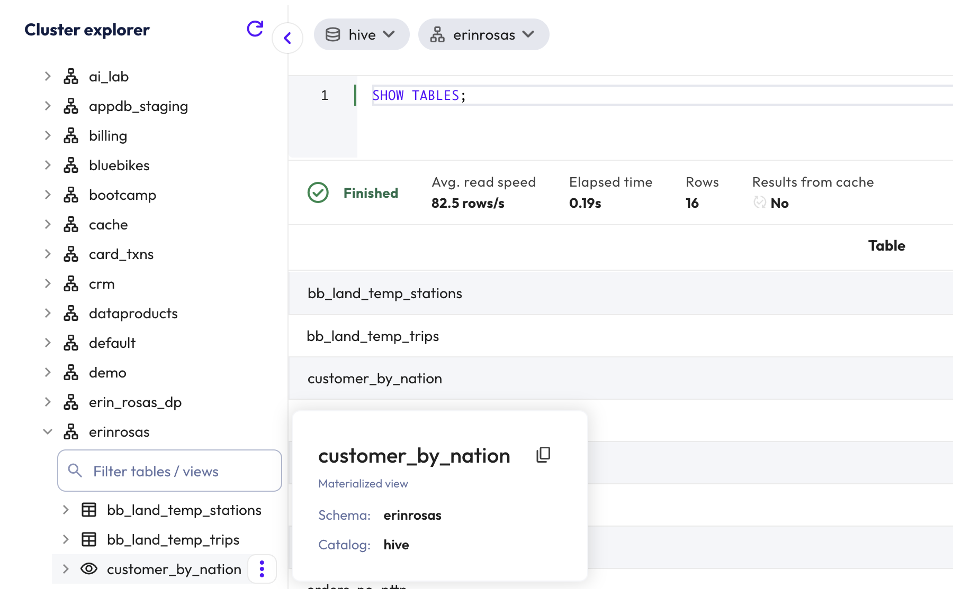
Listing materialized views
Views are visualized with the UI or CLI along with the tables inside a schema
Notes:
Very similar to what (and how) you can do with a normal table

Slide 184
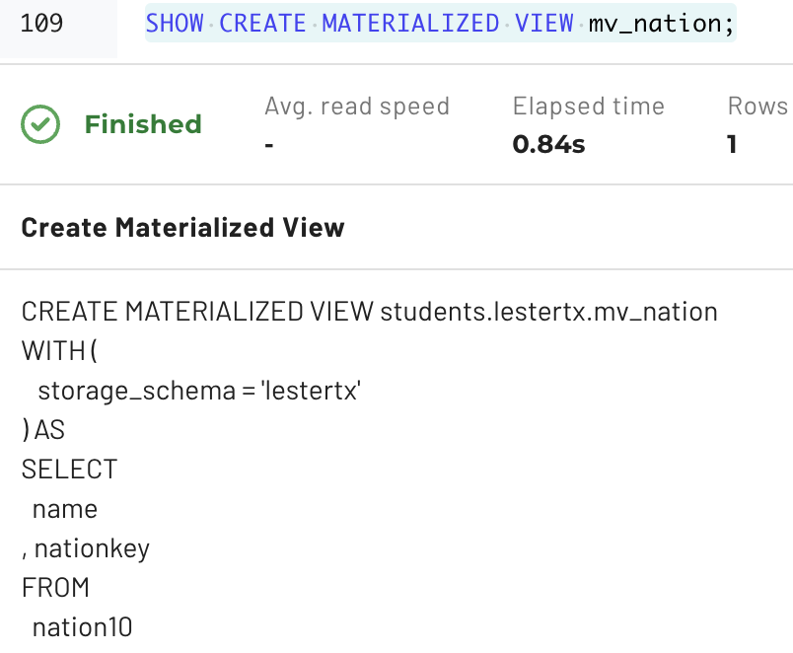
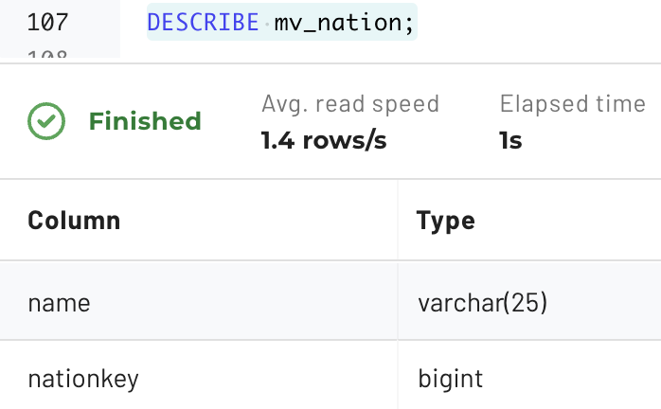
Details of a materialized view
SHOW CREATE MATERIALIZED VIEW mv_nation;
Skills Library
Live, Private Training
$525 per user/year
$6,750 per day
DESCRIBE mv_nation;
Online, Self Paced
Virtual
Notes:
Very similar to what (and how) you can do with a normal table.

Slide 185
Updating data for materialized views
REFRESH MATERIALIZED VIEW forces an update
Deletes any existing persisted data and (re)loads the data from executing the referenced query
A new materialized view is NOT initially populated and requires this command.
The actual table where the refresh results are located is called the storage table
The storage table is based on a point-in-time and thus can become stale
  The Hive and Iceberg connectors have additional features aimed to limit stale data issues
  Data pipelines that manipulate the tables used in the materialized view definition have the responsibility to consider using the REFRESH command as part of their workflow
Data Products implemented as materialized views are refreshed after creation

Slide 186
Storage table location
Starburst Enterprise
The Hive connector requires administrators to configure a default schema for the storage tables.
The Iceberg connector allows administrators to configure a default schema for storage tables – default behavior is to use the same schema where the materialized view is defined.

Slide 187
Hive’s automated refresh options
With the Hive connector on Starburst Enterprise clusters, you can optionally automate refreshes using these WITH clause properties at creation time.
Properties | Description
refesh_interval OR cron | The automated process can be triggered based on a repeatable period of time OR by leveraging a cron expression to defined a more elaborate schedule
max_import_duration AND grace_period | Declares how long the refresh process can execute before aborting it AND how long after a storage table is out of date can be used in a query execution
incremental_column | An optional mechanism to facilitate loading data incrementally instead of a full table refresh
Notes:
Cron is the Linux default scheduler

Slide 188
Iceberg’s atomic full refresh
There is no automated or incremental refresh. Materialized views can only be fully refreshed via a REFRESH MATERIALIZED VIEW command.
Users can continue to query the materialized view while it is being refreshed as the change is performed atomically just as if it was a change to a normal Iceberg table.

Slide 189
Hands-on exercise
Using Materialized Views for performance gains (20 min)

Slide 190
Lesson summary
Cache service: Materialized views
As with views, the following activities are almost identical to how they are accomplished with tables:
Creating and dropping the materialized view
Describing the materialized views columns
Recreating the DDL CREATE commands
Listing materialized views
Starburst Enterprise supports Hive and Iceberg materialized views.
The Hive connector requires a default schema to be identified for storage tables while Iceberg's model allows you to set a property during materialized view creation.

Slide 191
Lesson summary (continued)
Data lake views: Materialized views
Hive allows for refreshes to be configured to execute automatically.
Iceberg only allows a full refresh.

Slide 192
Data Products
https://docs.google.com/presentation/d/1kuh0ELp2Ja9Wq25iINz172h1kS3LMW2CdS5DIYZ4fxI/edit?usp=share_link
https://docs.google.com/presentation/d/1kuh0ELp2Ja9Wq25iINz172h1kS3LMW2CdS5DIYZ4fxI/edit?usp=share_link
https://docs.google.com/presentation/d/1kuh0ELp2Ja9Wq25iINz172h1kS3LMW2CdS5DIYZ4fxI/edit?usp=share_link
Notes:
TIMING NOTE: Approx. 35 min lecture

Slide 193
Lesson objectives
Define data products and describe their usefulness.
Provide examples of data products
Find and use curated data products in Starburst Enterprise.
Subtitle here
Data Products

Slide 194





What is a Data Product?
Definition:
A data product is a curated, reusable dataset designed for a specific business purpose.
Key traits:
Reliable
Well-documented
Governed
Easy to discover and use
Raw Data
Sources
Data Product
AI

Slide 195
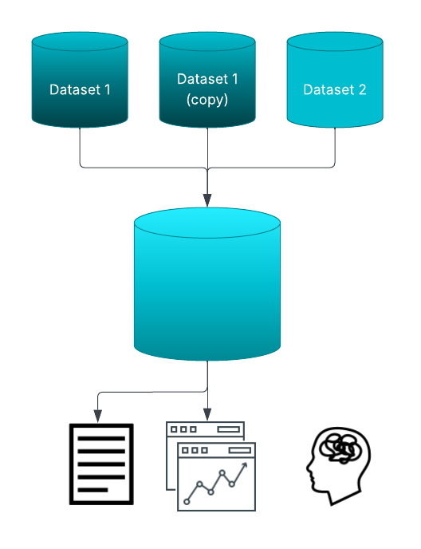
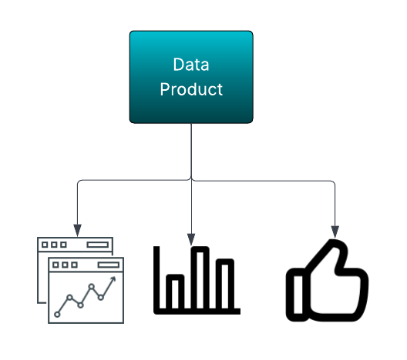
Why Are Data Products Important?
Problem without them:
Analysts spend too much time cleaning data.
Multiple teams recreate the same dataset differently.
Trust in reports is low.
Solution with data products:
Standardized, trusted datasets
Faster access to insights
Consistency across the org

Slide 196

How Data Products Benefit Data Consumers
Save time (less wrangling, more analyzing)
Increase confidence in results (trusted definitions)
Self-service discovery (find and use the right dataset quickly)
Enable advanced analytics & AI (cleaner, structured inputs)

Slide 197
Instructor demonstration
Exploring a customer 360 data product (15 minutes)

Slide 198
Hands-on exercise
Compare results from raw tables vs. curated data product (20 minutes)

Slide 199
Lesson summary
Data Products
A data product is a curated, reusable dataset designed for a specific purpose.
Data products ensure faster access to insights and consistency across the organization.
Data products save time and increase confidence for data analysts.

Slide 200
Cost-based optimization
Overview
Subtitle here

Slide 201
Lesson objectives
Describe what cost-based optimization (CBO) is and why it matters.
Explain the role that table statistics play in CBO.
Use SQL to view and calculate tables statistics.
Subtitle here
Cost-based optimization: Overview

Slide 202
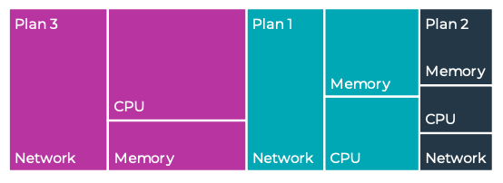
What is a cost-based optimizer?
CBO evaluates multiple query execution plans and selects the most efficient one.
It considers CPU time, network bandwidth, and memory requirements.
Unlike a Rule-Based Optimizer (RBO), which follows static rules, CBO is adaptive and data-driven.
Plan with the lowest “cost” is chosen
Notes:
Instead of blindly applying rules, CBO analyzes data statistics to choose the best execution strategy.

Slide 203
Starburst CBO key components
Statistics Collection: Gathers metadata like row count, low value, high value, and estimated distinct values.
Join Optimization: Selects the best join strategy (broadcast vs. distributed).
Predicate Pushdown: Filters data as early as possible to reduce scanned rows by pushing the predicate down to the underlying data source or to the lower layer in the data lake.
Partition Pruning: Avoids scanning unnecessary partitions.
Reordering Joins: Arranges tables in the most efficient join sequence.
Notes:
CBO optimizes queries at multiple levels, from reducing scanned data to choosing the best join method.
Partition pruning: Partition pruning happens at the metadata level (i.e., you learn which partitions to skip scanning).
A good example for the Lake formats is that we take basic column-level predicates (=, ranges, etc) and inside the ORC/Parquet reader we compare them to the built-in block level min/max indices to see if we can skip over a given block entirely.

Slide 204
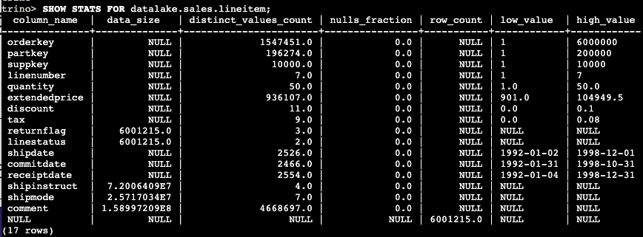
Statistics collection: The foundation of CBO
The CBO relies on accurate table statistics to estimate query costs.
Table statitistics:
  Row count (# rows in table)
Column statistics:
  Data size (size of data that needs to be read)
  Nulls fraction (fraction of null values)
  Distinct value count (# distinct values)
  Low value (smallest value in column)
  High value (largest value in column)
Notes:
Without accurate statistics, CBO cannot make informed decisions. Regularly updating statistics is crucial for performance. These are the standard table statistics, but some connectors have extended statistics that the CBO can handle.
Two important things to consider:
1/ If data is being written out by SEP then we update the stats as we write so you don't need to run ANALYZE for Lake tables unless you are concerned another engine added rows.
2/ When you enable the managed stats feature, you can actually ANALYZE non lake tables like Teradata and we'll collect stats and store them in our SEP back end database.

Slide 205
View and calculate statistics
View statistics
SHOW STATS FOR table_name;
Calculate statistics
ANALYZE table_name WITH (
partitions = ARRAY[ARRAY['p2_value1', 'p2_value2']],
columns = ARRAY['col_1', 'col_2'])
Note: Identifying specific columns and/or partitions is optional, but recommended.
Notes:
Calculating statistics for all columns usually does not make sense; especially for very wide tables. You only need to calculate statistics that the CBO will be looking for with operations such as sorting, joining, grouping, etc. Since most partitions’ data becomes static at some point, you do not need to continue to calculate statistics on partition data once it stops being added to and/or updated.

Slide 206
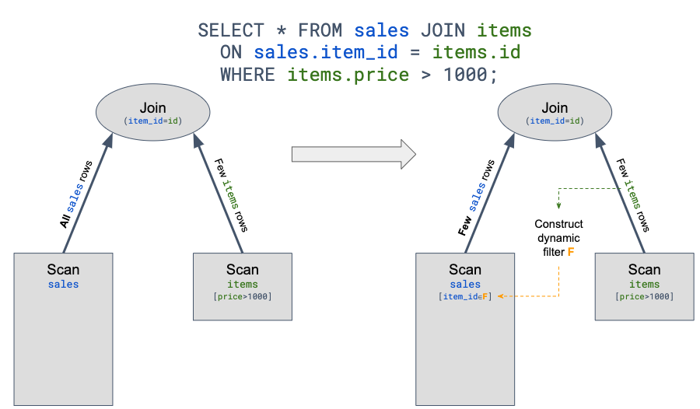
Query Optimization
Pushdown
Dynamic Filtering
Move the filtering condition as close to the source of the data as possible.
Some benefits:
  improved overall query performance
  reduced network traffic between Trino and the data source
  reduced load on the remote data source
Types:
  Predicate
  Aggregation
  Join
  Limit
  Top-N
Significantly improve the performance of queries with selective joins by avoiding reading of data that would be filtered by join condition.
Improve performance on federated queries
  Better resource utilization for better data filtering
Skip loading of partitions (dynamic partitioning pruning)
Notes:
Multiple ways a predicate pushdown can be helpful
Leverage partitioning
Leveraging bucketing
ORC file bloom filters
ORC and Parquet have metadata in the individual files that can
Help Trino walk away from a particular file if the values needed are not present
Possibly speed up accessing particular values by reading the metadata pointers/stripes/etc information

Slide 207
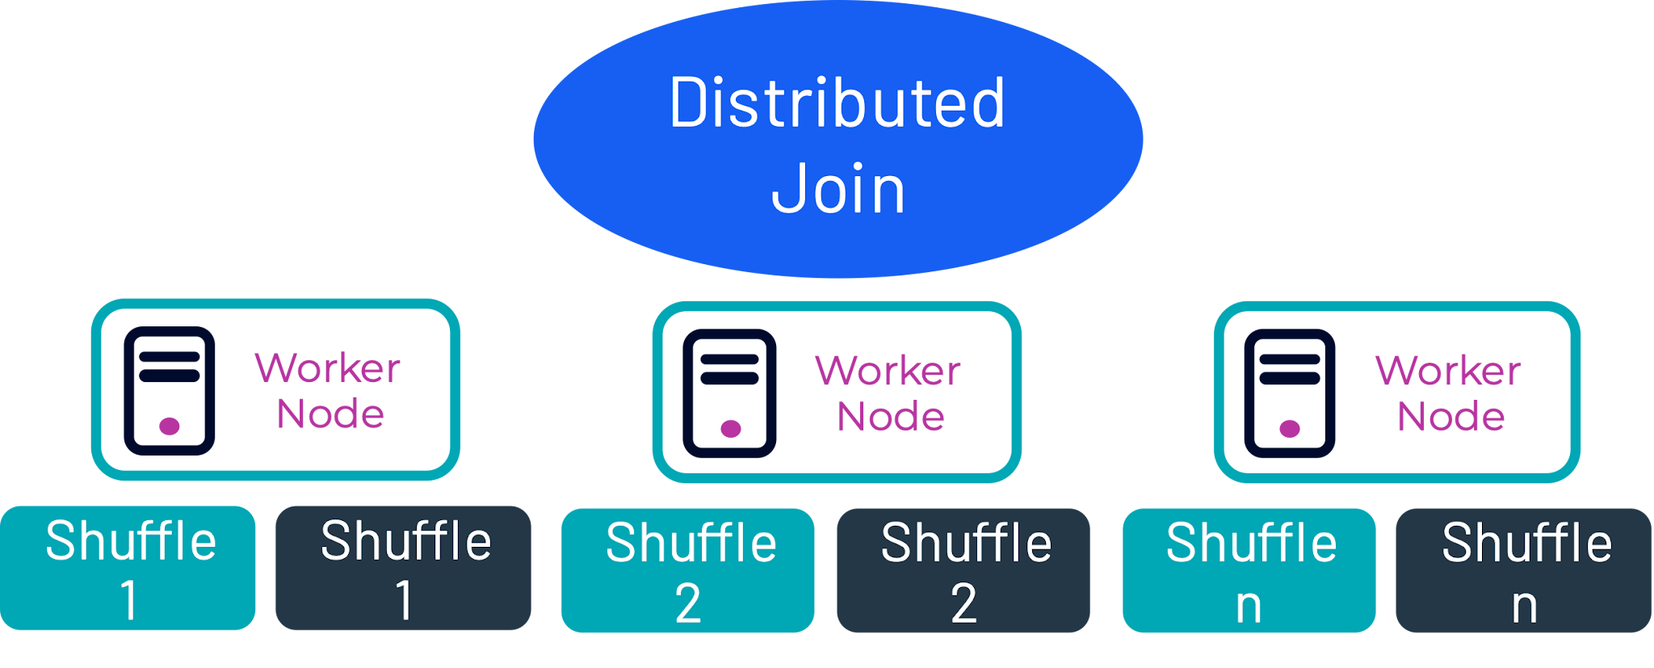
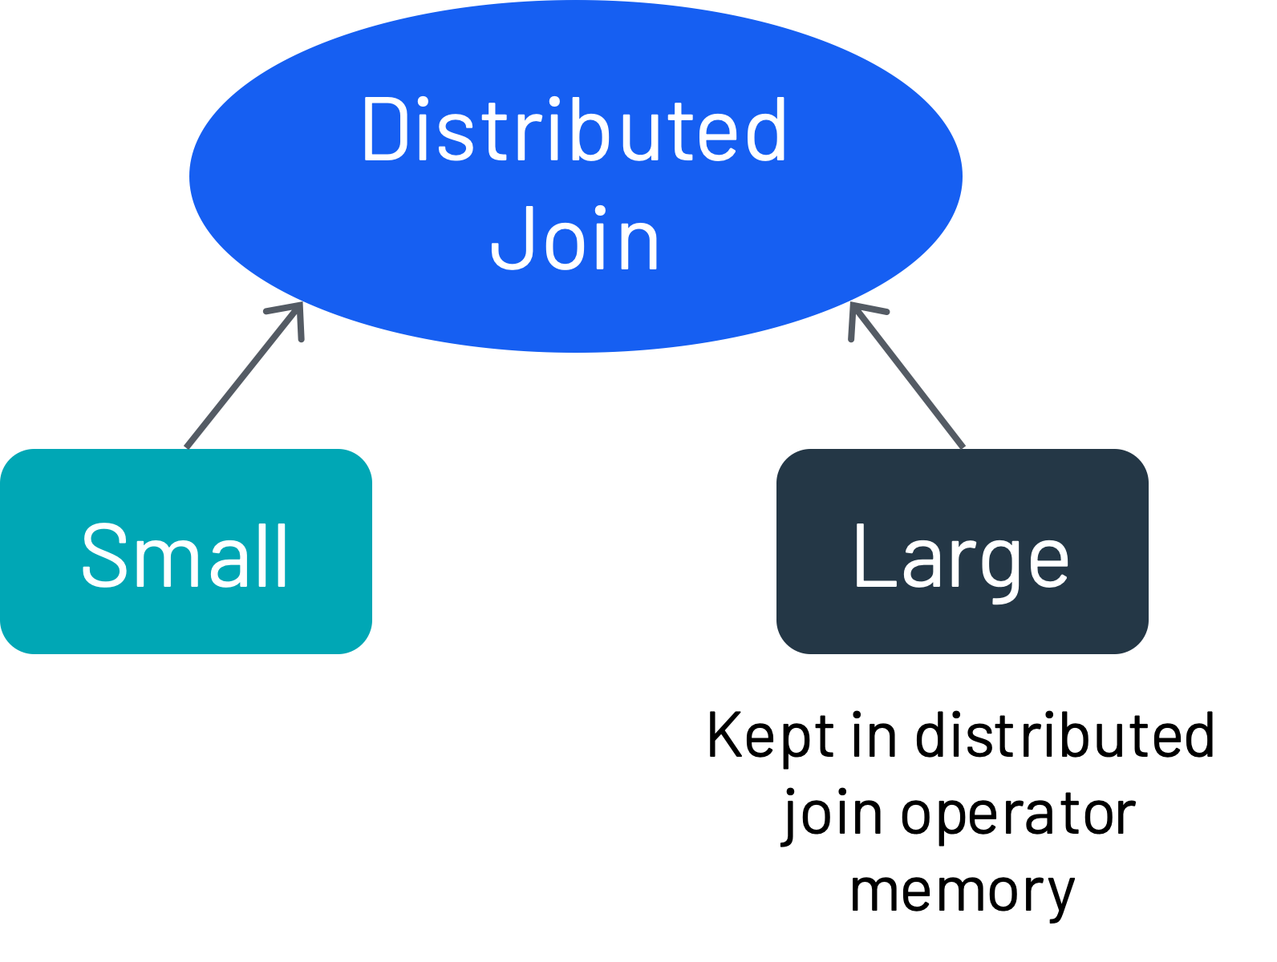
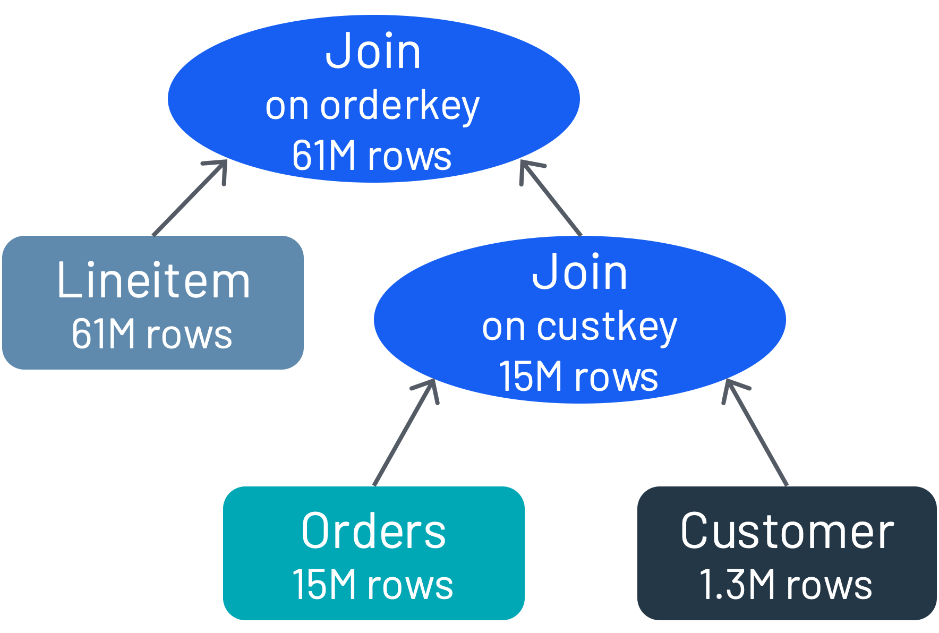
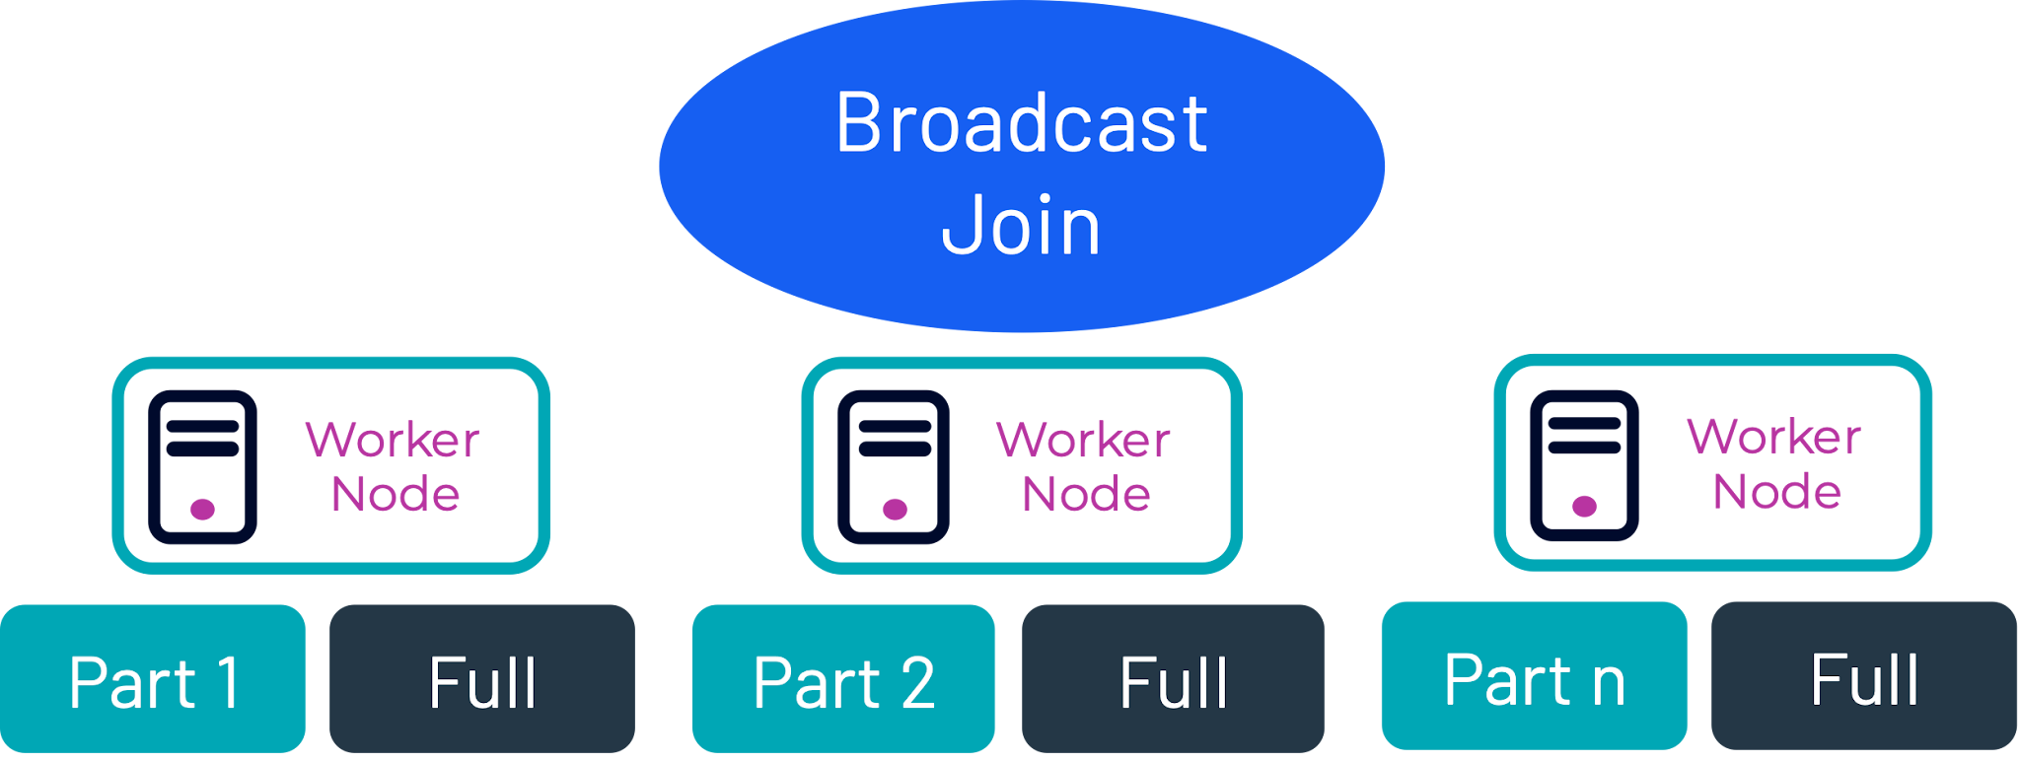


Query Improvements
Broadcast vs distributed
Join sides reordering
Join tree reordering
Table A
Table B

Slide 208
Lesson summary
Cost-based optimization: Overview
The cost-based optimizer (CBO) performs various transformations of a query plan to arrive at the most efficient variant.
CBO uses table statistics to identify the best plan.
SQL can be used to returned the optimized plan with, or without runtime details, generated by the CBO.
Queries are typically optimized for pushdown, join optimizations, and dynamic filtering.

Slide 209
Cost-based optimization
Query plan analysis
Subtitle here

Slide 210
Lesson objectives
Explain what query plans are and how they are achieved using Starburst architecture.
Describe the purpose of query plan analysis.
Analyze the typical output of an explain plan to determine value.
Explain how optimization is achieved and the mechanisms used to achieve it.
Subtitle here
Cost-based optimization: Query plan analysis

Slide 211








Starburst Logical Architecture
Data Sources
Metastore
Policy Mgmt
User Sync
Authentication
Metadata
RBAC
Data Warehouse
Cloud Data Warehouse
SQL
Metadata
Coordinator
Results
Data
Location
Data
Data Lake
Cloud Data Lake
BI Tool, DS Tool, SQL Client, CLI
Worker Node
Data
Worker Node
Worker Node
NoSQL
Streaming
Worker Node
Coordinator
Data
Worker
Auto-Scaling Group
RDBMS
Object Storage
Connectors
JDBC/ODBC/CLI
Intra-cluster
API Call
External DB
Coordinator: Event Logs
Ranger: RBAC
HSM

Slide 212
Starburst execution flow
Starburst / Trino Cluster
Coordinator
Data Source Storage System
Metadata SPI
Statistics SPI
Data Location SPI
Client
Queue
Parser / Analyzer
Planner / Optimizer
Scheduler
Worker
Processor
Data Source API
Worker
Processor
Worker
Processor
Data Source API
Notes:
Top row is the plan creation and bottom row is the scheduling & running of all the work.

Slide 213
Query Execution Model
Stage 1
SELECT …
Parser / Analyzer
Planner / Optimizer
Stage 2
Stage 3
Stage 0
1
2
3
Coordinator
Worker
4
Scheduler
Task
Worker
Split
Split
Task
Worker
Stage
Worker
Split
Task
Task
Task
Worker
Task
Split
Split
Task
Task
Task
Worker
Task
Notes:
The black circles are unique operations such as scan, filter, and project. This example suggests two different scans occurring on two datasets and then doing an additional activity such as a row-based (scalar) function THEN sending data via hashing to the next circle that is possibly joining these datasets THEN final circle could be a sort.
Numbers should be in reverse order (i.e. the final step should be stage 0), but this is showing that the operations that can be done in a mutually exclusive way get lumped together into a stage and the data movement from stage to stage is called an exchange.
Top 2 were about PLANNING, and these next two are about SCHEDULING. Coordinator spreads the work as wide as the cluster is.
The Workers now do the actual heavy lifting work of reading, processing and returning data.

Slide 214
Query Execution Model Nomenclature
Statement: Starburst executes ANSI-compatible SQL statements, which consist of clauses, expressions, and predicates.
Query: a conversion of a parsed statement into a distributed query plan, which is then realized as a series of interconnected stages.
Stage: When the query engine executes a query, it breaks up the execution into a hierarchy of stages.
Tasks: a stage is implemented as a series of tasks distributed over a network of workers
Split: sections of a larger data set. Stages retrieve data via splits from connectors as well as other stages higher up in a distributed query plan.
Driver: Tasks contain one or more parallel drivers. Drivers act upon data and combine operators to produce output that is then aggregated by a task and then delivered to another task in another stage.
Operator: An operator consumes, transforms, and produces data.
Exchange: transfer data between Starburst nodes for different stages of a query
Notes:
Definitions from https://trino.io/docs/current/overview/concepts.html

Slide 215
EXPLAIN plan overview
EXPLAIN plans are key to identifying bottlenecks and optimizing joins, filters, and data access.
Let’s take a look at the following:
What tools are available for us to troubleshoot query issues?
How can we use the tools to identify bottlenecks?
How can we understand what is going on in the engine?
What can we recommend to improve query performance?
What information does Support need to troubleshoot issues?

Slide 216

What’s an EXPLAIN Plan?
EXPLAIN SELECT c.custkey, sum(l.extendedprice * l.discount) discount
FROM customer c, orders o, lineitem l
WHERE c.custkey = o.custkey
AND l.orderkey = o.orderkey
GROUP BY c.custkey
ORDER BY discount desc
Query Execution Plan
  What logical tasks, in what order (table reads, joins, sorts, order by, etc)
  What distribution type (how many workers to use per task)
Uses Table Statistics
  Estimates rows per task (influences join type & ordering)
Output of CBO (cost-based optimizer)
  Shows execution path / processing order for tasks
  Shows optimizations (predicate push down, join reordering, etc)
Notes:
Output of Explain is a series of Fragments
Fragments represent logical groupings of work that will get executed in stages
Fragments executed on single or multiple nodes
Query plans are read from the bottom up
*The query plan displayed on this slide is only a portion of the query plan for the query shown

Slide 217
Generating an EXPLAIN Plan
Prefix any query with the word ‘EXPLAIN’
Results in an execution plan
Multiple variants:
  EXPLAIN: Query plan before execution, plan structure + cost estimates
  EXPLAIN ANALYZE: Plan structure + cost estimates + actual execution statistics
EXPLAIN ANALYZE
SELECT custkey, sum(totalprice) AS total
FROM orders
WHERE
orderstatus = 'F' AND
orderdate BETWEEN DATE '1995-01-01' AND DATE '1995-12-31'
GROUP BY custkey
ORDER BY total DESC;
Notes:
Multiple ways to see plan structure
Web UI: simplified version with some real-time stats
EXPLAIN Plan: our focus for this presentation
Prefix any query with EXPLAIN
Output is textual representation of query execution plan
Output is a set of fragments linked together in their own sections
Query on the slide will be used as an example as we walk through different components of an EXPLAIN PLAN

Slide 218
EXPLAIN Plan Output
Query: EXPLAIN SELECT custkey, sum(totalprice) AS total FROM orders WHERE orderstatus = 'F' AND orderdate between DATE '1995-01-01' AND DATE '1995-12-31' GROUP BY custkey ORDER BY total DESC;
Fragment 0 [SINGLE]
Output layout: [custkey, sum]
Output partitioning: SINGLE []
Output[columnNames = [custkey, total]]
│ Layout: [custkey:bigint, sum:double]
│ Estimates: {rows: 99595 (1.71MB), cpu: 0, memory: 0B, network: 0B}
│ total := sum
└─ RemoteMerge[sourceFragmentIds = [1]]
Layout: [custkey:bigint, sum:double]
Fragment 1 [ROUND_ROBIN]
Output layout: [custkey, sum]
Output partitioning: SINGLE []
LocalMerge[orderBy = [sum DESC NULLS LAST]]
│ Layout: [custkey:bigint, sum:double]
│ Estimates: {rows: 99595 (1.71MB), cpu: 0, memory: 0B, network: 0B}
└─ PartialSort[orderBy = [sum DESC NULLS LAST]]
│ Layout: [custkey:bigint, sum:double]
│ Estimates: {rows: 99595 (1.71MB), cpu: ?, memory: ?, network: ?}
└─ RemoteSource[sourceFragmentIds = [2]]
Layout: [custkey:bigint, sum:double]
Fragment 2 [HASH]
Output layout: [custkey, sum]
Output partitioning: ROUND_ROBIN []
Aggregate[type = FINAL, keys = [custkey]]
│ Layout: [custkey:bigint, sum:double]
│ Estimates: {rows: 99595 (1.71MB), cpu: 1.71M, memory: 1.71MB, network: 0B}
│ sum := sum(sum_0)
└─ LocalExchange[partitioning = HASH, arguments = [custkey::bigint]]
│ Layout: [custkey:bigint, sum_0:double]
│ Estimates: {rows: 99595 (1.71MB), cpu: 1.71M, memory: 0B, network: 0B}
└─ RemoteSource[sourceFragmentIds = [3]]
Layout: [custkey:bigint, sum_0:double]
Fragment 3 [SOURCE]
Output layout: [custkey, sum_0]
Output partitioning: HASH [custkey]
Aggregate[type = PARTIAL, keys = [custkey]]
│ Layout: [custkey:bigint, sum_0:double]
│ Estimates: {rows: 99595 (1.71MB), cpu: ?, memory: ?, network: ?}
│ sum_0 := sum(totalprice)
└─ ScanFilterProject[table = glue_enablement:tpch_sf1:orders, filterPredicate = ((orderdate BETWEEN date '1995-01-01' AND date '1995-12-31') AND (orderstatus = varchar(1) 'F'))]
Layout: [custkey:bigint, totalprice:double]
Estimates: {rows: 1500000 (25.75MB), cpu: 41.48M, memory: 0B, network: 0B}/{rows: 99595 (1.71MB), cpu: 41.48M, memory: 0B, network: 0B}/{rows: 99595 (1.71MB), cpu: 1.71M, memory: 0B, network: 0B}
orderstatus := orderstatus:varchar(1):REGULAR
custkey := custkey:bigint:REGULAR
orderdate := orderdate:date:REGULAR
totalprice := totalprice:double:REGULAR
Series of fragments:
Representing logical sections of work to be performed in stages in cluster
Work executed on single or multiple-nodes
Notes:
Output of Explain is a series of Fragments
Fragments represent logical groupings of work that will get executed in stages
Fragments executed on single or multiple nodes

Slide 219
Exchanges
Fragment 0 [SINGLE]
Output layout: [custkey, sum]
Output partitioning: SINGLE []
Output[columnNames = [custkey, total]]
│ Layout: [custkey:bigint, sum:double]
│ Estimates: {rows: 99595 (1.71MB), cpu: 0, memory: 0B, network: 0B}
│ total := sum
└─ RemoteMerge[sourceFragmentIds = [1]]
Layout: [custkey:bigint, sum:double]
Fragment 1 [ROUND_ROBIN]
Output layout: [custkey, sum]
Output partitioning: SINGLE []
LocalMerge[orderBy = [sum DESC NULLS LAST]]
│ Layout: [custkey:bigint, sum:double]
│ Estimates: {rows: 99595 (1.71MB), cpu: 0, memory: 0B, network: 0B}
└─ PartialSort[orderBy = [sum DESC NULLS LAST]]
│ Layout: [custkey:bigint, sum:double]
│ Estimates: {rows: 99595 (1.71MB), cpu: ?, memory: ?, network: ?}
└─ RemoteSource[sourceFragmentIds = [2]]
Layout: [custkey:bigint, sum:double]
Fragment ids indicate how data is transferred between fragments
Fragment 2 [HASH]
Output layout: [custkey, sum]
Output partitioning: ROUND_ROBIN []
Aggregate[type = FINAL, keys = [custkey]]
│ Layout: [custkey:bigint, sum:double]
│ Estimates: {rows: 99595 (1.71MB), cpu: 1.71M, memory: 1.71MB, network: 0B}
│ sum := sum(sum_0)
└─ LocalExchange[partitioning = HASH, arguments = [custkey::bigint]]
│ Layout: [custkey:bigint, sum_0:double]
│ Estimates: {rows: 99595 (1.71MB), cpu: 1.71M, memory: 0B, network: 0B}
└─ RemoteSource[sourceFragmentIds = [3]]
Layout: [custkey:bigint, sum_0:double]
Fragment 3 [SOURCE]
Output layout: [custkey, sum_0]
Output partitioning: HASH [custkey]
Aggregate[type = PARTIAL, keys = [custkey]]
│ Layout: [custkey:bigint, sum_0:double]
│ Estimates: {rows: 99595 (1.71MB), cpu: ?, memory: ?, network: ?}
│ sum_0 := sum(totalprice)
└─ ScanFilterProject[table = glue_enablement:tpch_sf1:orders, filterPredicate = ((orderdate BETWEEN date '1995-01-01' AND date '1995-12-31') AND (orderstatus = varchar(1) 'F'))]
Layout: [custkey:bigint, totalprice:double]
Estimates: {rows: 1500000 (25.75MB), cpu: 41.48M, memory: 0B, network: 0B}/{rows: 99595 (1.71MB), cpu: 41.48M, memory: 0B, network: 0B}/{rows: 99595 (1.71MB), cpu: 1.71M, memory: 0B, network: 0B}
orderstatus := orderstatus:varchar(1):REGULAR
custkey := custkey:bigint:REGULAR
orderdate := orderdate:date:REGULAR
totalprice := totalprice:double:REGULAR
Notes:
Fragments are identified by an id
Here’s look at how fragments are linked together as work is performed and data flows between fragments at execution time of a query

Slide 220
EXPLAIN vs EXPLAIN ANALYZE output
Fragment 2 [HASH]
Output layout: [custkey, sum]
Output partitioning: ROUND_ROBIN []
Aggregate[type = FINAL, keys = [custkey]]
│ Layout: [custkey:bigint, sum:double]
│ Estimates: {rows: 99595 (1.71MB), cpu: 1.71M, memory: 1.71MB, network: 0B}
│ sum := sum(sum_0)
└─ LocalExchange[partitioning = HASH, arguments = [custkey::bigint]]
│ Layout: [custkey:bigint, sum_0:double]
│ Estimates: {rows: 99595 (1.71MB), cpu: 1.71M, memory: 0B, network: 0B}
└─ RemoteSource[sourceFragmentIds = [3]]
Layout: [custkey:bigint, sum_0:double]
Fragment 3 [SOURCE]
Output layout: [custkey, sum_0]
Output partitioning: HASH [custkey]
Aggregate[type = PARTIAL, keys = [custkey]]
│ Layout: [custkey:bigint, sum_0:double]
│ Estimates: {rows: 99595 (1.71MB), cpu: ?, memory: ?, network: ?}
│ sum_0 := sum(totalprice)
└─ ScanFilterProject[table = glue_enablement:tpch_sf1:orders, filterPredicate = ((orderdate BETWEEN date '1995-01-01' AND date '1995-12-31') AND (orderstatus = varchar(1) 'F'))]
Layout: [custkey:bigint, totalprice:double]
Estimates: {rows: 1500000 (25.75MB), cpu: 41.48M, memory: 0B, network: 0B}/{rows: 99595 (1.71MB), cpu: 41.48M, memory: 0B, network: 0B}/{rows: 99595 (1.71MB), cpu: 1.71M, memory: 0B, network: 0B}
orderstatus := orderstatus:varchar(1):REGULAR
custkey := custkey:bigint:REGULAR
orderdate := orderdate:date:REGULAR
totalprice := totalprice:double:REGULAR
Fragment 2 [HASH]
CPU: 21.52ms, Scheduled: 27.91ms, Blocked 2.36m (Input: 1.16m, Output: 0.00ns), Input: 40371 rows (709.65kB); per task: avg.: 20185.50 std.dev.: 37.50, Output: 37377 rows (657.02kB)
Peak Memory: 10.17MB, Tasks count: 2; per task: max: 9.80MB
Output layout: [custkey, sum]
Output partitioning: ROUND_ROBIN []
Aggregate[type = FINAL, keys = [custkey]]
│ Layout: [custkey:bigint, sum:double]
│ Estimates: {rows: 99595 (1.71MB), cpu: 1.71M, memory: 1.71MB, network: 0B}
│ CPU: 13.00ms (2.80%), Scheduled: 18.00ms (1.19%), Blocked: 0.00ns (0.00%), Output: 37377 rows (657.02kB)
│ Input avg.: 630.80 rows, Input std.dev.: 3.94%
│ sum := sum(sum_0)
└─ LocalExchange[partitioning = HASH, arguments = [custkey::bigint]]
│ Layout: [custkey:bigint, sum_0:double]
│ Estimates: {rows: 99595 (1.71MB), cpu: 1.71M, memory: 0B, network: 0B}
│ CPU: 2.00ms (0.43%), Scheduled: 2.00ms (0.13%), Blocked: 1.18m (33.21%), Output: 40371 rows (709.65kB)
│ Input avg.: 630.80 rows, Input std.dev.: 453.30%
└─ RemoteSource[sourceFragmentIds = [3]]
Layout: [custkey:bigint, sum_0:double]
CPU: 0.00ns (0.00%), Scheduled: 0.00ns (0.00%), Blocked: 1.16m (32.44%), Output: 40371 rows (709.65kB)
Input avg.: 630.80 rows, Input std.dev.: 453.30%
Fragment 3 [SOURCE]
CPU: 421.95ms, Scheduled: 1.46s, Blocked 0.00ns (Input: 0.00ns, Output: 0.00ns), Input: 1500000 rows (41.48MB); per task: avg.: 750000.00 std.dev.: 480379.00, Output: 40371 rows (709.65kB)
Peak Memory: 676.63kB, Tasks count: 2; per task: max: 13.03MB
Amount of input data processed by the workers for this stage might be skewed
Output layout: [custkey, sum_0]
Output partitioning: HASH [custkey]
Aggregate[type = PARTIAL, keys = [custkey]]
│ Layout: [custkey:bigint, sum_0:double]
│ Estimates: {rows: 99595 (1.71MB), cpu: ?, memory: ?, network: ?}
│ CPU: 14.00ms (3.01%), Scheduled: 14.00ms (0.93%), Blocked: 0.00ns (0.00%), Output: 40371 rows (709.65kB)
│ Input avg.: 24041.00 rows, Input std.dev.: 63.75%
│ sum_0 := sum(totalprice)
└─ ScanFilterProject[table = glue_enablement:tpch_sf1:orders, filterPredicate = ((orderdate BETWEEN date '1995-01-01' AND date '1995-12-31') AND (orderstatus = varchar(1) 'F'))]
Layout: [custkey:bigint, totalprice:double]
Estimates: {rows: 1500000 (25.75MB), cpu: 41.48M, memory: 0B, network: 0B}/{rows: 99595 (1.71MB), cpu: 41.48M, memory: 0B, network: 0B}/{rows: 99595 (1.71MB), cpu: 1.71M, memory: 0B, network: 0B}
CPU: 408.00ms (87.74%), Scheduled: 1.45s (95.83%), Blocked: 0.00ns (0.00%), Output: 48082 rows (845.19kB)
Input avg.: 750000.00 rows, Input std.dev.: 64.05%
orderstatus := orderstatus:varchar(1):REGULAR
custkey := custkey:bigint:REGULAR
orderdate := orderdate:date:REGULAR
totalprice := totalprice:double:REGULAR
Input: 1500000 rows (41.48MB), Filtered: 96.79%, Physical input: 16.21MB, Physical input time: 1.26s
EXPLAIN Plan
EXPLAIN is useful for:
  A long running query when you just want the Query Plan
  Out Of Memory issues for queries
EXPLAIN ANALYZE Plan

Slide 221
Distribution
SINGLE
SOURCE
HASH
ROUND ROBIN
Work in fragments is executed in single or fixed number of nodes
Fragment type indicates distribution of work
Source fragments access data from source
Hash and Round Robin are distributed across nodes
Fragment 3 [SOURCE]
CPU: 421.95ms, Scheduled: 1.46s, Blocked 0.00ns (Input: 0.00ns, Output: 0.00ns), Input: 1500000 rows (41.48MB); per task: avg.: 750000.00 std.dev.: 480379.00, Output: 40371 rows (709.65kB)
Peak Memory: 676.63kB, Tasks count: 2; per task: max: 13.03MB
Amount of input data processed by the workers for this stage might be skewed
Output layout: [custkey, sum_0]
Output partitioning: HASH [custkey]
Aggregate[type = PARTIAL, keys = [custkey]]
│ Layout: [custkey:bigint, sum_0:double]
│ Estimates: {rows: 99595 (1.71MB), cpu: ?, memory: ?, network: ?}
│ CPU: 14.00ms (3.01%), Scheduled: 14.00ms (0.93%), Blocked: 0.00ns (0.00%), Output: 40371 rows (709.65kB)
│ Input avg.: 24041.00 rows, Input std.dev.: 63.75%
│ sum_0 := sum(totalprice)
└─ ScanFilterProject[table = glue_enablement:tpch_sf1:orders, filterPredicate = ((orderdate BETWEEN date '1995-01-01' AND date '1995-12-31') AND (orderstatus = varchar(1) 'F'))]
Layout: [custkey:bigint, totalprice:double]
Estimates: {rows: 1500000 (25.75MB), cpu: 41.48M, memory: 0B, network: 0B}/{rows: 99595 (1.71MB), cpu: 41.48M, memory: 0B, network: 0B}/{rows: 99595 (1.71MB), cpu: 1.71M, memory: 0B, network: 0B}
CPU: 408.00ms (87.74%), Scheduled: 1.45s (95.83%), Blocked: 0.00ns (0.00%), Output: 48082 rows (845.19kB)
Input avg.: 750000.00 rows, Input std.dev.: 64.05%
orderstatus := orderstatus:varchar(1):REGULAR
custkey := custkey:bigint:REGULAR
orderdate := orderdate:date:REGULAR
totalprice := totalprice:double:REGULAR
Input: 1500000 rows (41.48MB), Filtered: 96.79%, Physical input: 16.21MB, Physical input time: 1.26s
Notes:
Type of fragment indicates how work is distributes on nodes
SOURCE: fragment that accesses data from source
Other most common are:
HASH: fragment is scheduled on a fixed number of nodes, each node handles a portion of the rows, which are partitioned according to a hash function
SINGLE: fragment is scheduled on a single node. E.g., data aggregation before returning to client, global sorting or limit, coordinator sending results to client tool

Slide 222
Fragment structure
Global fragment details
Fragment 3 [SOURCE]
CPU: 421.95ms, Scheduled: 1.46s, Blocked 0.00ns (Input: 0.00ns, Output: 0.00ns), Input: 1500000 rows (41.48MB); per task: avg.: 750000.00 std.dev.: 480379.00, Output: 40371 rows (709.65kB)
Peak Memory: 676.63kB, Tasks count: 2; per task: max: 13.03MB
Amount of input data processed by the workers for this stage might be skewed
Output layout: [custkey, sum_0]
Output partitioning: HASH [custkey]
Aggregate[type = PARTIAL, keys = [custkey]]
│ Layout: [custkey:bigint, sum_0:double]
│ Estimates: {rows: 99595 (1.71MB), cpu: ?, memory: ?, network: ?}
│ CPU: 14.00ms (3.01%), Scheduled: 14.00ms (0.93%), Blocked: 0.00ns (0.00%), Output: 40371 rows (709.65kB)
│ Input avg.: 24041.00 rows, Input std.dev.: 63.75%
│ sum_0 := sum(totalprice)
└─ ScanFilterProject[table = glue_enablement:tpch_sf1:orders, filterPredicate = ((orderdate BETWEEN date '1995-01-01' AND date '1995-12-31') AND (orderstatus = varchar(1) 'F'))]
Layout: [custkey:bigint, totalprice:double]
Estimates: {rows: 1500000 (25.75MB), cpu: 41.48M, memory: 0B, network: 0B}/{rows: 99595 (1.71MB), cpu: 41.48M, memory: 0B, network: 0B}/{rows: 99595 (1.71MB), cpu: 1.71M, memory: 0B, network: 0B}
CPU: 408.00ms (87.74%), Scheduled: 1.45s (95.83%), Blocked: 0.00ns (0.00%), Output: 48082 rows (845.19kB)
Input avg.: 750000.00 rows, Input std.dev.: 64.05%
orderstatus := orderstatus:varchar(1):REGULAR
custkey := custkey:bigint:REGULAR
orderdate := orderdate:date:REGULAR
totalprice := totalprice:double:REGULAR
Input: 1500000 rows (41.48MB), Filtered: 96.79%, Physical input: 16.21MB, Physical input time: 1.26s
Plan node details
Plan node details
Notes:
Fragment->series of plan nodes
Operations that are performed across the data
Plan nodes, displayed hierarchically
Each fragment has a preamble
Contains global information of about the fragment
Fragment details
Output of fragment
Per node details
Some items common to all types of nodes
Others are specific to the type of operation
Example, ScanFilterProject->estimates->filterPredicate->columns

Slide 223
Source Fragment: Column pruning
EXPLAIN ANALYZE Query: EXPLAIN ANALYZE SELECT orderstatus, sum(totalprice) FROM orders GROUP BY orderstatus | Table DDL: TABLE orders ( orderkey bigint, custkey bigint, orderstatus varchar(1), totalprice double, orderdate date, orderpriority varchar(15), clerk varchar(15), shippriority integer, comment varchar(79))
Fragment 2 [SOURCE]
CPU: 195.48ms, Scheduled: 752.63ms, Blocked 0.00ns (Input: 0.00ns, Output: 0.00ns), Input: 1500000 rows (21.46MB); per task: avg.: 750000.00 std.dev.: 480379.00, Output: 6 rows (90B)
Peak Memory: 6.80MB, Tasks count: 2; per task: max: 6.99MB
Amount of input data processed by the workers for this stage might be skewed
Output layout: [orderstatus, sum_0]
Output partitioning: HASH [orderstatus]
Aggregate[type = PARTIAL, keys = [orderstatus]]
│ Layout: [orderstatus:varchar(1), sum_0:double]
│ Estimates: {rows: 1500000 (21.46MB), cpu: ?, memory: ?, network: ?}
│ CPU: 87.00ms (44.62%), Scheduled: 87.00ms (11.57%), Blocked: 0.00ns (0.00%), Output: 6 rows (90B)
│ Input avg.: 750000.00 rows, Input std.dev.: 64.05%
│ sum_0 := sum(totalprice)
└─ TableScan[table = glue_enablement:tpch_sf1:orders]
Layout: [orderstatus:varchar(1), totalprice:double]
Estimates: {rows: 1500000 (21.46MB), cpu: 21.46M, memory: 0B, network: 0B}
CPU: 108.00ms (55.38%), Scheduled: 665.00ms (88.43%), Blocked: 0.00ns (0.00%), Output: 1500000 rows (21.46MB)
Input avg.: 750000.00 rows, Input std.dev.: 64.05%
orderstatus := orderstatus:varchar(1):REGULAR
totalprice := totalprice:double:REGULAR
Input: 1500000 rows (21.46MB), Physical input: 11.28MB, Physical input time: 606.90ms
Notes:
In SQL, we call this projection. The SELECT statement is doing the projection by stating the columns it needs.
Pretty common optimization in any database
For connectors with columnar data, can avoid reading columns that aren’t going to be used
For connectors that fetch data remotely (e.g., SQL databases), can avoid transferring unnecessary data
Consider the orders table:
Imagine the comment column that’s a varchar with 79 characters-> data volume can get quite large
In our query, if we only need orderstatus and sumprice, it would be a bad idea to read all of the columns just for the two we need
Starburst/Trino can look at the columns needed and only read those columns from storage

Slide 224
Estimates
Cost-based optimizer relies on statistics being available from columns in queries.
Only need stats for:
  join keys
  Columns filtered on
Estimates sections show stats that are available
  If no stats are available, numbers will be question marks
Collected stats include:
  Total size in bytes of columns
  Number of distinct values
  Fraction of nulls
  Number of rows
  Min/Max value
Stats collected with Hive connector by running ANALYZE on tables
Stats for databases collected by database
Fragment 3 [SOURCE]
CPU: 421.95ms, Scheduled: 1.46s, Blocked 0.00ns (Input: 0.00ns, Output: 0.00ns), Input: 1500000 rows (41.48MB); per task: avg.: 750000.00 std.dev.: 480379.00, Output: 40371 rows (709.65kB)
Peak Memory: 676.63kB, Tasks count: 2; per task: max: 13.03MB
Amount of input data processed by the workers for this stage might be skewed
Output layout: [custkey, sum_0]
Output partitioning: HASH [custkey]
Aggregate[type = PARTIAL, keys = [custkey]]
│ Layout: [custkey:bigint, sum_0:double]
│ Estimates: {rows: 99595 (1.71MB), cpu: ?, memory: ?, network: ?}
│ CPU: 14.00ms (3.01%), Scheduled: 14.00ms (0.93%), Blocked: 0.00ns (0.00%), Output: 40371 rows (709.65kB)
│ Input avg.: 24041.00 rows, Input std.dev.: 63.75%
│ sum_0 := sum(totalprice)
└─ ScanFilterProject[table = glue_enablement:tpch_sf1:orders, filterPredicate = ((orderdate BETWEEN date '1995-01-01' AND date '1995-12-31') AND (orderstatus = varchar(1) 'F'))]
Layout: [custkey:bigint, totalprice:double]
Estimates: {rows: 1500000 (25.75MB), cpu: 41.48M, memory: 0B, network: 0B}/{rows: 99595 (1.71MB), cpu: 41.48M, memory: 0B, network: 0B}/{rows: 99595 (1.71MB), cpu: 1.71M, memory: 0B, network: 0B}
CPU: 408.00ms (87.74%), Scheduled: 1.45s (95.83%), Blocked: 0.00ns (0.00%), Output: 48082 rows (845.19kB)
Input avg.: 750000.00 rows, Input std.dev.: 64.05%
orderstatus := orderstatus:varchar(1):REGULAR
custkey := custkey:bigint:REGULAR
orderdate := orderdate:date:REGULAR
totalprice := totalprice:double:REGULAR
Input: 1500000 rows (41.48MB), Filtered: 96.79%, Physical input: 16.21MB, Physical input time: 1.26s
Notes:
Values based on estimates from source data
Estimates are used by CBO to make optimization
In this case, Estimates are after an Aggregate and ScanFilterProject

Slide 225
‘Layout’ rows
Columns passed as output from one section to the next
Provides tracking of columns from beginning to final stages of query execution
Internal names can be assigned to columns during execution
Fragment 3 [SOURCE]
CPU: 421.95ms, Scheduled: 1.46s, Blocked 0.00ns (Input: 0.00ns, Output: 0.00ns), Input: 1500000 rows (41.48MB); per task: avg.: 750000.00 std.dev.: 480379.00, Output: 40371 rows (709.65kB)
Peak Memory: 676.63kB, Tasks count: 2; per task: max: 13.03MB
Amount of input data processed by the workers for this stage might be skewed
Output layout: [custkey, sum_0]
Output partitioning: HASH [custkey]
Aggregate[type = PARTIAL, keys = [custkey]]
│ Layout: [custkey:bigint, sum_0:double]
│ Estimates: {rows: 99595 (1.71MB), cpu: ?, memory: ?, network: ?}
│ CPU: 14.00ms (3.01%), Scheduled: 14.00ms (0.93%), Blocked: 0.00ns (0.00%), Output: 40371 rows (709.65kB)
│ Input avg.: 24041.00 rows, Input std.dev.: 63.75%
│ sum_0 := sum(totalprice)
└─ ScanFilterProject[table = glue_enablement:tpch_sf1:orders, filterPredicate = ((orderdate BETWEEN date '1995-01-01' AND date '1995-12-31') AND (orderstatus = varchar(1) 'F'))]
Layout: [custkey:bigint, totalprice:double]
Estimates: {rows: 1500000 (25.75MB), cpu: 41.48M, memory: 0B, network: 0B}/{rows: 99595 (1.71MB), cpu: 41.48M, memory: 0B, network: 0B}/{rows: 99595 (1.71MB), cpu: 1.71M, memory: 0B, network: 0B}
CPU: 408.00ms (87.74%), Scheduled: 1.45s (95.83%), Blocked: 0.00ns (0.00%), Output: 48082 rows (845.19kB)
Input avg.: 750000.00 rows, Input std.dev.: 64.05%
orderstatus := orderstatus:varchar(1):REGULAR
custkey := custkey:bigint:REGULAR
orderdate := orderdate:date:REGULAR
totalprice := totalprice:double:REGULAR
Input: 1500000 rows (41.48MB), Filtered: 96.79%, Physical input: 16.21MB, Physical input time: 1.26s
Notes:
Output layout is the set of columns every row will contain coming out of fragment
Columns contain data types
Columns may get assigned internal aliases that will ultimately get adjusted
Can trace back aliases (ex: sum_0)

Slide 226
Performance stats
Scheduled time = total amount of time work was scheduled. Accounts for:
  CPU time
  Reading data from source (ex: tables, files)
  Transferring data across network
CPU time= portion of Scheduled time when CPU was active
Difference in metrics shows time waiting for data to come into cluster
(%) = percentage of total query time
Fragment 3 [SOURCE]
CPU: 421.95ms, Scheduled: 1.46s, Blocked 0.00ns (Input: 0.00ns, Output: 0.00ns), Input: 1500000 rows (41.48MB); per task: avg.: 750000.00 std.dev.: 480379.00, Output: 40371 rows (709.65kB)
Peak Memory: 676.63kB, Tasks count: 2; per task: max: 13.03MB
Amount of input data processed by the workers for this stage might be skewed
Output layout: [custkey, sum_0]
Output partitioning: HASH [custkey]
Aggregate[type = PARTIAL, keys = [custkey]]
│ Layout: [custkey:bigint, sum_0:double]
│ Estimates: {rows: 99595 (1.71MB), cpu: ?, memory: ?, network: ?}
│ CPU: 14.00ms (3.01%), Scheduled: 14.00ms (0.93%), Blocked: 0.00ns (0.00%), Output: 40371 rows (709.65kB)
│ Input avg.: 24041.00 rows, Input std.dev.: 63.75%
│ sum_0 := sum(totalprice)
└─ ScanFilterProject[table = glue_enablement:tpch_sf1:orders, filterPredicate = ((orderdate BETWEEN date '1995-01-01' AND date '1995-12-31') AND (orderstatus = varchar(1) 'F'))]
Layout: [custkey:bigint, totalprice:double]
Estimates: {rows: 1500000 (25.75MB), cpu: 41.48M, memory: 0B, network: 0B}/{rows: 99595 (1.71MB), cpu: 41.48M, memory: 0B, network: 0B}/{rows: 99595 (1.71MB), cpu: 1.71M, memory: 0B, network: 0B}
CPU: 408.00ms (87.74%), Scheduled: 1.45s (95.83%), Blocked: 0.00ns (0.00%), Output: 48082 rows (845.19kB)
Input avg.: 750000.00 rows, Input std.dev.: 64.05%
orderstatus := orderstatus:varchar(1):REGULAR
custkey := custkey:bigint:REGULAR
orderdate := orderdate:date:REGULAR
totalprice := totalprice:double:REGULAR
Input: 1500000 rows (41.48MB), Filtered: 96.79%, Physical input: 16.21MB, Physical input time: 1.26s
Notes:
Metrics that describe the costs of running operations
CPU: actual CPU time
Scheduled: how much time threads were assigned to do work for that query and fragment. Account for CPU time and includes I/O wait time
Input: number of rows that went into that stage
Avg rows per task: input rows / number of tasks associated with stage
Stdev: indicates how much did input row vary per task across workers
Output rows

Slide 227

CBO Optimizations
Optimization examples (always check docs as optimizations vary per connector
Two categories of optimizations
Avoid doing unnecessary work
Do the work at hand as fast as possible
Connector:
Column pruning (skip reading unneeded columns)
Predicate pushdown (push filters to data source)
Partition pruning (skip reading unneeded partitions/files)
Pushdown optimization:
Aggregation pushdown (push aggregates down to data source)
Joins:
Join type selection: Partition vs Broadcast
Join reordering
Notes:
We’ve already introduced these optimizations – now we’ll learn how to identify them in a query plan.
Two types of optimizations:
Do the work at hand as fast and efficiently as possible
Avoid doing unnecessary work
Some optimizations require connector cooperation
Not every connector supports every optimization

Slide 228
Predicate pushdown into connectors (*postgres catalog example)
Query (without filter predicate): SELECT * FROM postgresql.query_plan_with_stats.orders_sf10;
Explain Analyze Plan: Fragment 1 [SOURCE] CPU: 34.63s, Scheduled: 1.37m, Blocked 0.00ns (Input: 0.00ns, Output: 0.00ns), Input: 15000000 rows (1.81GB); per task: avg.: 15000000.00 std.dev.: 0.00, Output: 15000000 rows (1.81GB) Peak Memory: 1.25MB, Tasks count: 1; per task: max: 1.25MB Output layout: [orderkey, custkey, orderstatus, totalprice, orderdate, orderpriority, clerk, shippriority, comment] Output partitioning: SINGLE [] TableScan[table = postgresql:query_plan_with_stats.orders_sf10 query_plan_with_stats.orders_sf10] ... CPU: 34.63s (100.00%), Scheduled: 1.37m (100.00%), Blocked: 0.00ns (?%), Output: 15000000 rows (1.81GB) Input avg.: 15000000.00 rows, Input std.dev.: 0.00% ...
Query (with filter predicate): SELECT * FROM postgresql.query_plan_with_stats.orders_sf10 WHERE orderdate BETWEEN DATE '1995-01-01' AND DATE '1995-12-31';
Explain Analyze Plan: Fragment 1 [SOURCE] CPU: 5.07s, Scheduled: 24.04s, Blocked 0.00ns (Input: 0.00ns, Output: 0.00ns), Input: 2275575 rows (281.88MB); per task: avg.: 2275575.00 std.dev.: 0.00, Output: 2275575 rows (281.88MB) Peak Memory: 1.25MB, Tasks count: 1; per task: max: 1.25MB Output layout: [orderkey, custkey, orderstatus, totalprice, orderdate, orderpriority, clerk, shippriority, comment] ... TableScan[table = postgresql:query_plan_with_stats.orders_sf10 query_plan_with_stats.orders_sf10 constraint on [orderdate]] ... CPU: 5.07s (100.00%), Scheduled: 24.03s (100.00%), Blocked: 0.00ns (?%), Output: 2275575 rows (281.88MB) Input avg.: 2275575.00 rows, Input std.dev.: 0.00% ...
Notes:
Starburst can pushdown filters into connectors directly
In this example, the filter predicate gets pushed down into connector and reduces number of rows
Postgres connector example
In this example, postgres computes the filter, transfers less data out across the network
CPU and schedule metrics in fragment show impact

Slide 229
Hive partition pruning
Explain Analyze Query: EXPLAIN ANALYZE SELECT orderdate, sum(totalprice) total FROM glue.bootcamp_explain_plan.orders_orderstatus_partition WHERE orderstatus = 'F' GROUP BY orderdate ORDER BY total DESC LIMIT 10; | Table DDL: CREATE TABLE glue.bootcamp_explain_plan.orders_ostatus_opriority_partition (...) WITH ( format = 'ORC', partitioned_by = array['orderstatus', 'orderpriority'])
Fragment 3 [SOURCE]
CPU: 823.19ms, Scheduled: 2.64s, Blocked 0.00ns (Input: 0.00ns, Output: 0.00ns), Input: 729413 rows (9.74MB); per task: avg.: 729413.00 std.dev.: 0.00, Output: 6289 rows (85.98kB)
Peak Memory: 3.95MB, Tasks count: 1; per task: max: 15.65MB
Total split distribution time: 150.99ms
Output layout: [orderdate, sum_0]
Output partitioning: HASH [orderdate]
Aggregate[type = PARTIAL, keys = [orderdate]]
│ Layout: [orderdate:date, sum_0:double]
│ Estimates: {rows: 729413 (9.74MB), cpu: ?, memory: ?, network: ?}
│ CPU: 330.00ms (38.78%), Scheduled: 948.00ms (35.53%), Blocked: 0.00ns (0.00%), Output: 6289 rows (85.98kB)
│ Input avg.: 145882.60 rows, Input std.dev.: 0.27%
│ sum_0 := sum(totalprice)
└─ TableScan[table = hive_training:training:orders_partition]
Layout: [totalprice:double, orderdate:date]
Estimates: {rows: 729413 (9.74MB), cpu: 9.74M, memory: 0B, network: 0B}
CPU: 494.00ms (58.05%), Scheduled: 1.69s (63.34%), Blocked: 0.00ns (0.00%), Output: 729413 rows (9.74MB)
Input avg.: 145882.60 rows, Input std.dev.: 0.27%
totalprice := totalprice:double:REGULAR
orderdate := orderdate:date:REGULAR
orderpriority:varchar(15):PARTITION_KEY
:: [[1-URGENT], [2-HIGH], [3-MEDIUM], [4-NOT SPECIFIED], [5-LOW]]
orderstatus:varchar(1):PARTITION_KEY
:: [[F]]
Input: 729413 rows (9.74MB), Physical input: 16.03MB, Physical input time: 634.49ms, Splits: 5
Table contains 15,000,000 rows
Notes:
For Hive connector, we can do a number of other things, I’ll discuss partition pruning here
Similar to predicate pushdown
This query filters by orderstatus
Since table is partitioned on orderstatus, this is pushed to connector
Notice no filter in TableScan
Two keys partitions were getting pruned:
orderstatus column
row output: tables has 150M rows but Starburst grabs ~73M

Slide 230
Aggregation pushdown
Explain Analyze Query: EXPLAIN ANALYZE SELECT orderstatus, sum(totalprice) FROM oders_sf10 GROUP BY orderstatus;
Explain Analyze Plan: Fragment 2 [SOURCE] CPU: 14.76s, Scheduled: 51.23s, Blocked 0.00ns (Input: 0.00ns, Output: 0.00ns), Input: 15000000 rows (214.58MB); per task: avg.: 15000000.00 std.dev.: 0.00, Output: 3 rows (45B) Peak Memory: 2.30MB, Tasks count: 1; per task: max: 2.35MB Output layout: [orderstatus, sum_0] Output partitioning: HASH [orderstatus] Aggregate[type = PARTIAL, keys = [orderstatus]] │ Layout: [orderstatus:varchar(1), sum_0:double] │ Estimates: {rows: 14999213 (228.87MB), cpu: ?, memory: ?, network: ?} │ CPU: 561.00ms (3.80%), Scheduled: 558.00ms (1.09%), Blocked: 0.00ns (0.00%), Output: 3 rows (45B) │ Input avg.: 15000000.00 rows, Input std.dev.: 0.00% │ sum_0 := sum(totalprice) └─ TableScan[table = postgresql:query_plan_with_stats.orders_sf10 query_plan_with_stats.orders_sf10 columns=[orderstatus:varchar(1):varchar, totalprice:double:float8]] Layout: [orderstatus:varchar(1), totalprice:double] Estimates: {rows: 14999213 (228.87MB), cpu: 228.87M, memory: 0B, network: 0B} CPU: 14.20s (96.20%), Scheduled: 50.67s (98.91%), Blocked: 0.00ns (0.00%), Output: 15000000 rows (214.58MB) Input avg.: 15000000.00 rows, Input std.dev.: 0.00% orderstatus := orderstatus:varchar(1):varchar totalprice := totalprice:double:float8 Input: 15000000 rows (214.58MB), Physical input time: 147.67ms
Notes:
Can also push down aggregations into sources
Here we see we have a sum and groupby orderstatus
Notice the partial aggregate – this indicates that pushdown happened
At times if there are filters or other functions, aggregation push down may not happen
It may have to happen in Starburst

Slide 231
Join type selection - Partitioned
EXPLAIN ANALYZE
SELECT o.orderkey, o.totalprice, c.name
FROM orders o
JOIN customer c
ON o.custkey = c.custkey;
Join
Join
Repartition on hash of join key
Repartition on hash of join key
Fragment 1 [HASH]
…
InnerJoin[criteria = (custkey = custkey_0), distribution = PARTITIONED]
…
│ Left (probe) Input avg.: 2343750.00 rows, Input std.dev.: 15.51%
│ Right (build) Input avg.: 234375.00 rows, Input std.dev.: 0.22%
│ Distribution: PARTITIONED
…
├─ RemoteSource[sourceFragmentIds = [2]]
│ …
└─ LocalExchange[partitioning = HASH, arguments = [custkey_0::bigint]]
│ …
└─ RemoteSource[sourceFragmentIds = [3]]
…
Fragment 2 [SOURCE]
…
Output partitioning: HASH [custkey]
ScanFilter[table = hive:hive_tpch_sf100:orders, dynamicFilters = {custkey = #df_309}]
…
Estimates: {rows: 150000000 (3.77GB), cpu: 3.77G, memory: 0B, network: 0B}/{rows: 150000000 (3.77GB), cpu: 3.77G, memory: 0B, network: 0B}
…
Input: 150000000 rows (3.77GB), Filtered: 0.00%, Physical input: 1.14GB, Physical input time: 59.64s
…
Fragment 3 [SOURCE]
…
Output partitioning: HASH [custkey_0]
TableScan[table = hive:hive_tpch_sf100:customer]
…
Estimates: {rows: 15000000 (457.76MB), cpu: 457.76M, memory: 0B, network: 0B}
…
Input: 15000000 rows (457.76MB), Physical input: 48.33MB, Physical input time: 6.92s
Scan
orders
Scan
customer
Notes:
A partitioned join (also known as a distributed join) is selected by the Starburst Cost-Based Optimizer (CBO) when it determines that the join should be executed across multiple worker nodes to evenly distribute the processing workload. This decision is based on query statistics, table size, and system resources.
When both tables involved in the join are large, a partitioned join is preferred since broadcasting a large table would be too expensive. In this case, the orders table has 150,000,000 rows and the customer table has 15,000,000 rows.
Joins performed distributed to leverage distributed CPU and memory
Each worker does a section of the join
Works by re-partitioning both sides of join on a hash of partition keys
Both tables get read into memory in source fragments
HASH on the common join key custkey
custkeys get re-partitioned to nodes in fragment 1 for distributed join
**Note that Partitioned joins require data shuffling, which can be expensive over slow networks.

Slide 232
Join type selection - Broadcast
EXPLAIN ANALYZE
SELECT o.orderkey, o.totalprice, c.name
FROM orders o
JOIN (SELECT * FROM customer WHERE nationkey = 18)c
ON o.custkey = c.custkey;
Join
Join
Orders table
Orders table
broadcast
Scan
customer
Scan
customer
Scan
orders
Fragment 1 [SOURCE]
…
InnerJoin[criteria = (custkey = custkey_0), distribution = REPLICATED]
│ …
│ Estimates: {rows: 8853512 (346.18MB), cpu: 4.16G, memory: 36.62MB, network: 0B}
│ …
│ Left (probe) Input avg.: 1171875.00 rows, Input std.dev.: 97.03%
│ Right (build) Input avg.: 18737.91 rows, Input std.dev.: 0.70%
│ Distribution: REPLICATED
│ …
├─ ScanFilter[table = hive:hive_tpch_sf100:orders, dynamicFilters = {custkey = #df_450}]
│ …
│ Estimates: {rows: 150000000 (3.77GB), cpu: 3.77G, memory: 0B, network: 0B}/{rows: 150000000 (3.77GB), cpu: 3.77G, memory: 0B, network: 0B}
│ …
│ Input: 150000000 rows (3.77GB), Filtered: 0.00%, Physical input: 1.14GB, Physical input time: 59.15s
│ …
└─ LocalExchange[partitioning = HASH, arguments = [custkey_0::bigint]]
│ …
└─ RemoteSource[sourceFragmentIds = [2]]
…
Fragment 2 [SOURCE]
…
Output partitioning: BROADCAST []
ScanFilterProject[table = hive:hive_tpch_sf100:customer, filterPredicate = (nationkey = bigint '18')]
…
Estimates: {rows: 15000000 (457.76MB), cpu: 586.51M, memory: 0B, network: 0B}/{rows: 600000 (18.31MB), cpu: 586.51M, memory: 0B, network: 0B}/{rows: 600000 (18.31MB), cpu: 18.31M, memory: 0B, network: 0B}
…
Input: 15000000 rows (586.49MB), Filtered: 96.00%, Physical input: 62.49MB, Physical input time: 2.86s
Notes:
Running same query as previously with a subquery filter, leaves customer table with much less rows
With Broadcast join, entire customer table gets replicated to each worker node
Table gets replicated into memory
Groups of rows from the orders table will then be joined to the tables in memory

Slide 233

Instructor demonstration
Query plan analysis (60 mins)
Notes:
Make this demo very interactive with asking LOTS of questions to see if there is understanding

Slide 234
Hands-on exercises
Lab 1: The EXPLAIN command (20 mins)
Lab 2: The EXPLAIN ANALYZE command (20 mins)
Lab 3: Explore the impact of statistics on query plans (45 mins)
Notes:
Ensure participants understand that this is a hard topic and the labs may not always be crystal clear to them. Remind them you are here to help them understand the labs and to not hesitate to ask questions.

Slide 235
Lesson summary
Cost-based optimization: Query plan analysis
Query plans are generated by the system as a processing roadmap. They show each of the steps that Starburst will uses to achieve its results. They can be created with, or without, runtime characteristics.
Explain plans list stages as fragments which include the pipeline of operations that are parallelized across the workers.
Explain plans can be represented visually; similar to flow charts. This is often helpful to understand the stages involved and assess the value of the plan.

